Slide 1
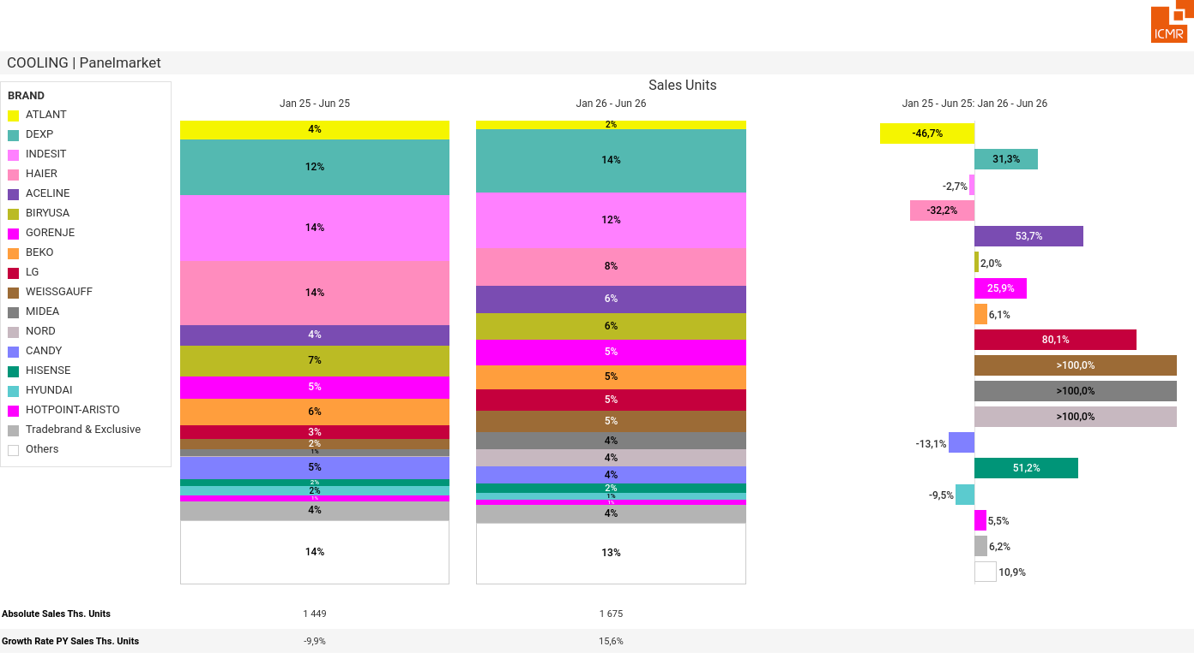
07/2026 PRJ 26fc7bc0 - TMPL 945c9f12 - FRM 564e17e1 - ID 1

Slide 2
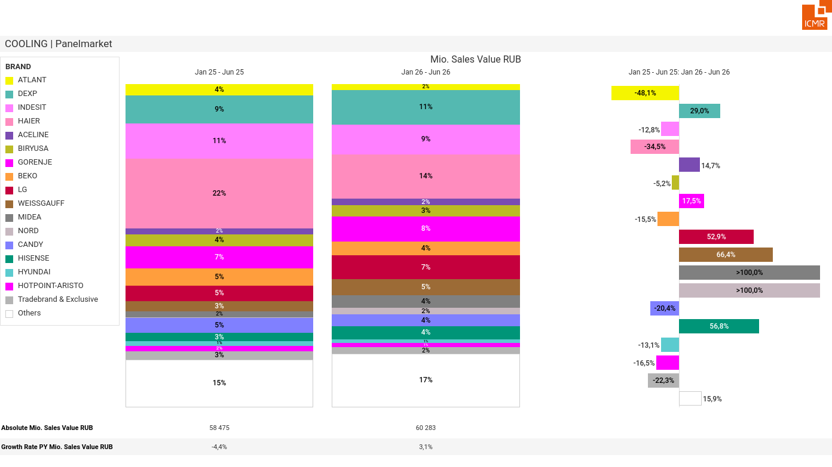
07/2026 PRJ 26fc7bc0 - TMPL 945c9f12 - FRM fbaacd6f - ID 2

Slide 3
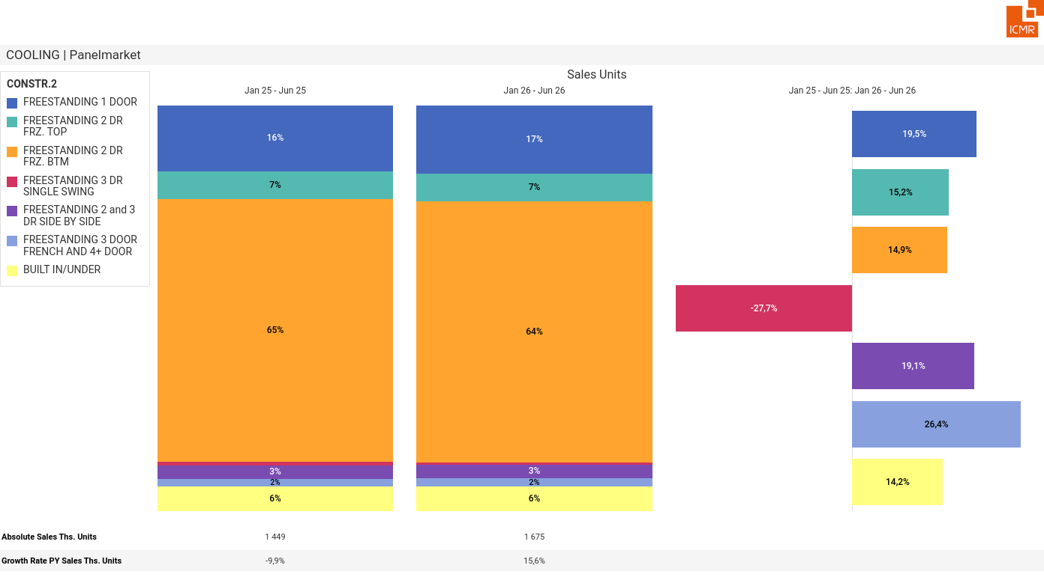
07/2026 PRJ 26fc7bc0 - TMPL 945c9f12 - FRM d512855d - ID 3

Slide 4
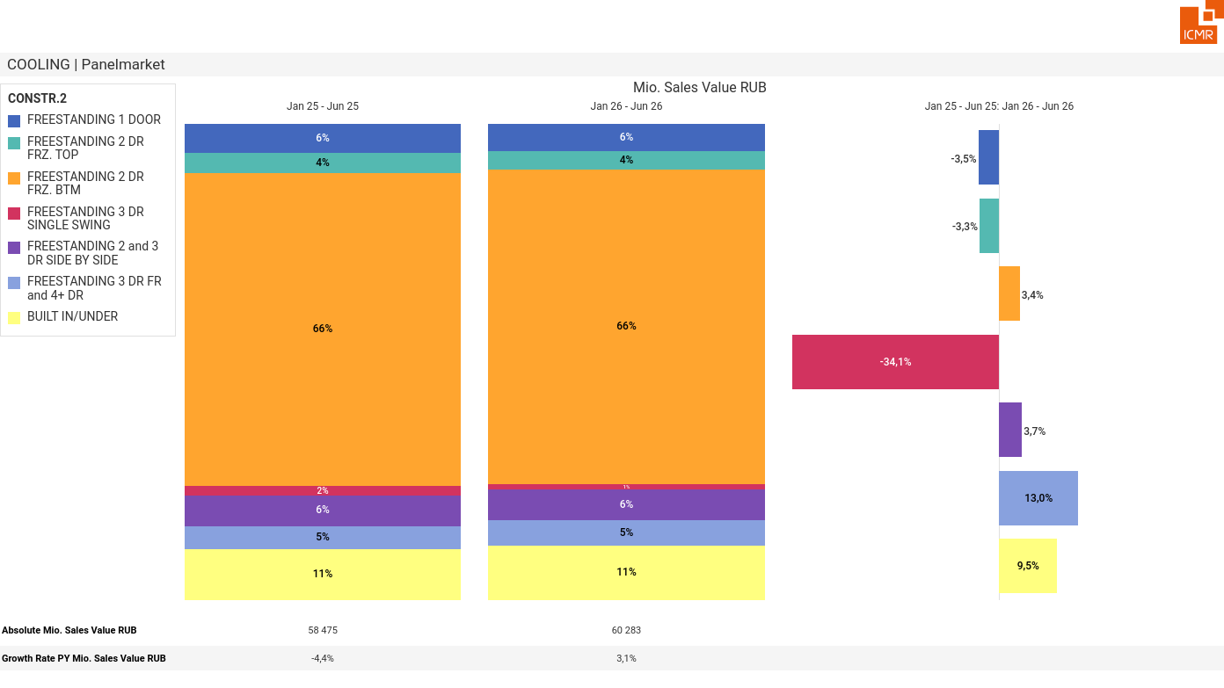
07/2026 PRJ 26fc7bc0 - TMPL 945c9f12 - FRM 5faca93f - ID 4

Slide 5
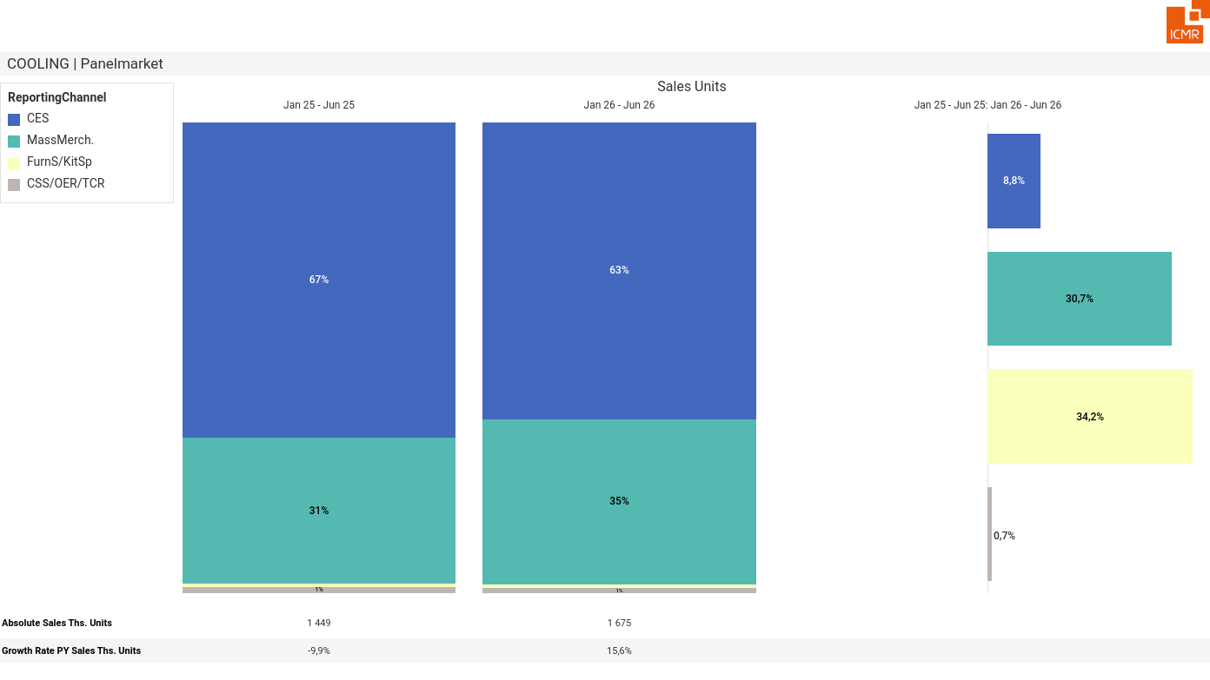
07/2026 PRJ 26fc7bc0 - TMPL 945c9f12 - FRM 24359b09 - ID 5

Slide 6
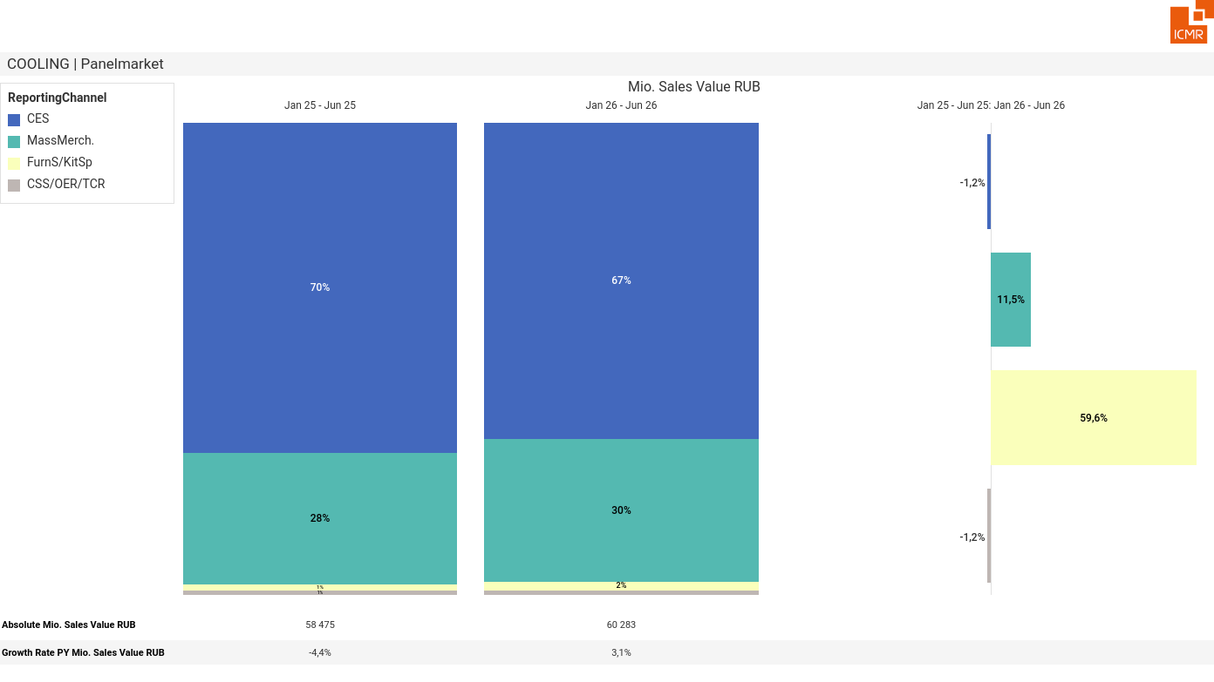
07/2026 PRJ 26fc7bc0 - TMPL 945c9f12 - FRM bec94907 - ID 6

Slide 7
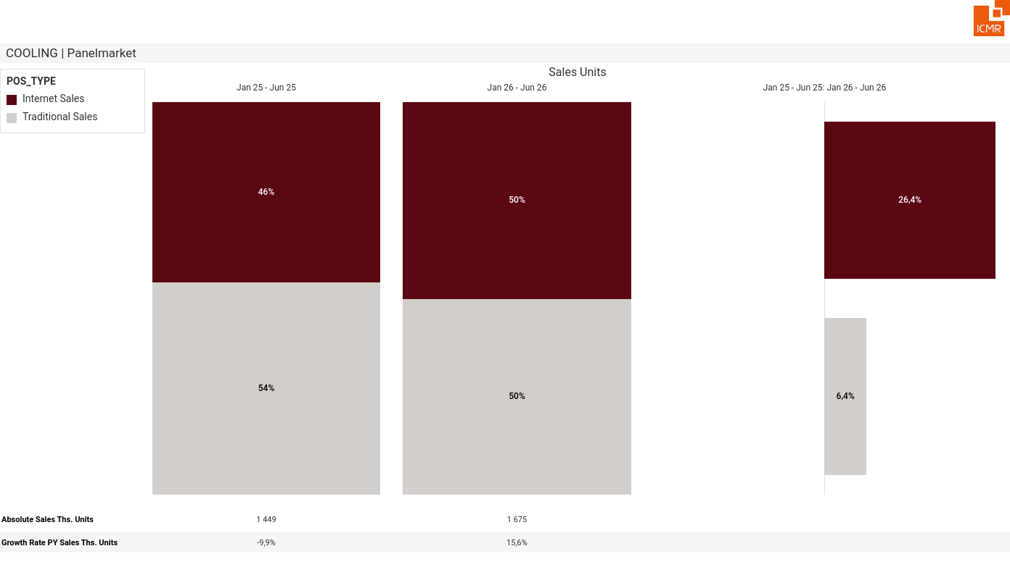
07/2026 PRJ 26fc7bc0 - TMPL 945c9f12 - FRM 681dc723 - ID 7

Slide 8
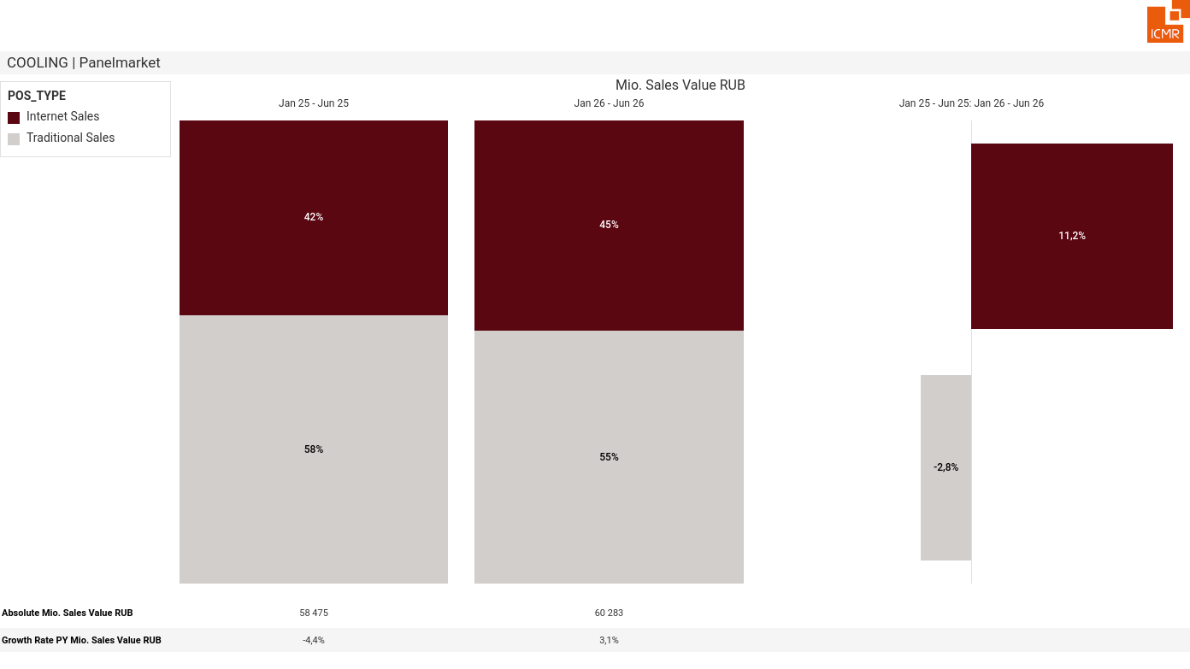
07/2026 PRJ 26fc7bc0 - TMPL 945c9f12 - FRM 9de6d8b7 - ID 8

Slide 9
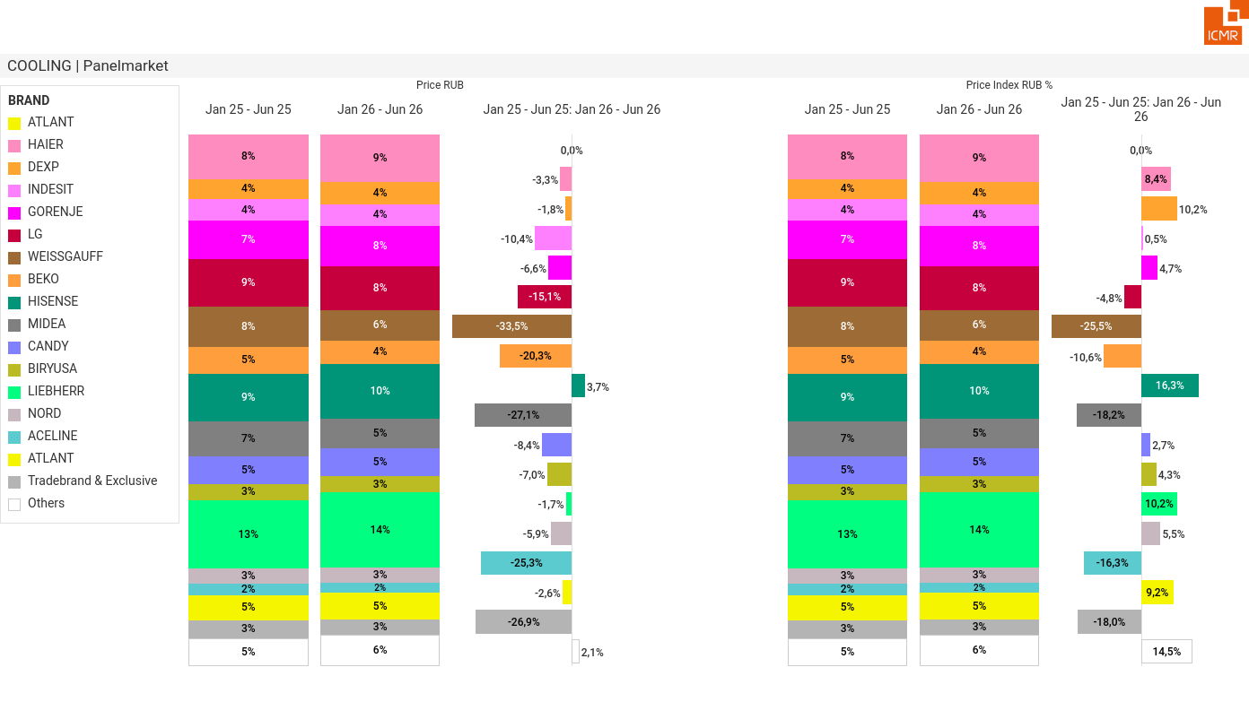
07/2026 PRJ 26fc7bc0 - TMPL 945c9f12 - FRM 287bc6fd - ID 9

