Slide 1
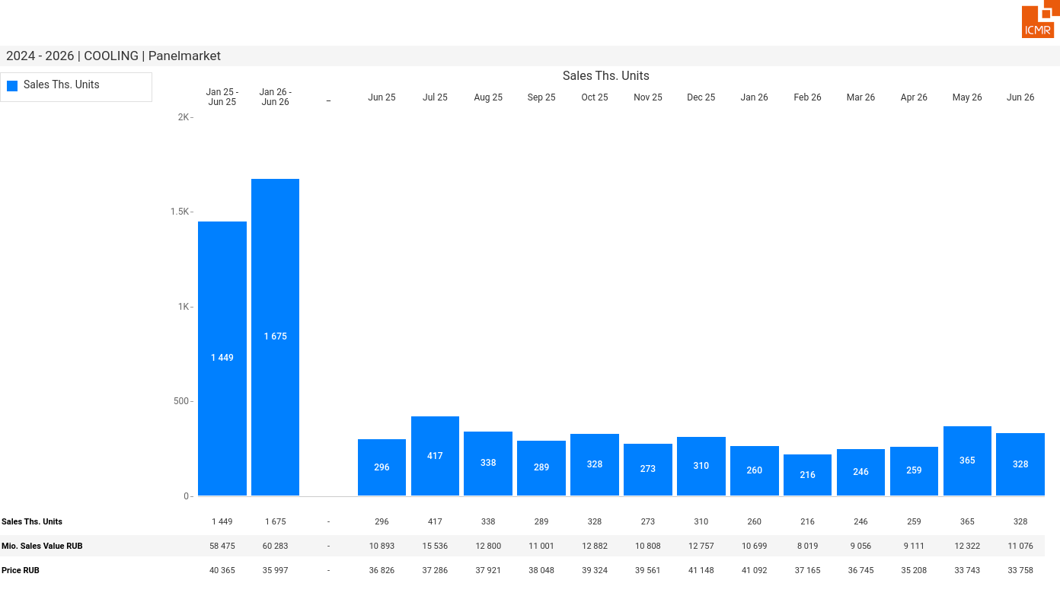
07/2026 PRJ 26fc7bc0 - TMPL e970a0a1 - FRM 3bde8c53 - ID 1

Slide 2
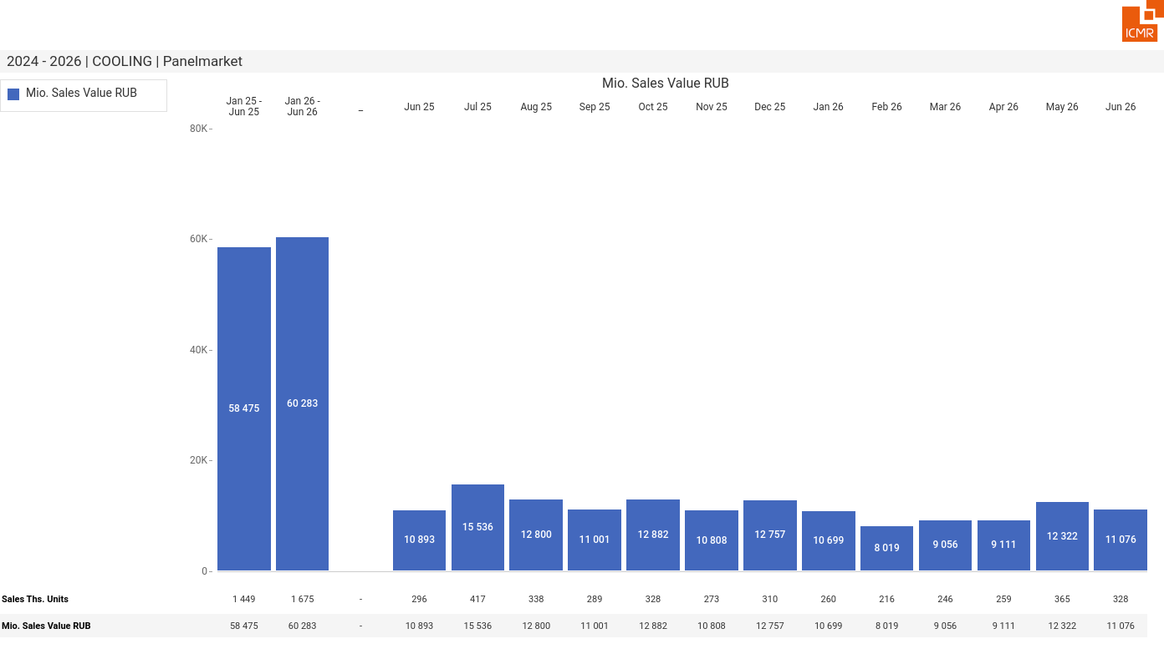
07/2026 PRJ 26fc7bc0 - TMPL e970a0a1 - FRM 1f978415 - ID 2

Slide 3
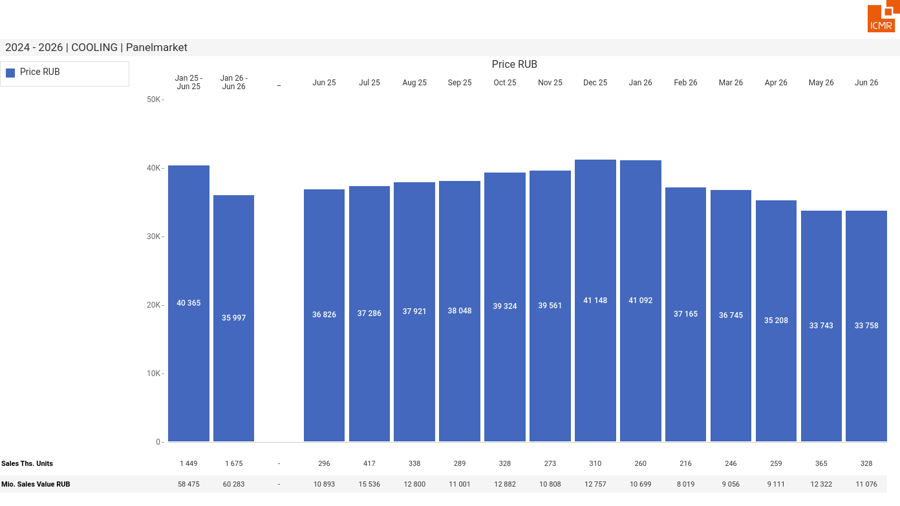
07/2026 PRJ 26fc7bc0 - TMPL e970a0a1 - FRM 7fe5c302 - ID 3

Slide 4
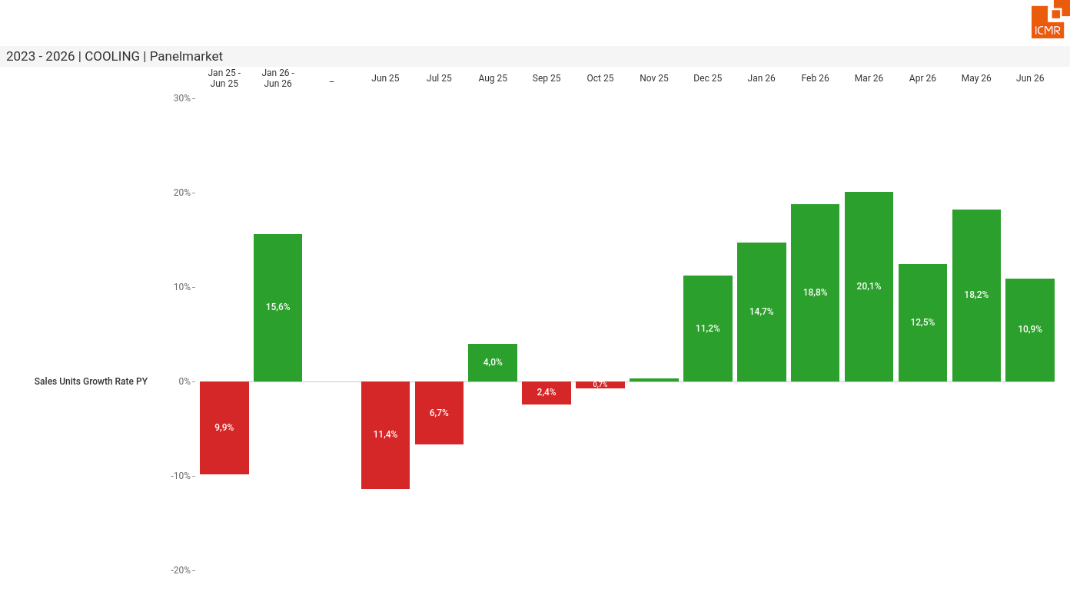
07/2026 PRJ 26fc7bc0 - TMPL e970a0a1 - FRM 72d2120c - ID 4

Slide 5
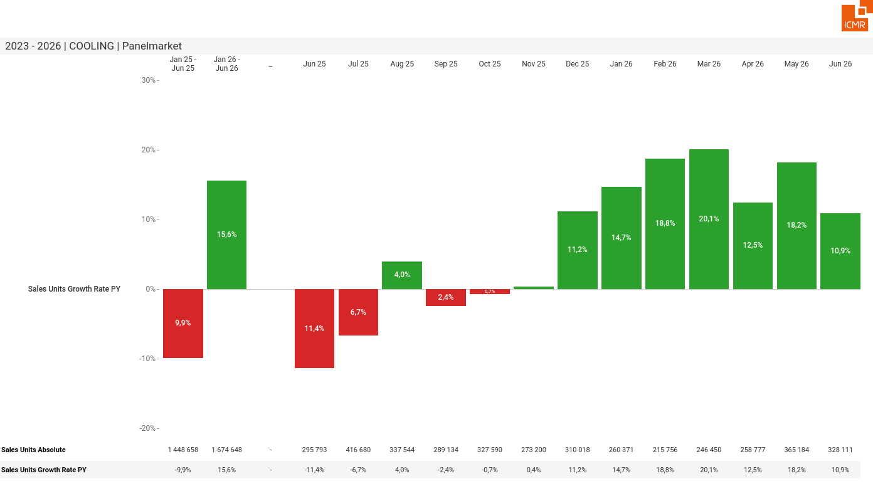
07/2026 PRJ 26fc7bc0 - TMPL e970a0a1 - FRM 2dc7fba1 - ID 5

Slide 6
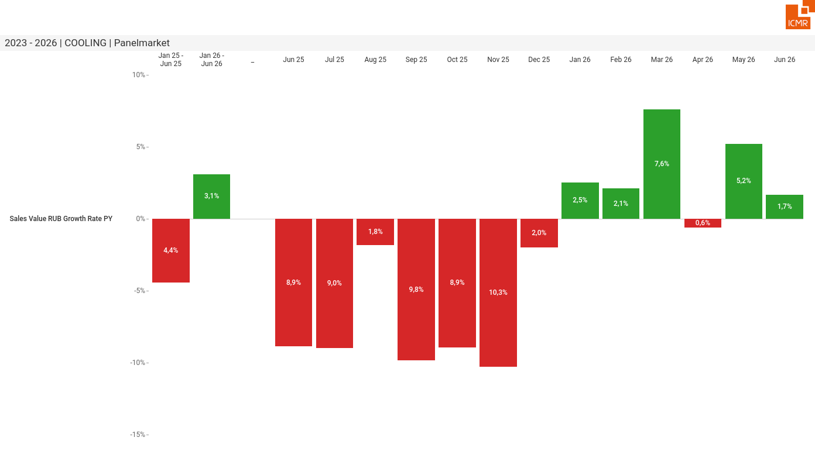
07/2026 PRJ 26fc7bc0 - TMPL e970a0a1 - FRM 2f5dabdb - ID 6

Slide 7
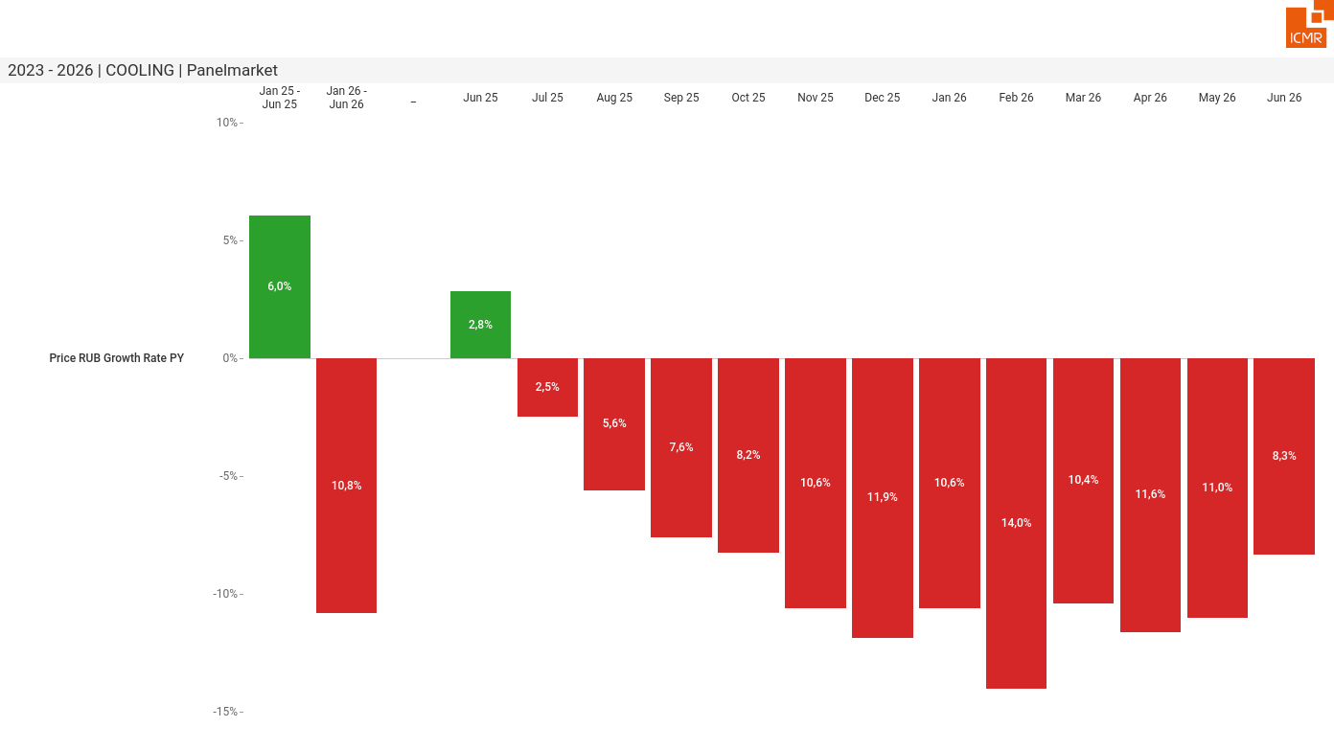
07/2026 PRJ 26fc7bc0 - TMPL e970a0a1 - FRM b2f6b277 - ID 7

Slide 8
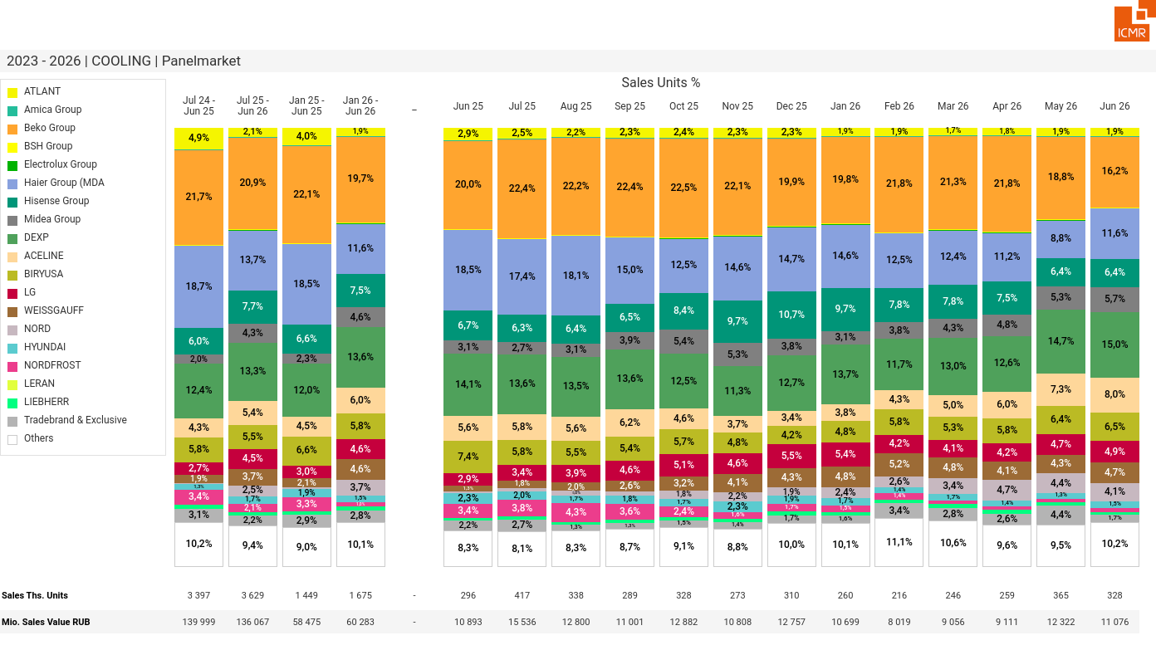
07/2026 PRJ 26fc7bc0 - TMPL e970a0a1 - FRM d21f0da1 - ID 8

Slide 9
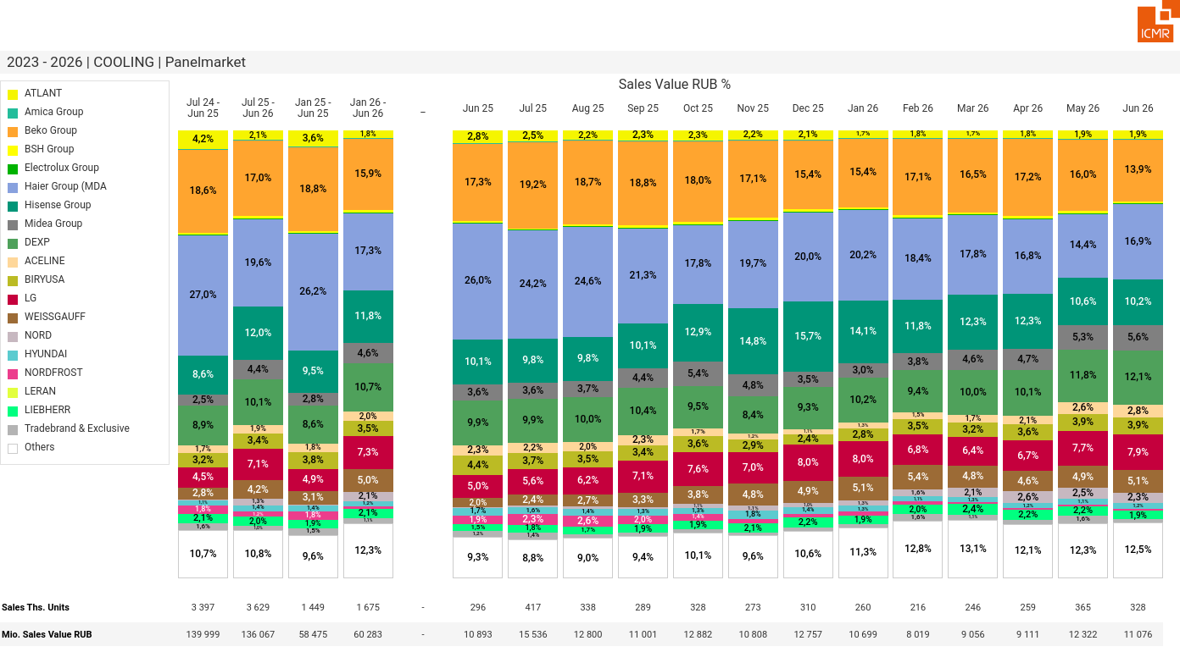
07/2026 PRJ 26fc7bc0 - TMPL e970a0a1 - FRM 00e4a365 - ID 9

Slide 10
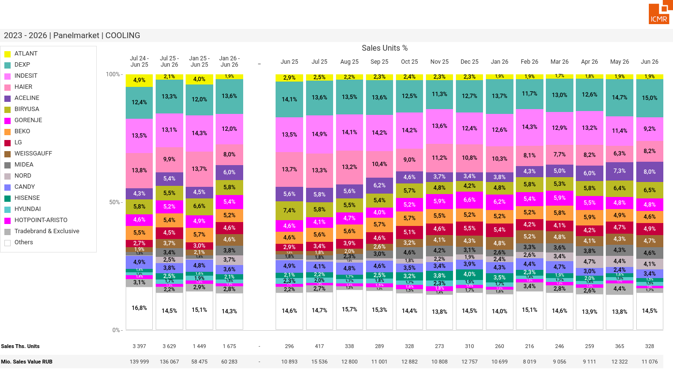
07/2026 PRJ 26fc7bc0 - TMPL e970a0a1 - FRM de844f15 - ID 10

Slide 11
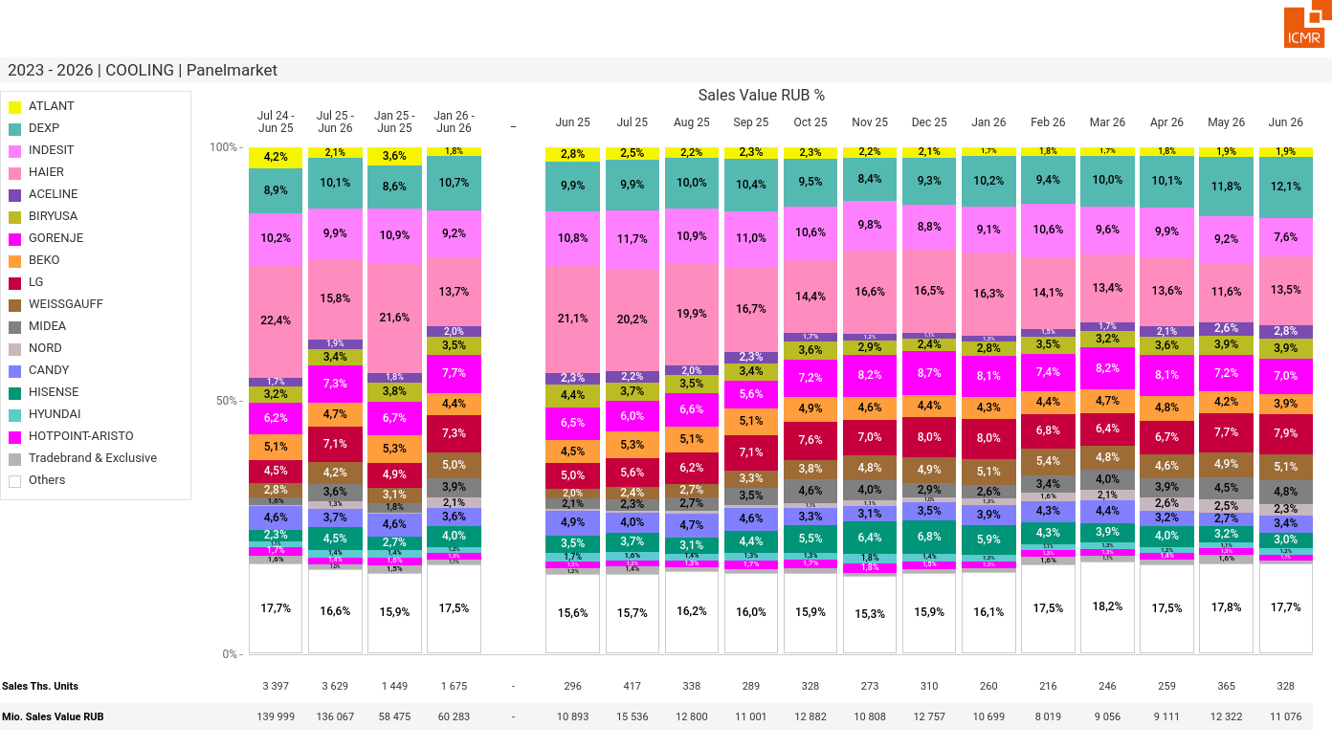
07/2026 PRJ 26fc7bc0 - TMPL e970a0a1 - FRM 50c09787 - ID 11

Slide 12
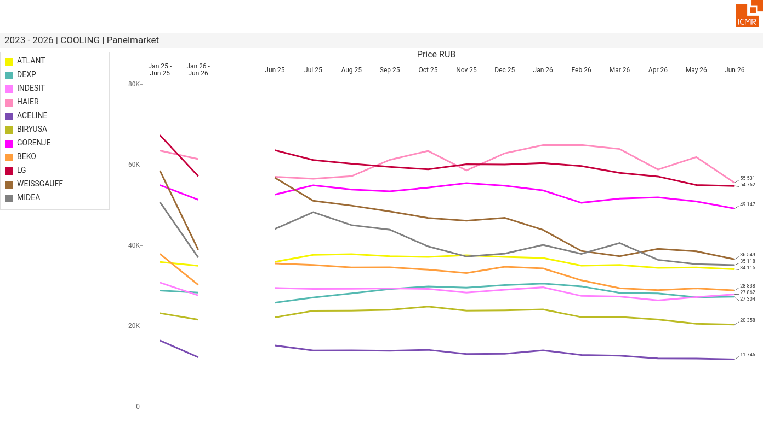
07/2026 PRJ 26fc7bc0 - TMPL e970a0a1 - FRM 34d5a72f - ID 12

Slide 13
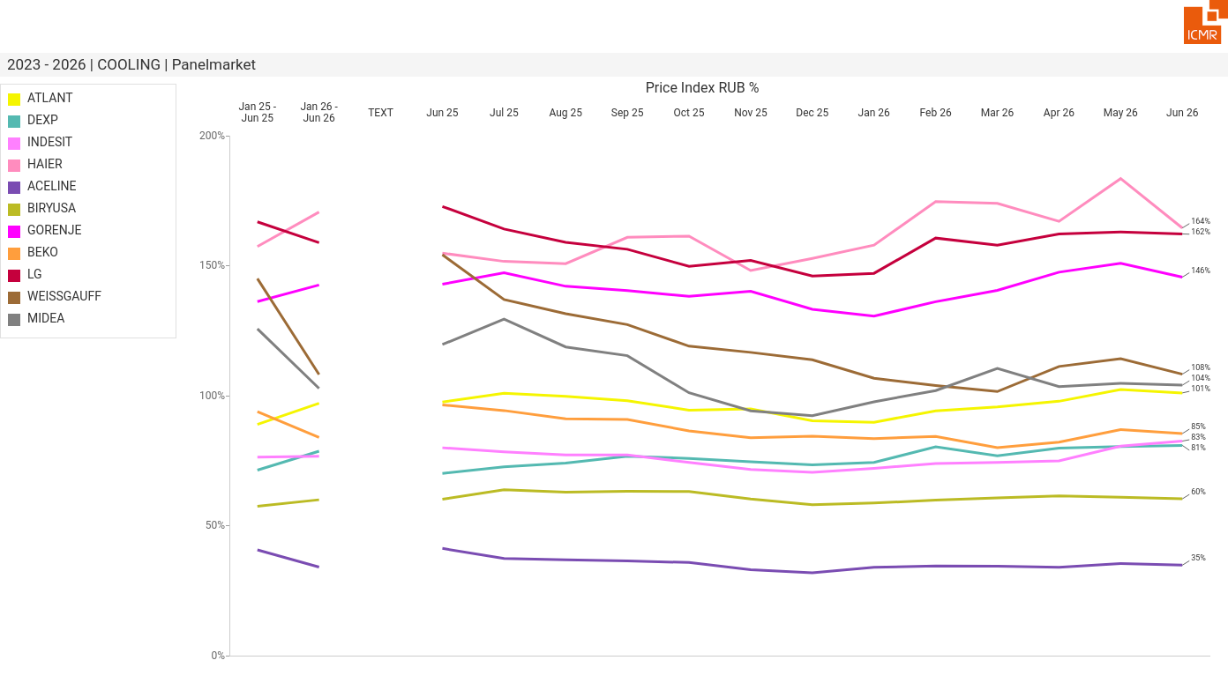
07/2026 PRJ 26fc7bc0 - TMPL e970a0a1 - FRM cd3a3c0b - ID 13

Slide 14
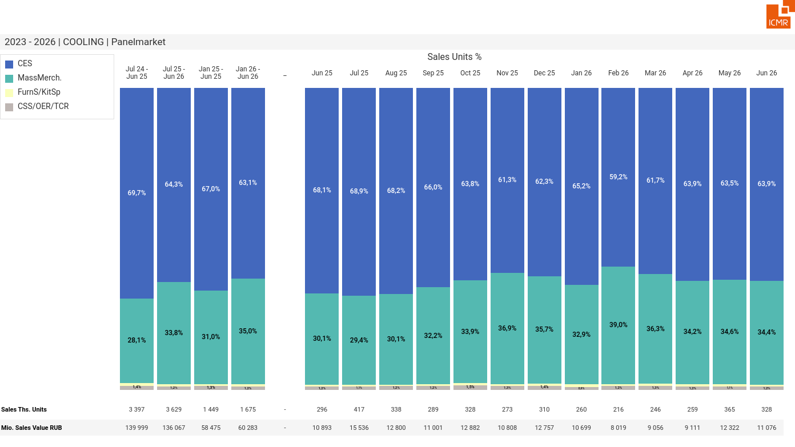
07/2026 PRJ 26fc7bc0 - TMPL e970a0a1 - FRM 0936eafd - ID 14

Slide 15
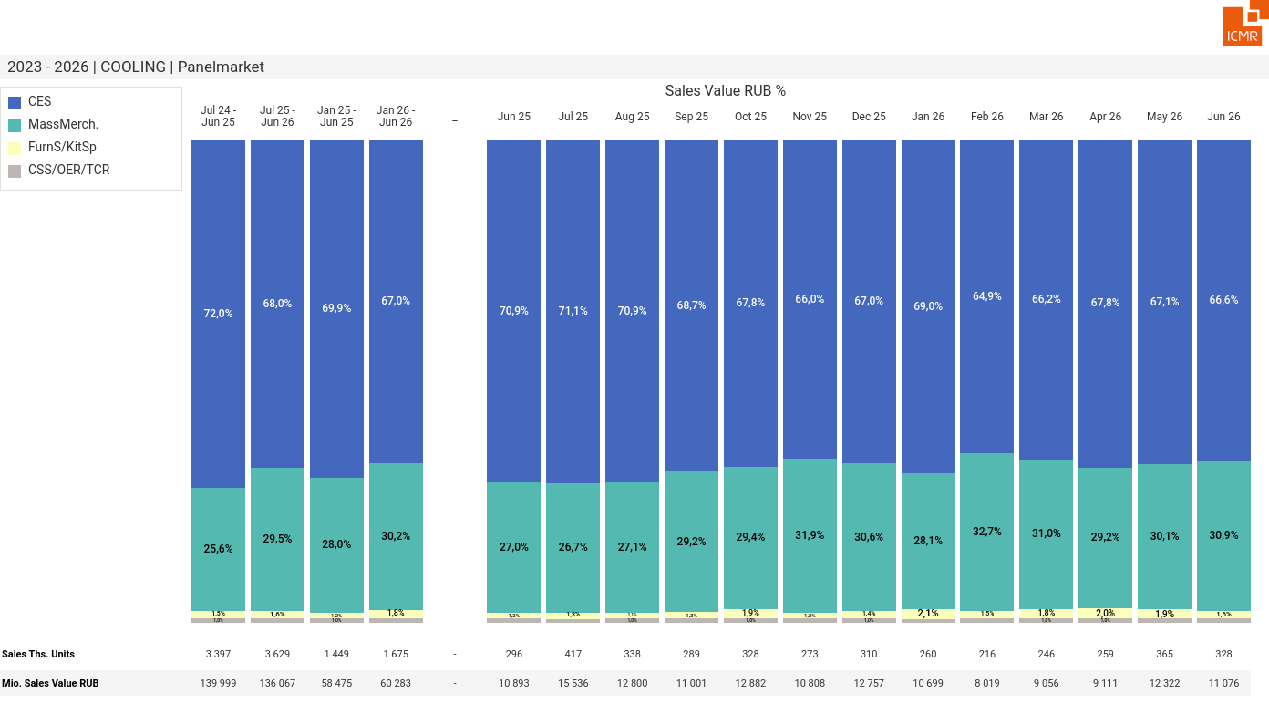
07/2026 PRJ 26fc7bc0 - TMPL e970a0a1 - FRM 89b621d9 - ID 15

Slide 16
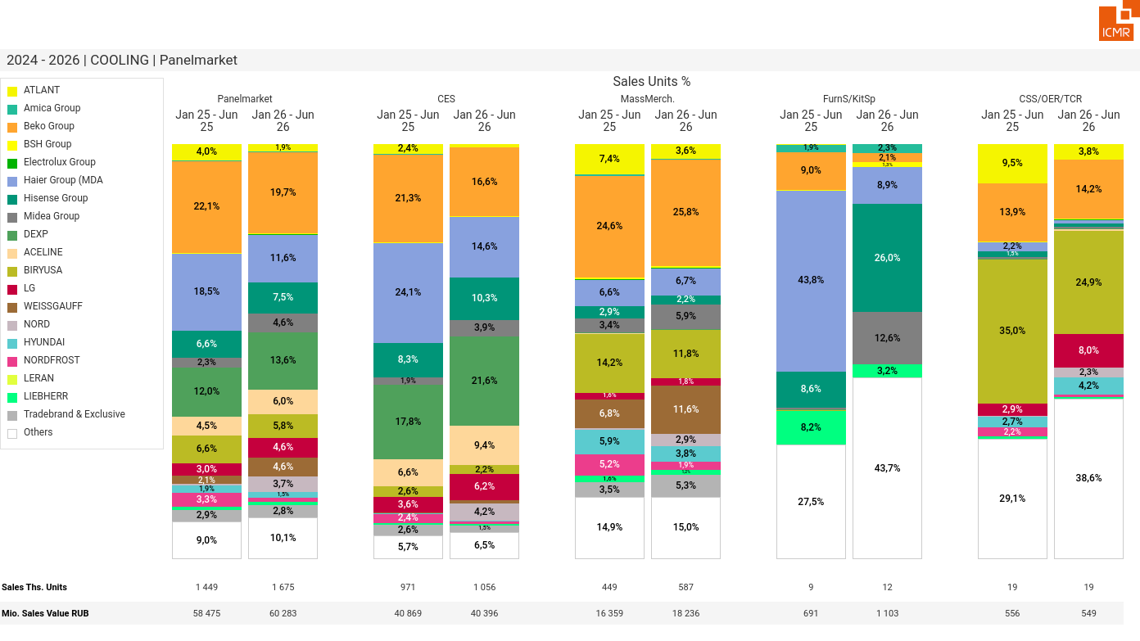
07/2026 PRJ 26fc7bc0 - TMPL e970a0a1 - FRM a146cf08 - ID 16

Slide 17
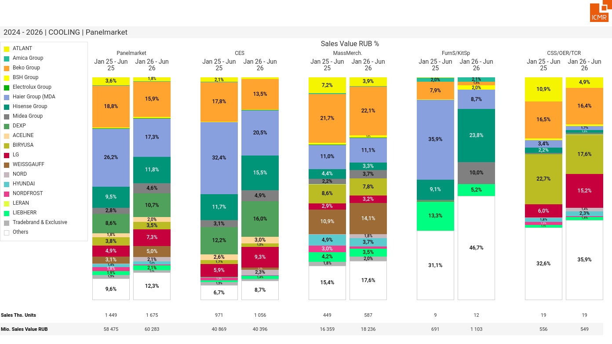
07/2026 PRJ 26fc7bc0 - TMPL e970a0a1 - FRM ec7ecace - ID 17

Slide 18
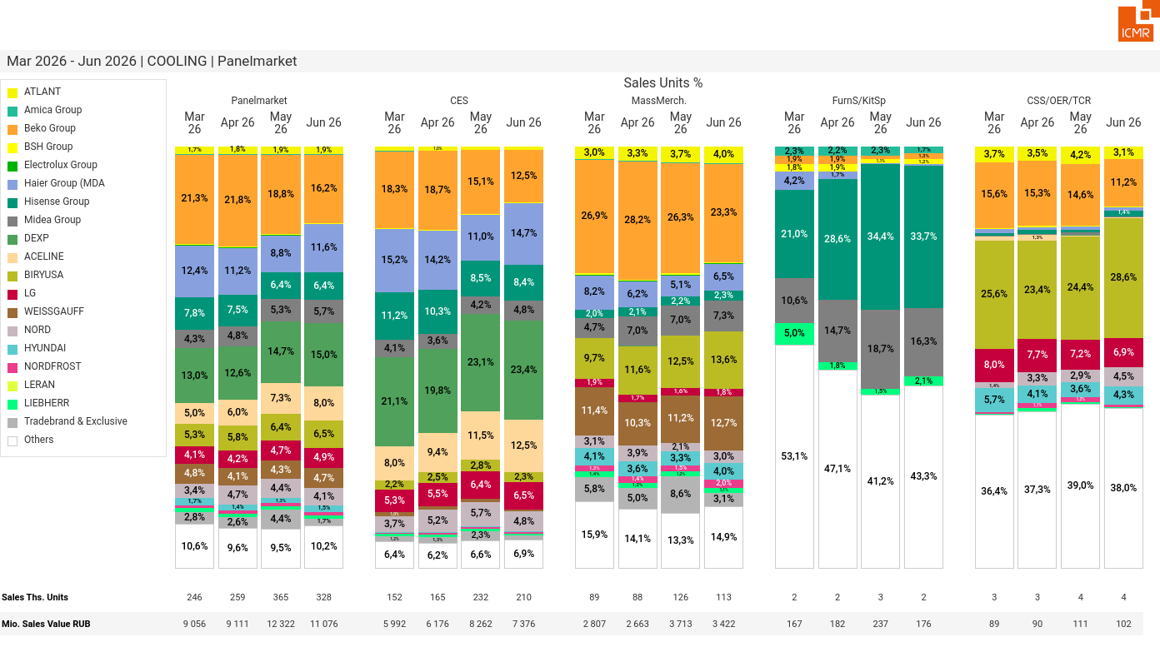
07/2026 PRJ 26fc7bc0 - TMPL e970a0a1 - FRM 7beb2c80 - ID 18

Slide 19
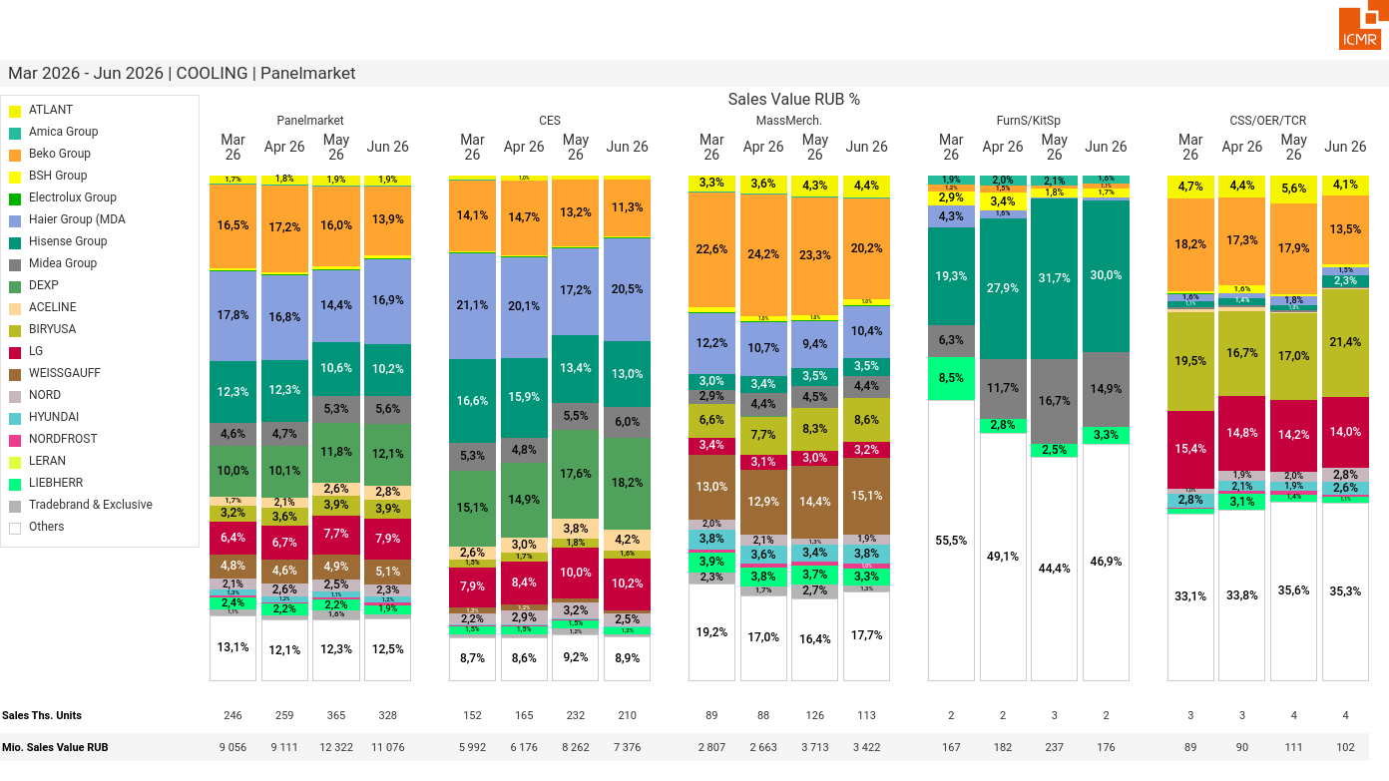
07/2026 PRJ 26fc7bc0 - TMPL e970a0a1 - FRM 1b46a4cf - ID 19

Slide 20
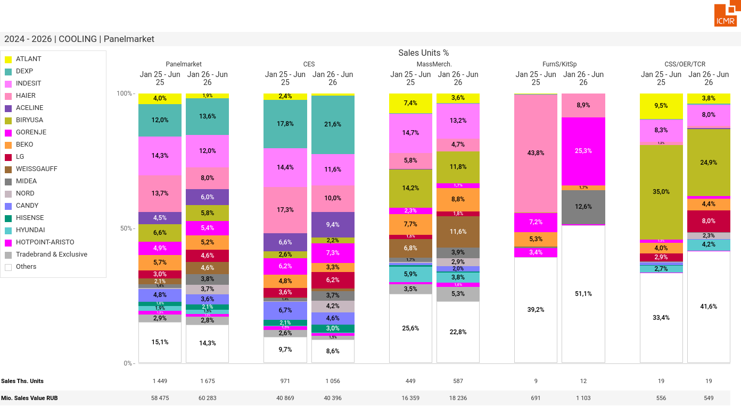
07/2026 PRJ 26fc7bc0 - TMPL e970a0a1 - FRM afc6b1fd - ID 20

Slide 21
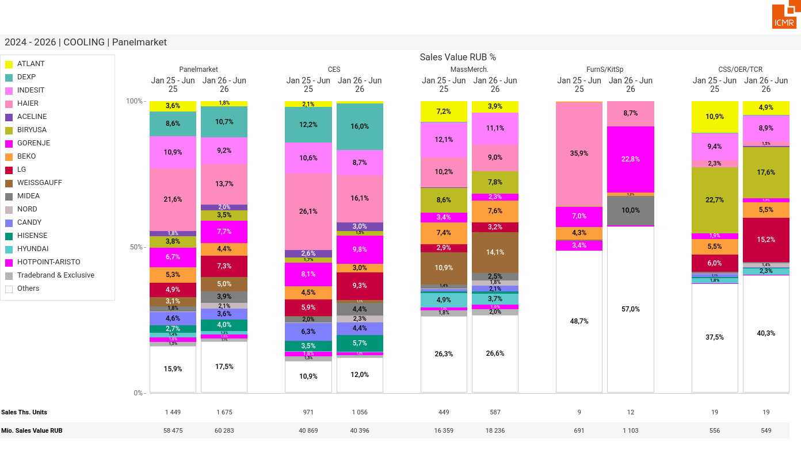
07/2026 PRJ 26fc7bc0 - TMPL e970a0a1 - FRM 3ed0a2fa - ID 21

Slide 22
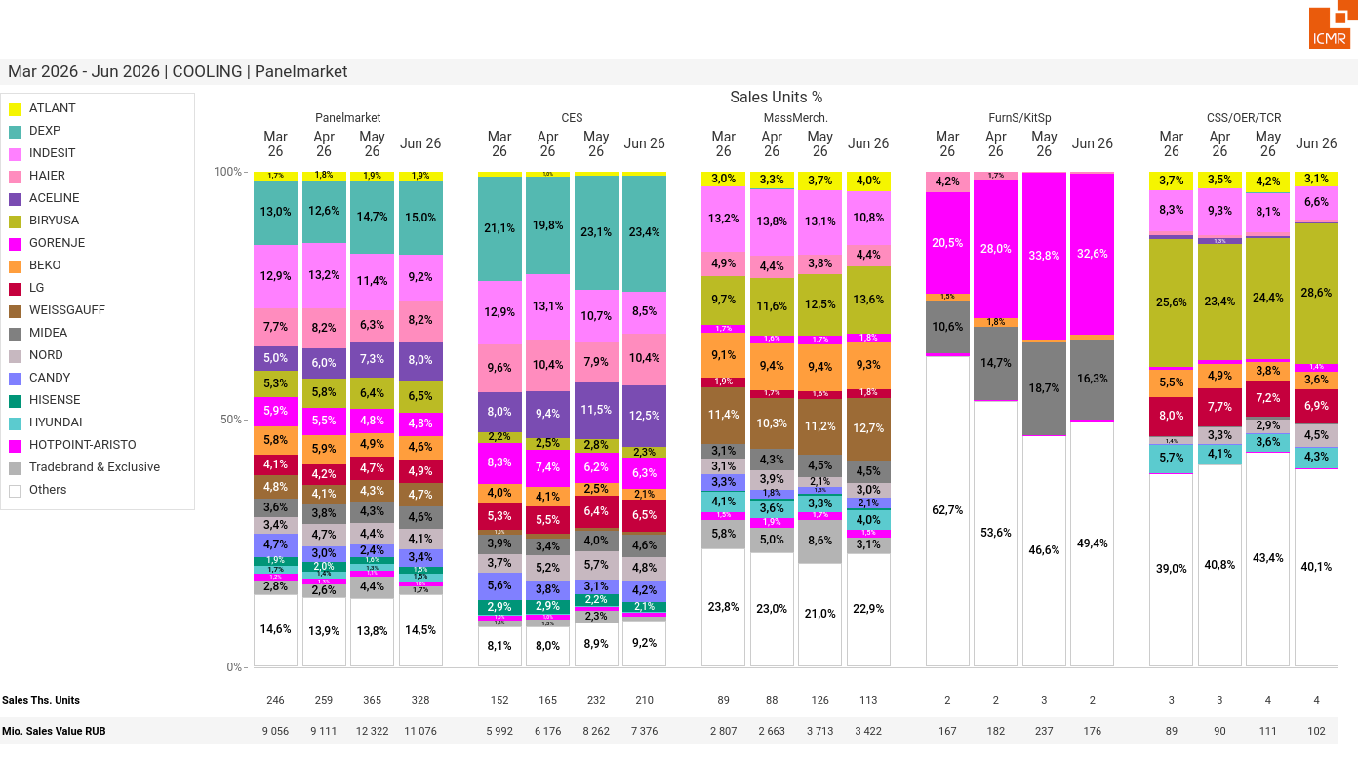
07/2026 PRJ 26fc7bc0 - TMPL e970a0a1 - FRM a905422a - ID 22

Slide 23
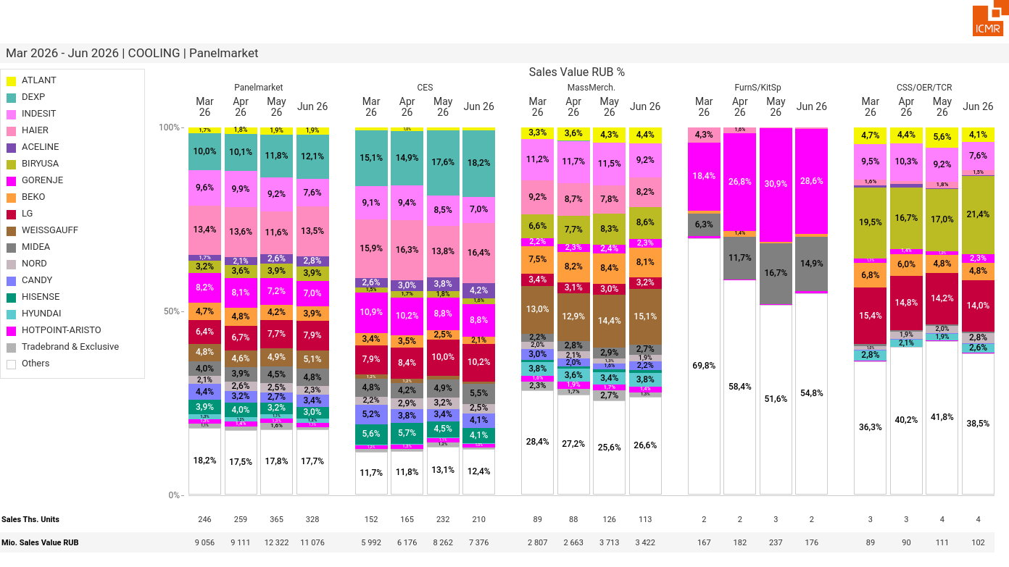
07/2026 PRJ 26fc7bc0 - TMPL e970a0a1 - FRM 66201847 - ID 23

Slide 24
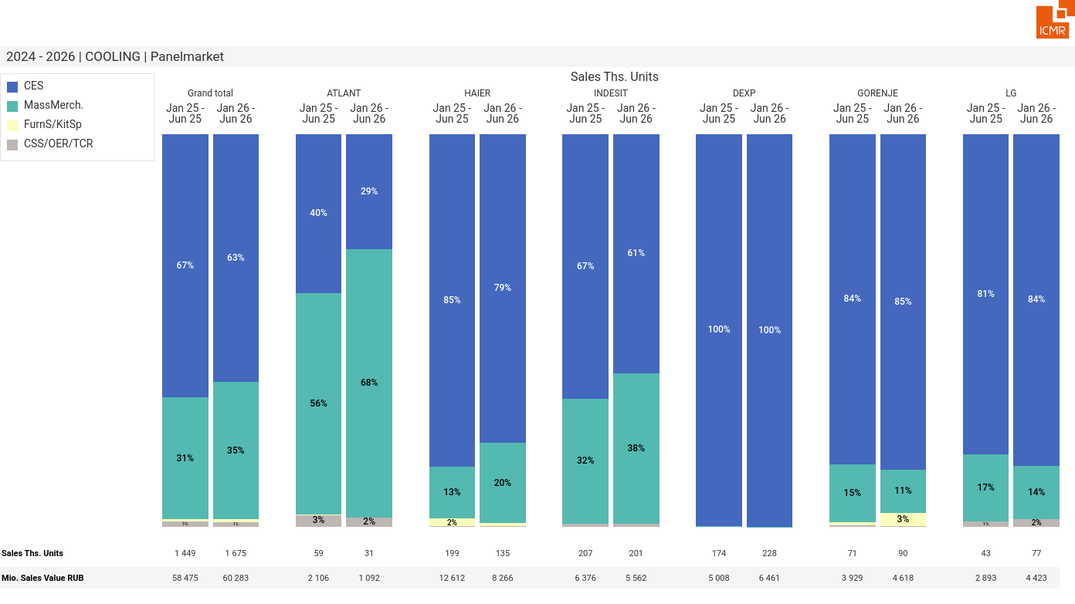
07/2026 PRJ 26fc7bc0 - TMPL e970a0a1 - FRM 68e59652 - ID 24

Slide 25
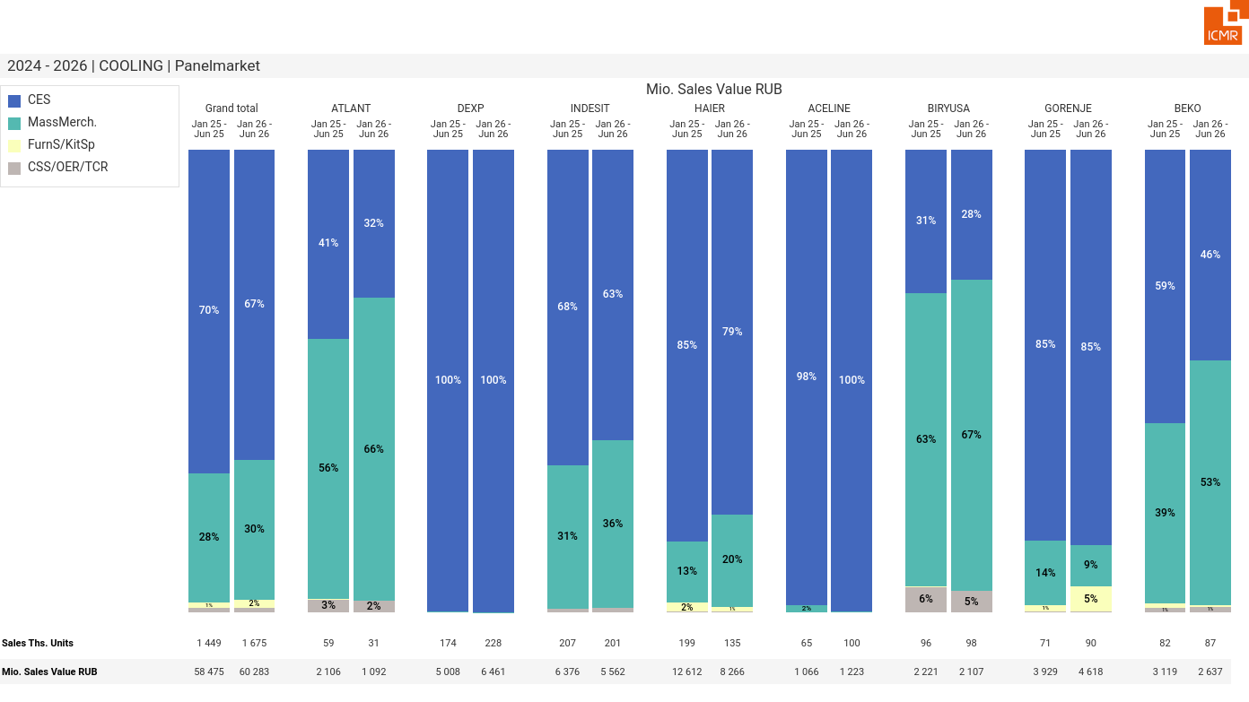
07/2026 PRJ 26fc7bc0 - TMPL e970a0a1 - FRM f8373854 - ID 25

Slide 26
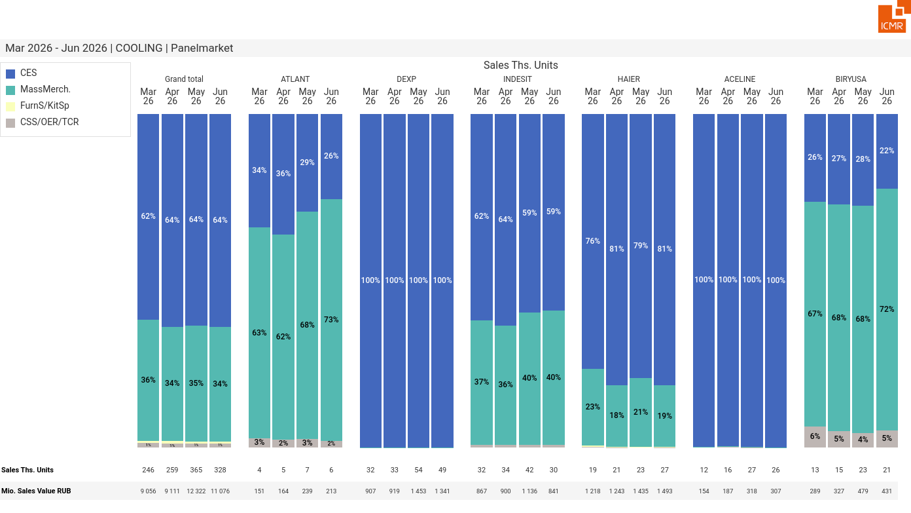
07/2026 PRJ 26fc7bc0 - TMPL e970a0a1 - FRM da922f9f - ID 26

Slide 27
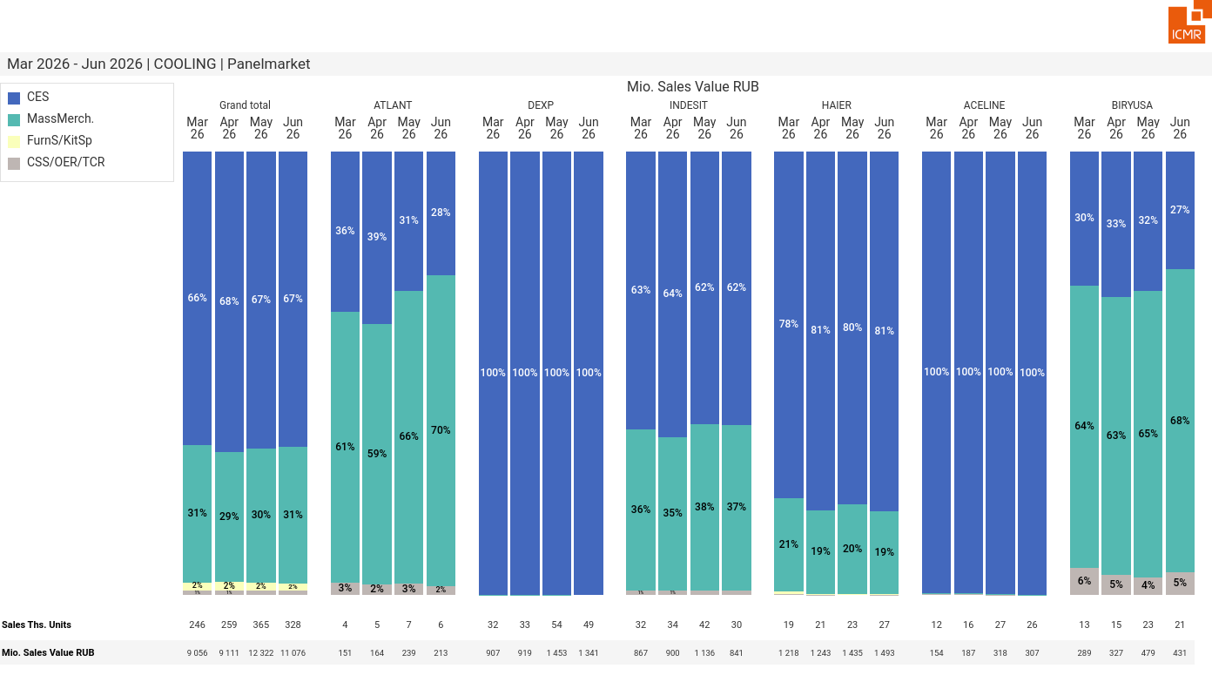
07/2026 PRJ 26fc7bc0 - TMPL e970a0a1 - FRM 762b2774 - ID 27

Slide 28
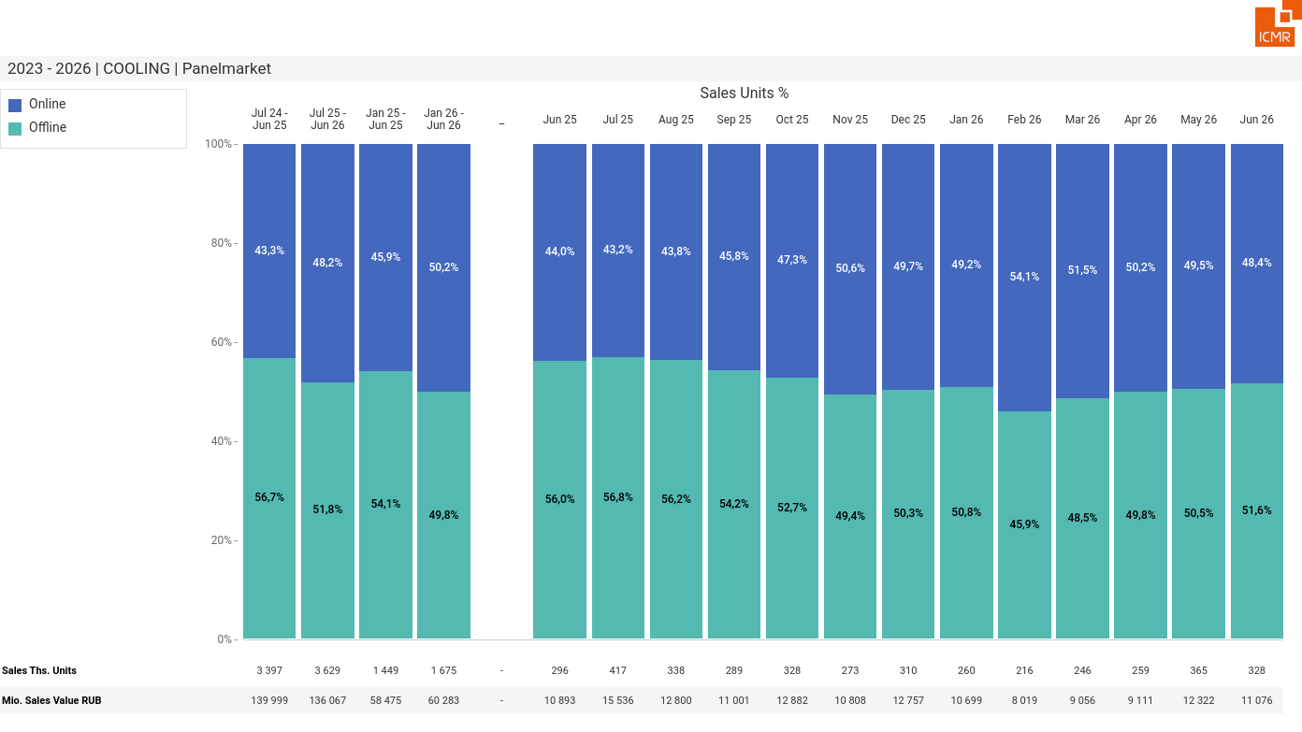
07/2026 PRJ 26fc7bc0 - TMPL e970a0a1 - FRM 6a0bc28a - ID 28

Slide 29
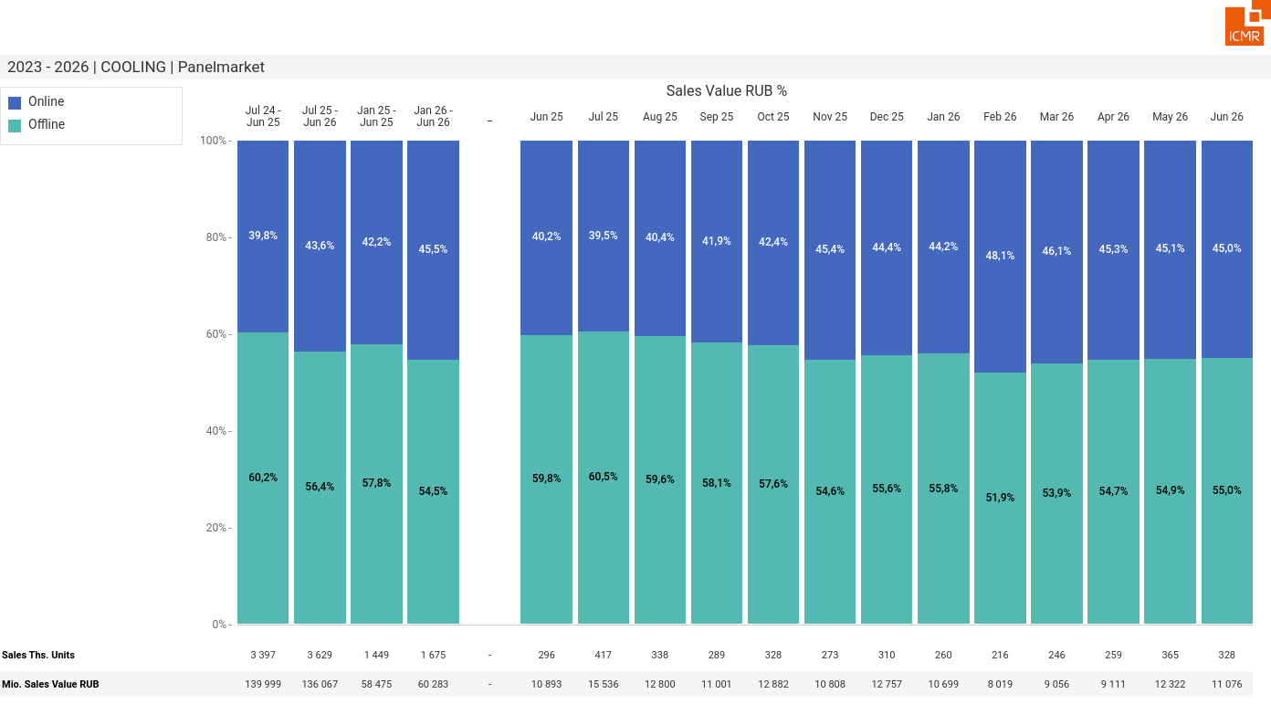
07/2026 PRJ 26fc7bc0 - TMPL e970a0a1 - FRM c4a02884 - ID 29

Slide 30
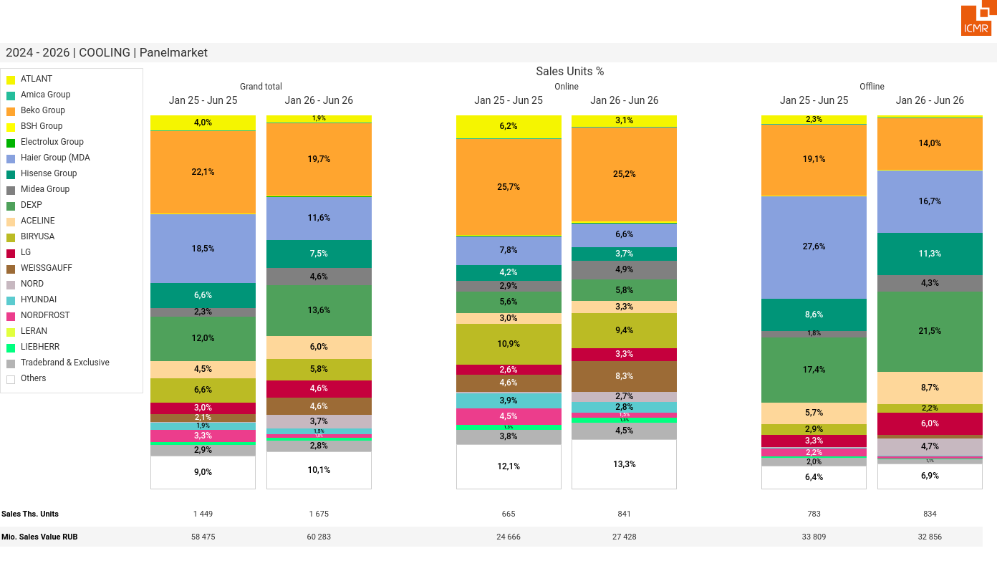
07/2026 PRJ 26fc7bc0 - TMPL e970a0a1 - FRM f56a01e9 - ID 30

Slide 31
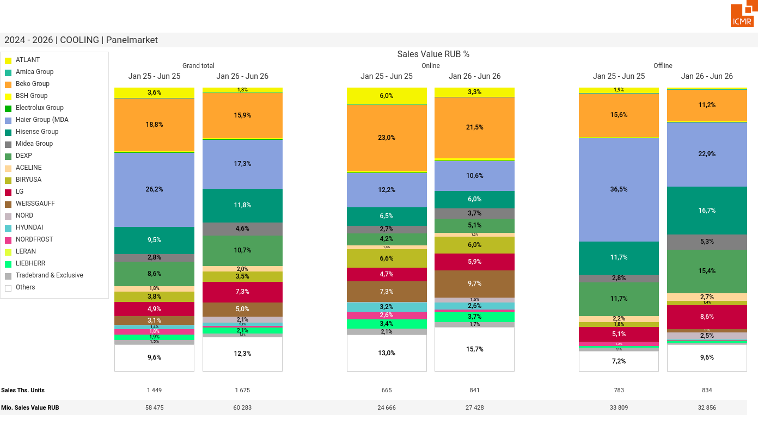
07/2026 PRJ 26fc7bc0 - TMPL e970a0a1 - FRM 949f6d7a - ID 31

Slide 32
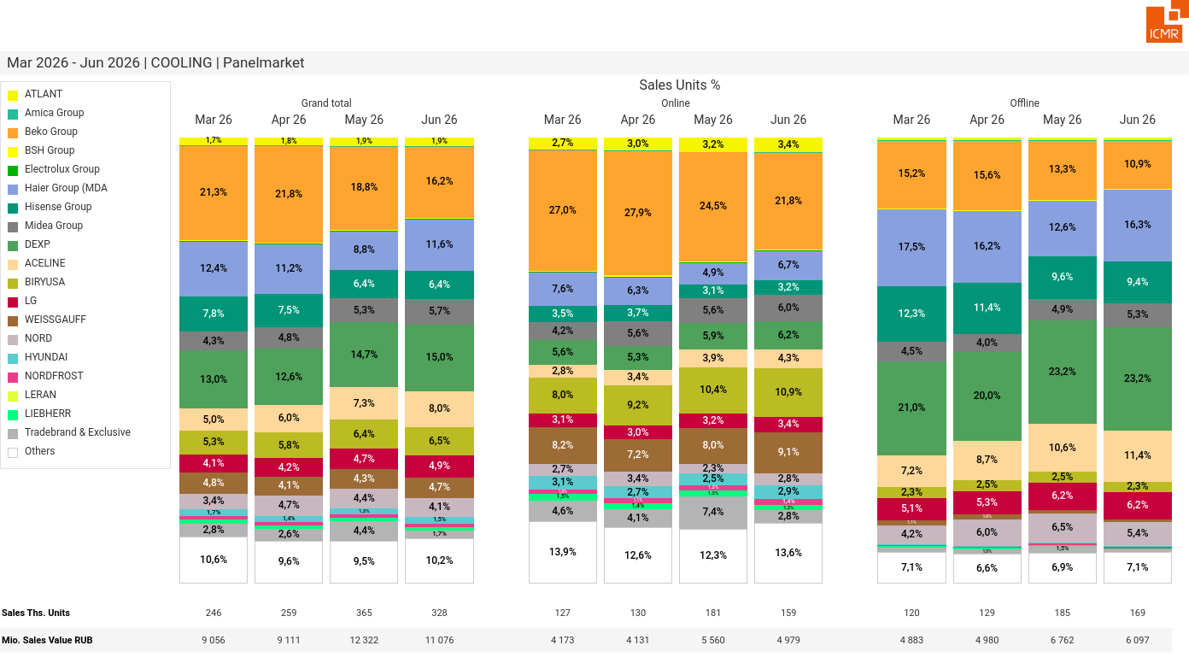
07/2026 PRJ 26fc7bc0 - TMPL e970a0a1 - FRM f38b1a6a - ID 32

Slide 33
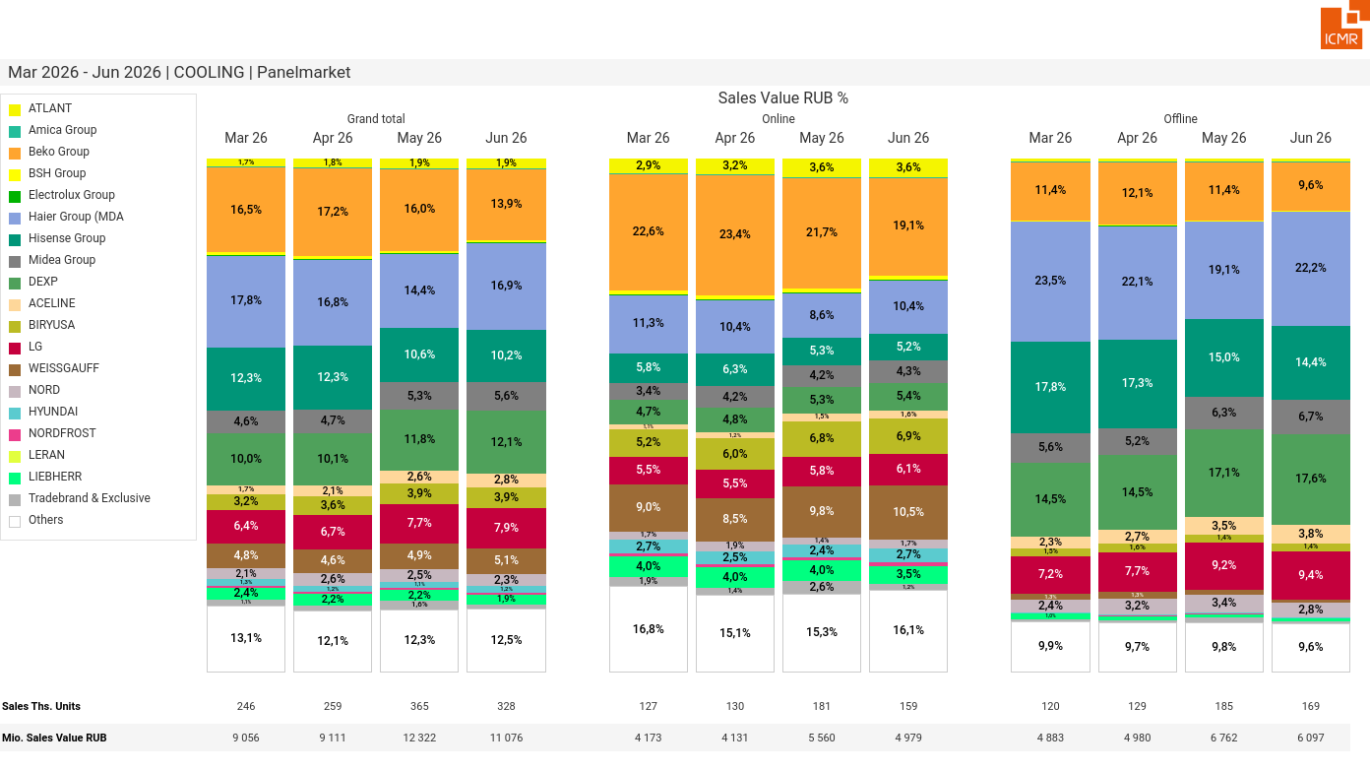
07/2026 PRJ 26fc7bc0 - TMPL e970a0a1 - FRM 70005f8b - ID 33

Slide 34
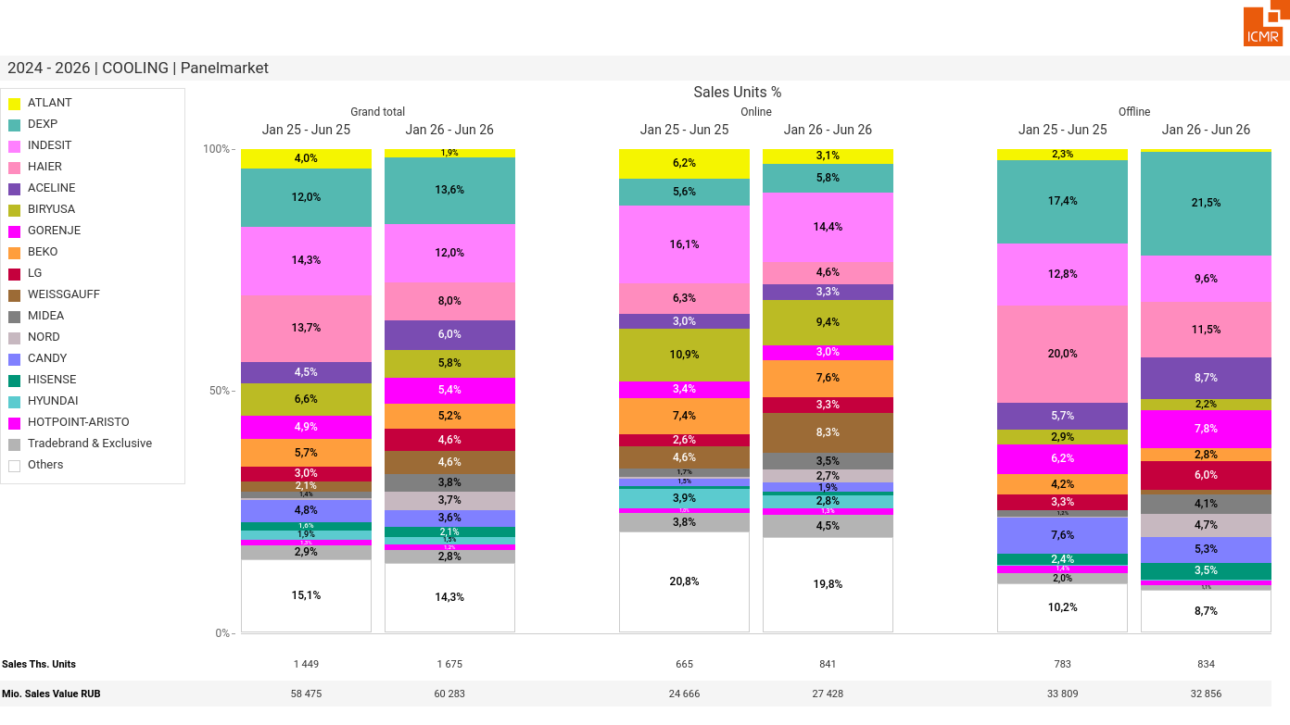
07/2026 PRJ 26fc7bc0 - TMPL e970a0a1 - FRM eb8e0d16 - ID 34

Slide 35
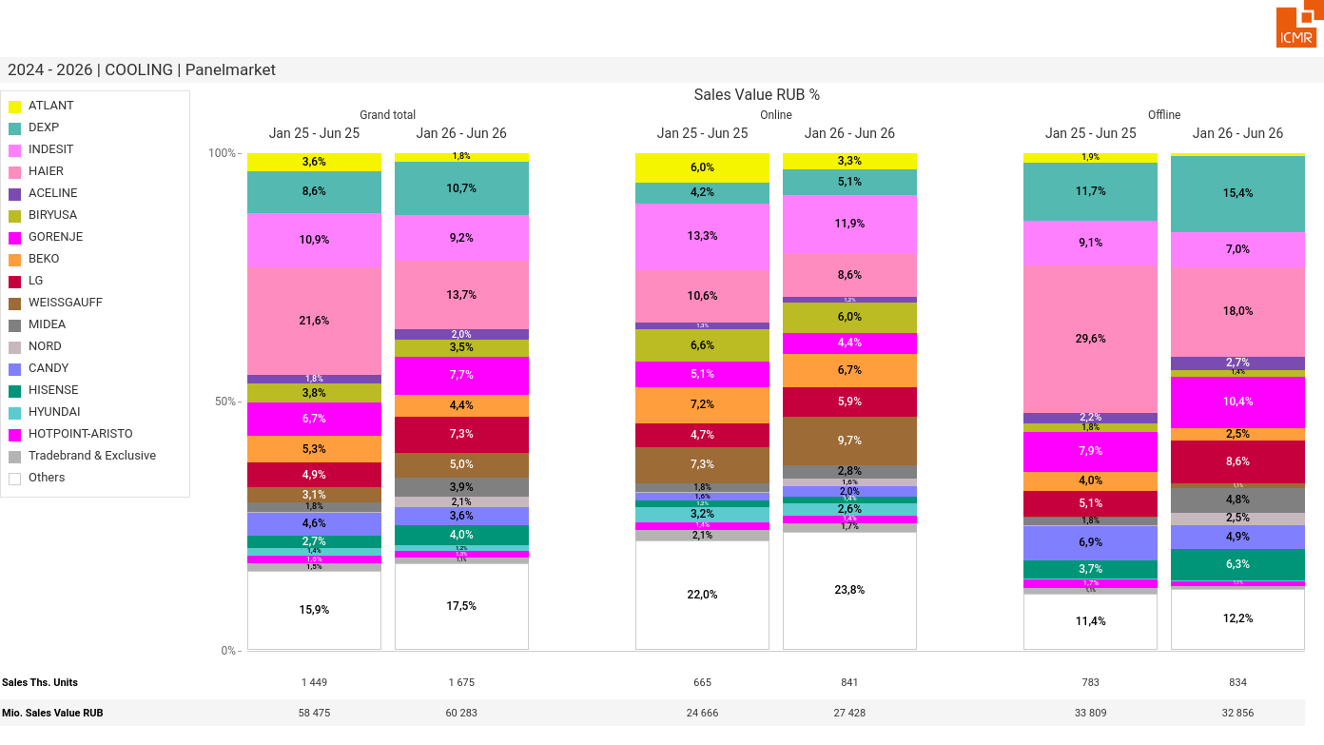
07/2026 PRJ 26fc7bc0 - TMPL e970a0a1 - FRM 85b9162e - ID 35

Slide 36
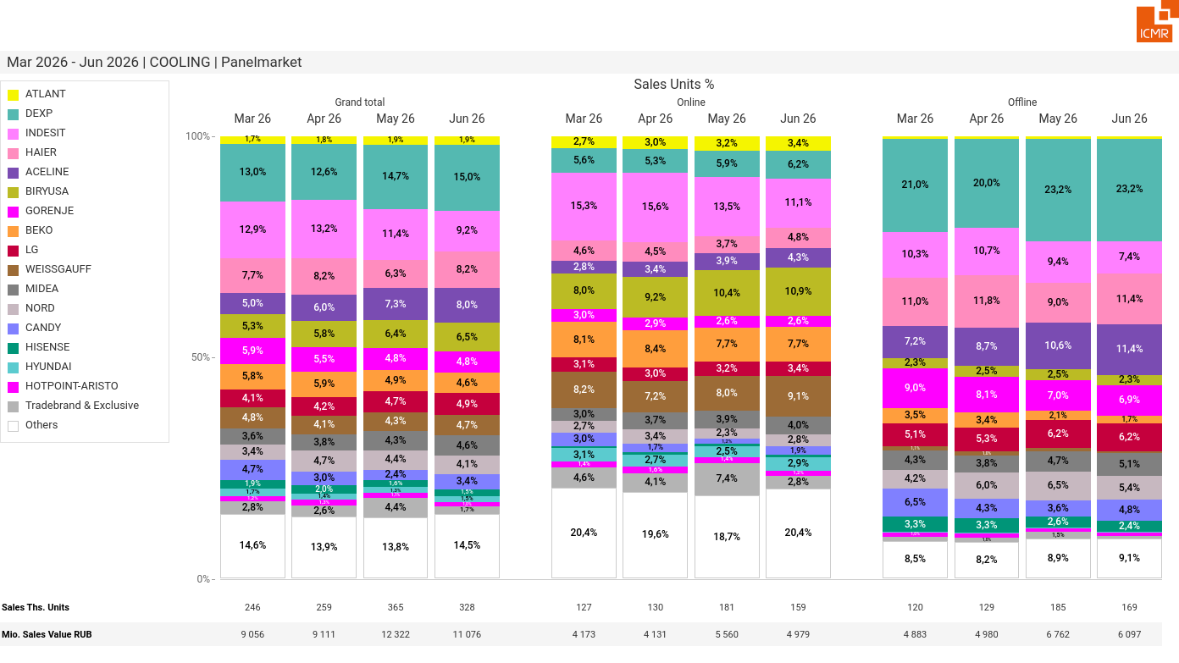
07/2026 PRJ 26fc7bc0 - TMPL e970a0a1 - FRM b48b02d4 - ID 36

Slide 37
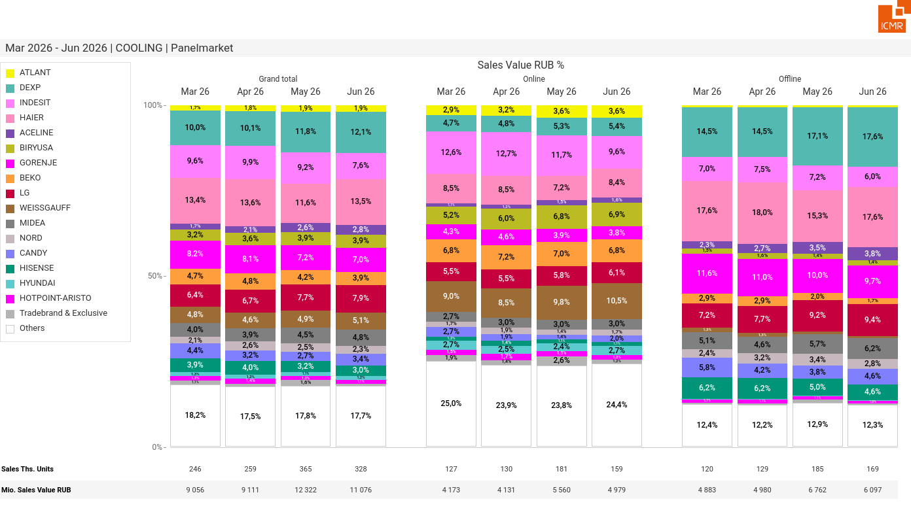
07/2026 PRJ 26fc7bc0 - TMPL e970a0a1 - FRM 2718df0a - ID 37

Slide 38
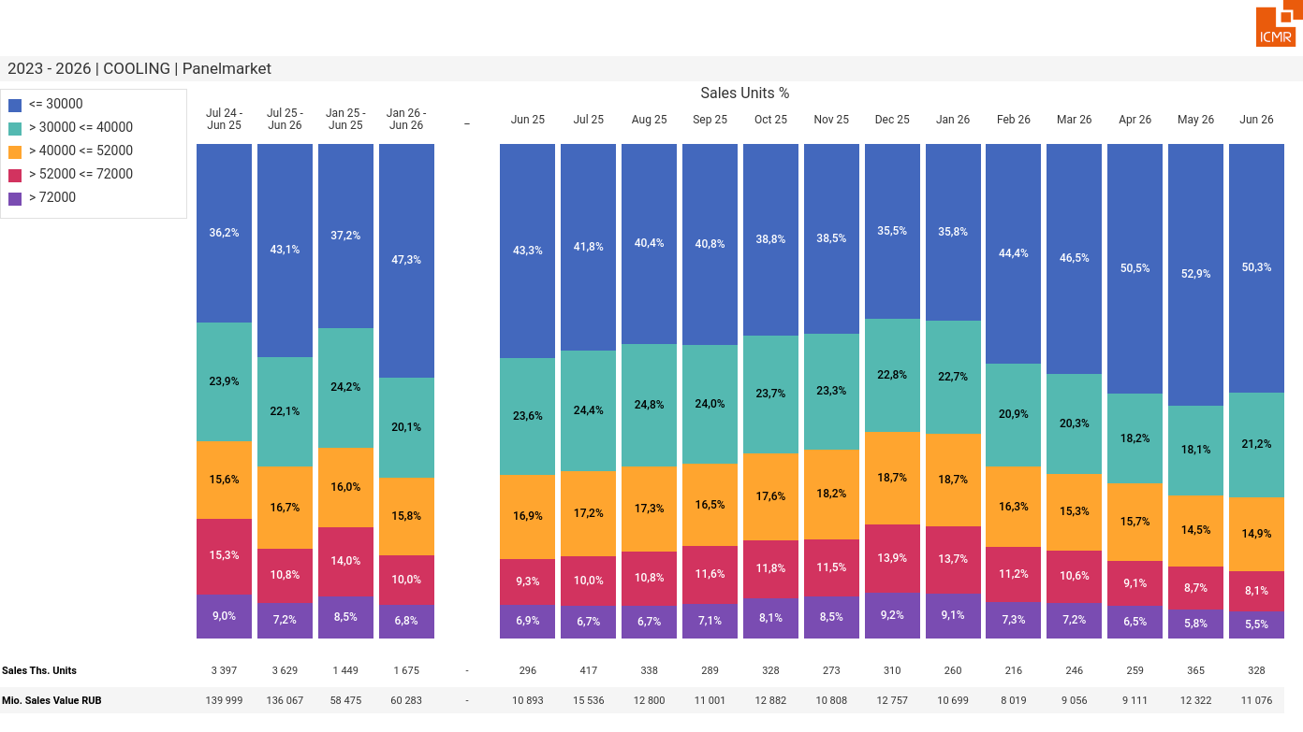
07/2026 PRJ 26fc7bc0 - TMPL e970a0a1 - FRM 852696a0 - ID 38

Slide 39
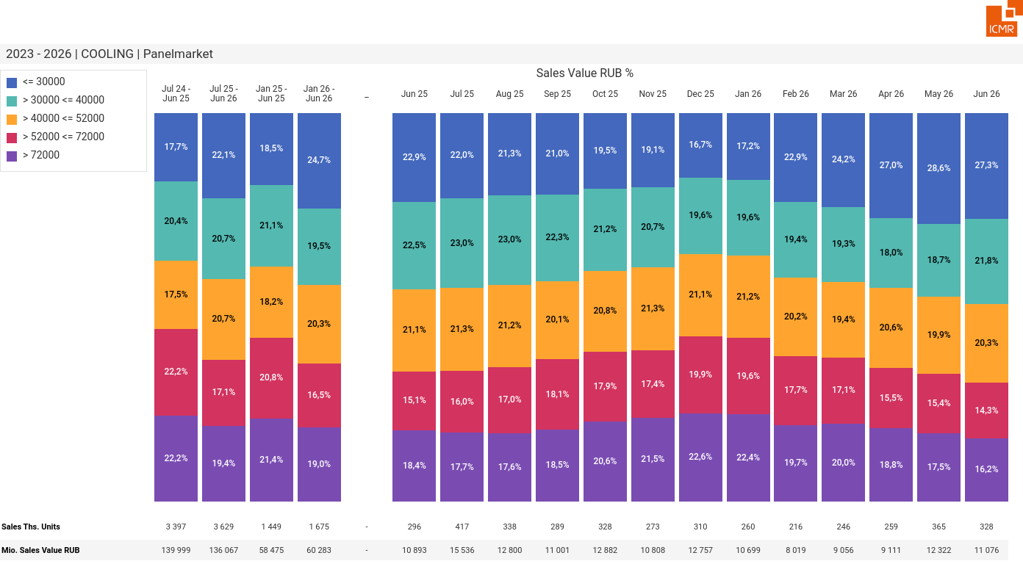
07/2026 PRJ 26fc7bc0 - TMPL e970a0a1 - FRM 545e5832 - ID 39

Slide 40
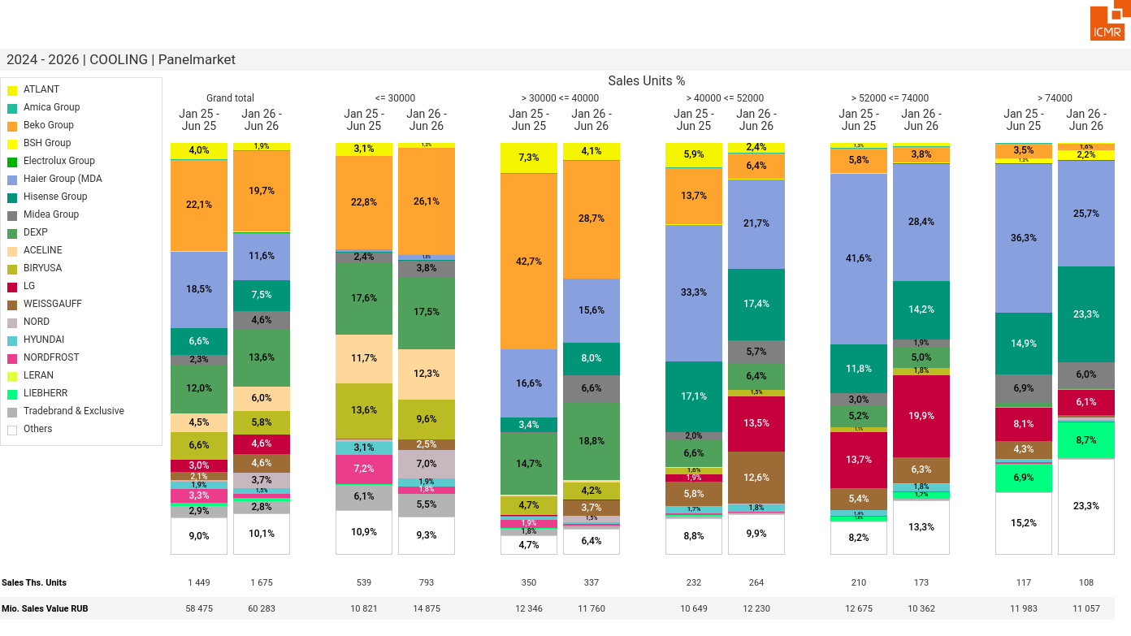
07/2026 PRJ 26fc7bc0 - TMPL e970a0a1 - FRM 3f6c0d07 - ID 40

Slide 41
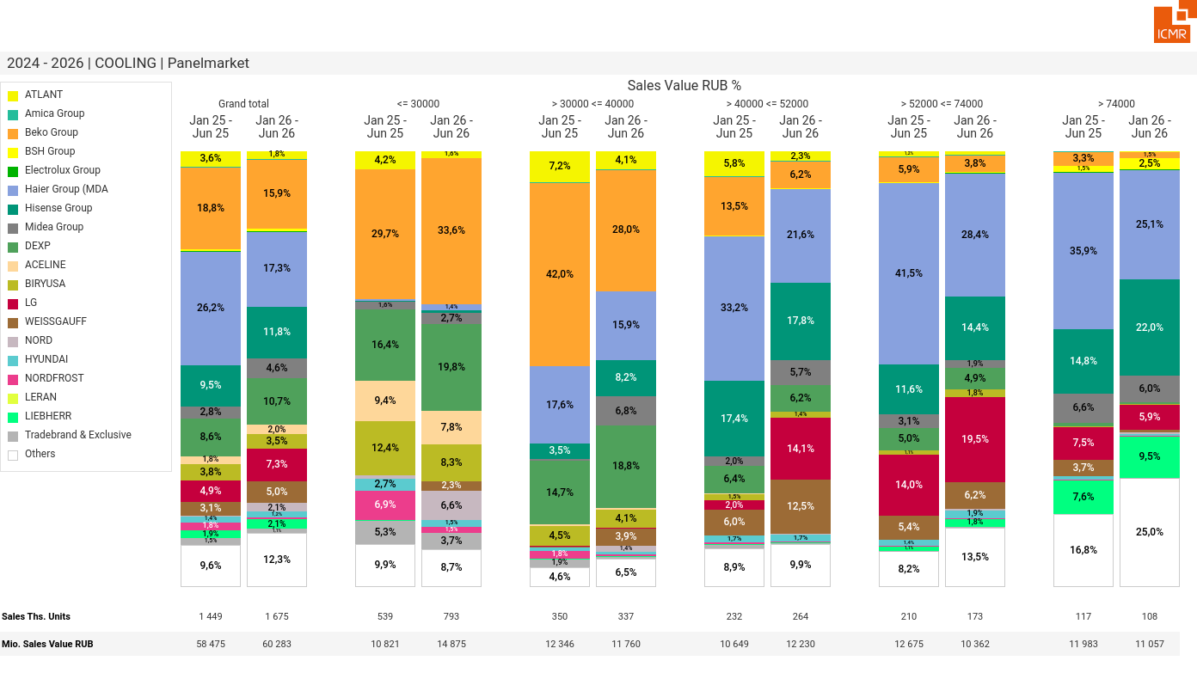
07/2026 PRJ 26fc7bc0 - TMPL e970a0a1 - FRM 907e1da5 - ID 41

Slide 42
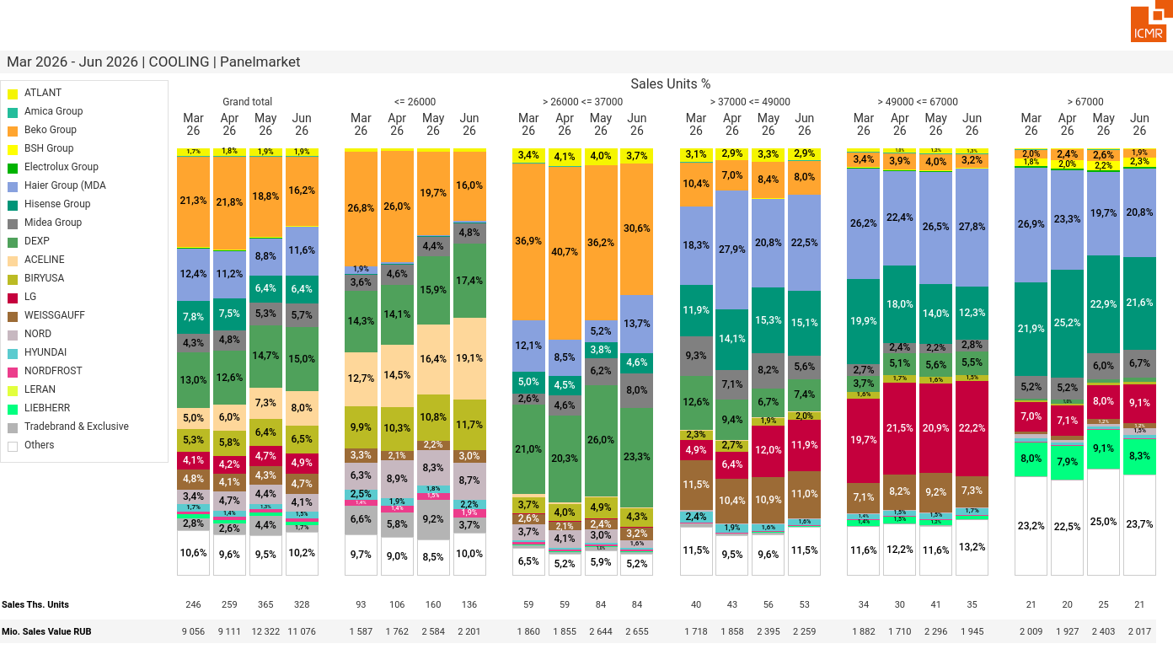
07/2026 PRJ 26fc7bc0 - TMPL e970a0a1 - FRM c85f512b - ID 42

Slide 43
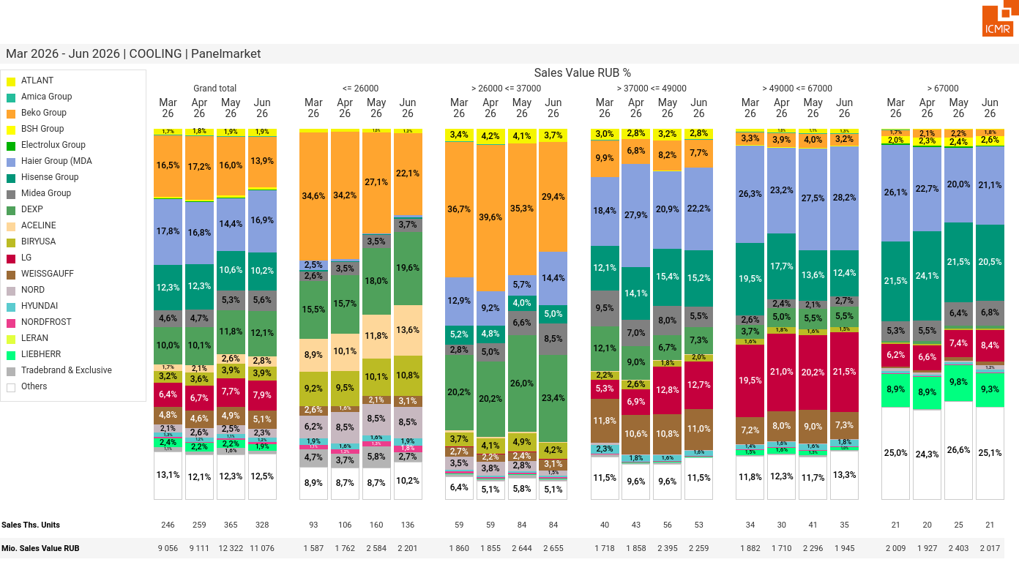
07/2026 PRJ 26fc7bc0 - TMPL e970a0a1 - FRM 61df3d98 - ID 43

Slide 44
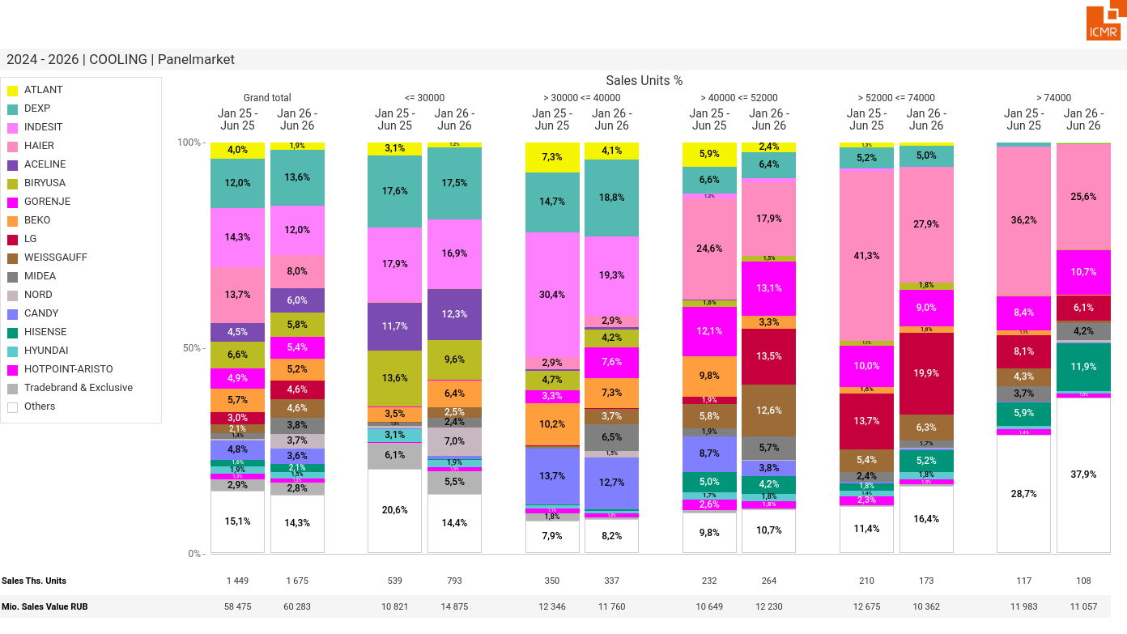
07/2026 PRJ 26fc7bc0 - TMPL e970a0a1 - FRM dc5f1620 - ID 44

Slide 45
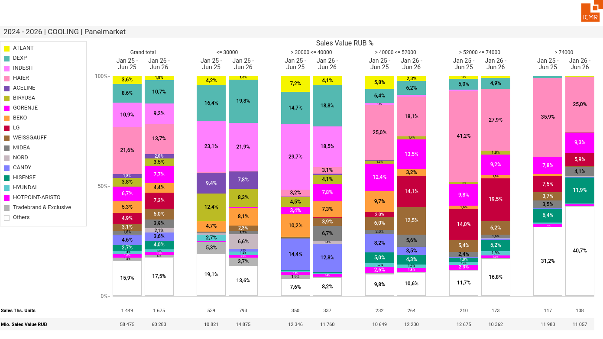
07/2026 PRJ 26fc7bc0 - TMPL e970a0a1 - FRM 3f7cc963 - ID 45

Slide 46
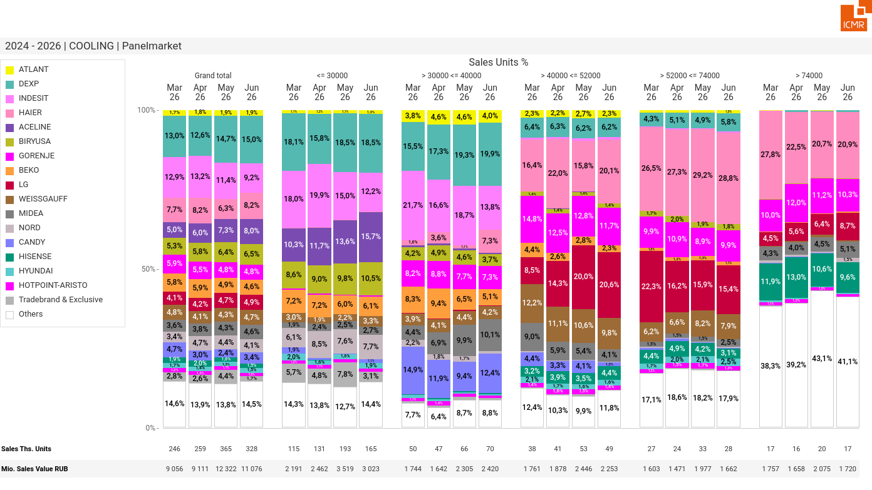
07/2026 PRJ 26fc7bc0 - TMPL e970a0a1 - FRM 4f146de0 - ID 46

Slide 47
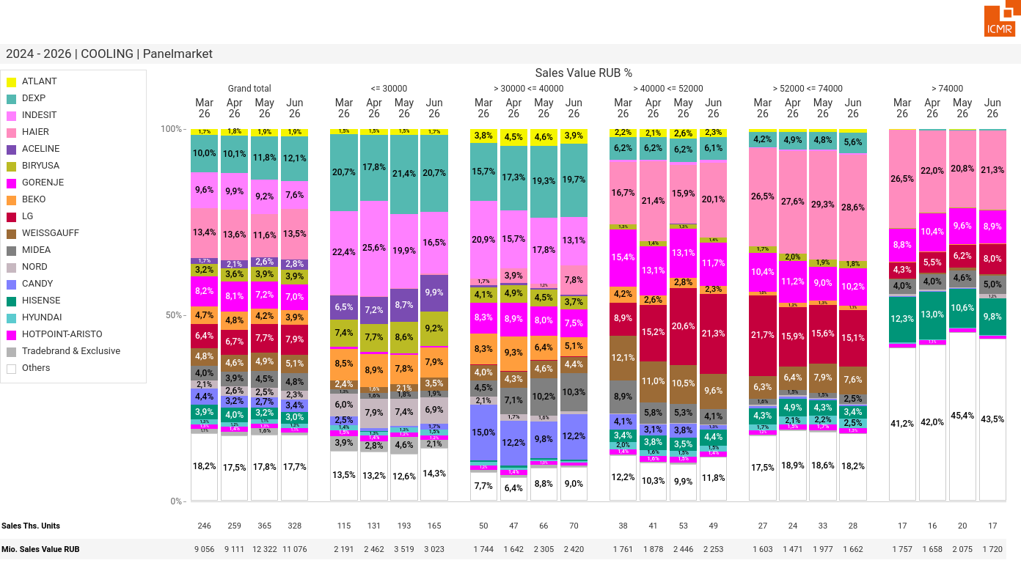
07/2026 PRJ 26fc7bc0 - TMPL e970a0a1 - FRM 79c5a32f - ID 47

Slide 48
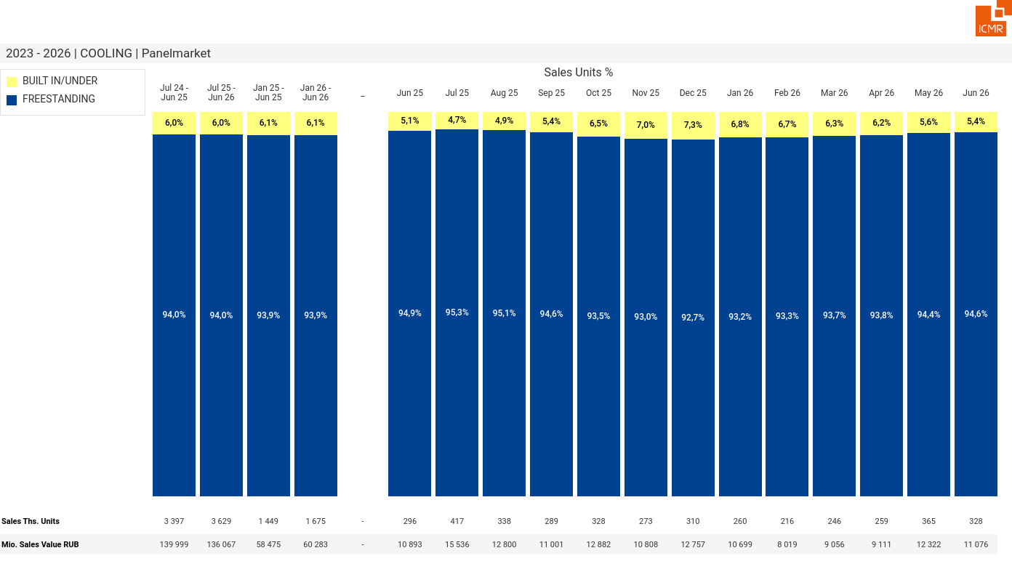
07/2026 PRJ 26fc7bc0 - TMPL e970a0a1 - FRM 285bca59 - ID 48

Slide 49
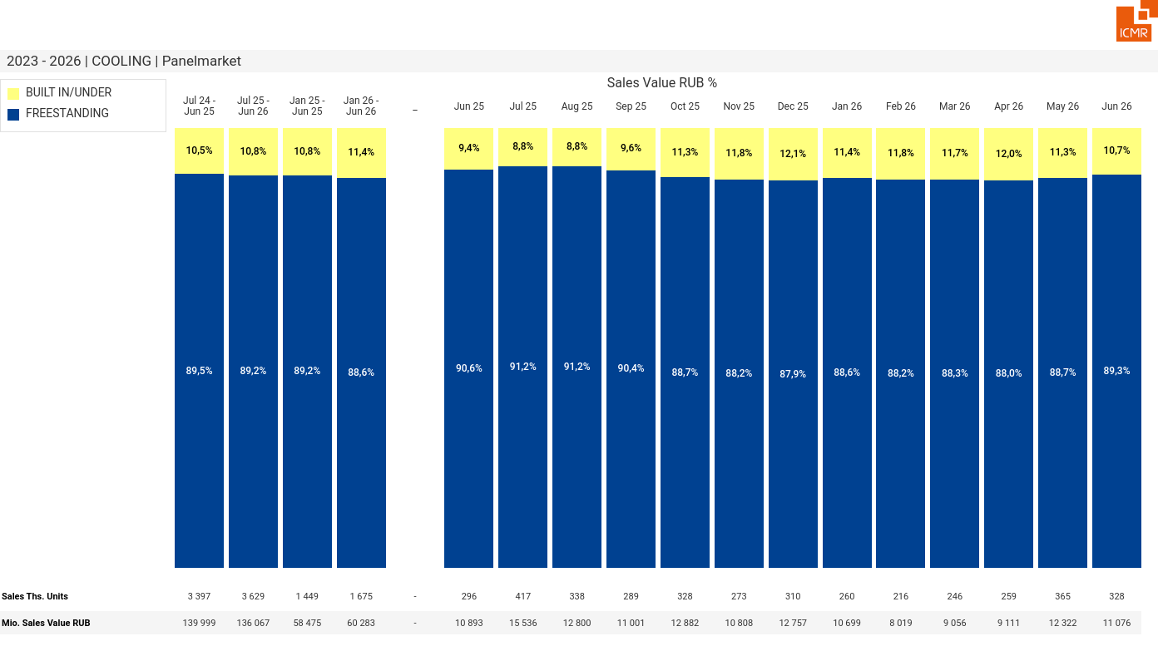
07/2026 PRJ 26fc7bc0 - TMPL e970a0a1 - FRM fc9b196c - ID 49

Slide 50
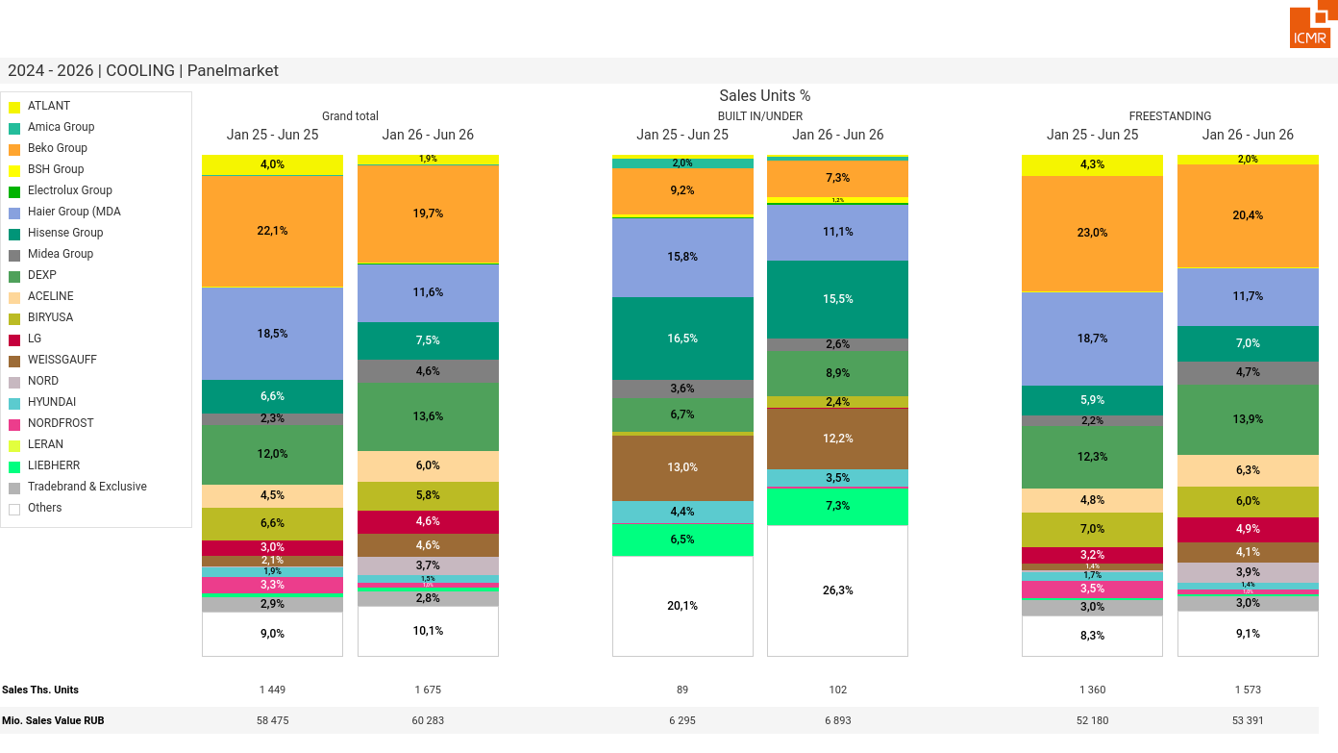
07/2026 PRJ 26fc7bc0 - TMPL e970a0a1 - FRM 778b2e6b - ID 50

Slide 51

07/2026 PRJ 26fc7bc0 - TMPL e970a0a1 - FRM 904c2312 - ID 51

Slide 52

07/2026 PRJ 26fc7bc0 - TMPL e970a0a1 - FRM b59ef5f4 - ID 52

Slide 53

07/2026 PRJ 26fc7bc0 - TMPL e970a0a1 - FRM dd6ea774 - ID 53

Slide 54

07/2026 PRJ 26fc7bc0 - TMPL e970a0a1 - FRM 08e5e0ce - ID 54

Slide 55

07/2026 PRJ 26fc7bc0 - TMPL e970a0a1 - FRM 8aadb053 - ID 55

Slide 56

07/2026 PRJ 26fc7bc0 - TMPL e970a0a1 - FRM afd5ea2e - ID 56

Slide 57

07/2026 PRJ 26fc7bc0 - TMPL e970a0a1 - FRM eccda346 - ID 57

Slide 58

07/2026 PRJ 26fc7bc0 - TMPL e970a0a1 - FRM db15134a - ID 58

Slide 59

07/2026 PRJ 26fc7bc0 - TMPL e970a0a1 - FRM 0f0db170 - ID 59

Slide 60

07/2026 PRJ 26fc7bc0 - TMPL e970a0a1 - FRM 0578e01e - ID 60

Slide 61

07/2026 PRJ 26fc7bc0 - TMPL e970a0a1 - FRM 204d8e19 - ID 61

Slide 62

07/2026 PRJ 26fc7bc0 - TMPL e970a0a1 - FRM 408ee6bd - ID 62

Slide 63

07/2026 PRJ 26fc7bc0 - TMPL e970a0a1 - FRM e416b6ed - ID 63

Slide 64

07/2026 PRJ 26fc7bc0 - TMPL e970a0a1 - FRM 850eaf96 - ID 64

Slide 65

07/2026 PRJ 26fc7bc0 - TMPL e970a0a1 - FRM dcf0fd88 - ID 65

Slide 66

07/2026 PRJ 26fc7bc0 - TMPL e970a0a1 - FRM 4fa59246 - ID 66

Slide 67

07/2026 PRJ 26fc7bc0 - TMPL e970a0a1 - FRM e96f5161 - ID 67

Slide 68

07/2026 PRJ 26fc7bc0 - TMPL e970a0a1 - FRM 66b38737 - ID 68

Slide 69

07/2026 PRJ 26fc7bc0 - TMPL e970a0a1 - FRM 5d1627e0 - ID 69

Slide 70

07/2026 PRJ 26fc7bc0 - TMPL e970a0a1 - FRM dc675730 - ID 70

Slide 71

07/2026 PRJ 26fc7bc0 - TMPL e970a0a1 - FRM e218d9c7 - ID 71

Slide 72

07/2026 PRJ 26fc7bc0 - TMPL e970a0a1 - FRM b433c153 - ID 72

Slide 73

07/2026 PRJ 26fc7bc0 - TMPL e970a0a1 - FRM 6540abee - ID 73

Slide 74

07/2026 PRJ 26fc7bc0 - TMPL e970a0a1 - FRM 42cc81bf - ID 74

Slide 75

07/2026 PRJ 26fc7bc0 - TMPL e970a0a1 - FRM 5f06baf7 - ID 75

Slide 76

07/2026 PRJ 26fc7bc0 - TMPL e970a0a1 - FRM 5bd14b97 - ID 76

Slide 77

07/2026 PRJ 26fc7bc0 - TMPL e970a0a1 - FRM f037d4cc - ID 77

Slide 78

07/2026 PRJ 26fc7bc0 - TMPL e970a0a1 - FRM d9172aaa - ID 78

Slide 79

07/2026 PRJ 26fc7bc0 - TMPL e970a0a1 - FRM 29930ba8 - ID 79

Slide 80

07/2026 PRJ 26fc7bc0 - TMPL e970a0a1 - FRM a4f84ccb - ID 80

Slide 81

07/2026 PRJ 26fc7bc0 - TMPL e970a0a1 - FRM 3f233d9d - ID 81

Slide 82

07/2026 PRJ 26fc7bc0 - TMPL e970a0a1 - FRM db0d82a2 - ID 82

Slide 83

07/2026 PRJ 26fc7bc0 - TMPL e970a0a1 - FRM 45308ce3 - ID 83

Slide 84

07/2026 PRJ 26fc7bc0 - TMPL e970a0a1 - FRM 9ac6e396 - ID 84

Slide 85

07/2026 PRJ 26fc7bc0 - TMPL e970a0a1 - FRM 2f274302 - ID 85

Slide 86

07/2026 PRJ 26fc7bc0 - TMPL e970a0a1 - FRM e2a74313 - ID 86

Slide 87

07/2026 PRJ 26fc7bc0 - TMPL e970a0a1 - FRM b889495a - ID 87

Slide 88

07/2026 PRJ 26fc7bc0 - TMPL e970a0a1 - FRM 39b27fef - ID 88

Slide 89

07/2026 PRJ 26fc7bc0 - TMPL e970a0a1 - FRM a987734f - ID 89

Slide 90

07/2026 PRJ 26fc7bc0 - TMPL e970a0a1 - FRM f432f8ce - ID 90

Slide 91

07/2026 PRJ 26fc7bc0 - TMPL e970a0a1 - FRM 53c2566f - ID 91

Slide 92

07/2026 PRJ 26fc7bc0 - TMPL e970a0a1 - FRM deabc1d3 - ID 92

Slide 93

07/2026 PRJ 26fc7bc0 - TMPL e970a0a1 - FRM b74537bc - ID 93

Slide 94

07/2026 PRJ 26fc7bc0 - TMPL e970a0a1 - FRM 4cca92d3 - ID 94

Slide 95

07/2026 PRJ 26fc7bc0 - TMPL e970a0a1 - FRM 3631beb6 - ID 95

Slide 96

07/2026 PRJ 26fc7bc0 - TMPL e970a0a1 - FRM da151bff - ID 96

Slide 97
07/2026 PRJ 26fc7bc0 - TMPL e970a0a1 - FRM 9868de82 - ID 97

Slide 98

07/2026 PRJ 26fc7bc0 - TMPL e970a0a1 - FRM e302240f - ID 98

Slide 99

07/2026 PRJ 26fc7bc0 - TMPL e970a0a1 - FRM cc80dd02 - ID 99

Slide 100

07/2026 PRJ 26fc7bc0 - TMPL e970a0a1 - FRM 6a2511cf - ID 100

Slide 101

07/2026 PRJ 26fc7bc0 - TMPL e970a0a1 - FRM 7e56ca9a - ID 101

Slide 102

07/2026 PRJ 26fc7bc0 - TMPL e970a0a1 - FRM f66b8c58 - ID 102

Slide 103

07/2026 PRJ 26fc7bc0 - TMPL e970a0a1 - FRM 30f766cc - ID 103

Slide 104

07/2026 PRJ 26fc7bc0 - TMPL e970a0a1 - FRM 57add867 - ID 104

Slide 105

07/2026 PRJ 26fc7bc0 - TMPL e970a0a1 - FRM d5217505 - ID 105

Slide 106

07/2026 PRJ 26fc7bc0 - TMPL e970a0a1 - FRM 9e7ac601 - ID 106

Slide 107

07/2026 PRJ 26fc7bc0 - TMPL e970a0a1 - FRM 1a3b87b4 - ID 107

Slide 108

07/2026 PRJ 26fc7bc0 - TMPL e970a0a1 - FRM fdc7e6b4 - ID 108

Slide 109

07/2026 PRJ 26fc7bc0 - TMPL e970a0a1 - FRM 32ffab00 - ID 109

Slide 110

07/2026 PRJ 26fc7bc0 - TMPL e970a0a1 - FRM 3565e593 - ID 110

Slide 111

07/2026 PRJ 26fc7bc0 - TMPL e970a0a1 - FRM a44823ca - ID 111

Slide 112

07/2026 PRJ 26fc7bc0 - TMPL e970a0a1 - FRM be955586 - ID 112

Slide 113

07/2026 PRJ 26fc7bc0 - TMPL e970a0a1 - FRM 3d785bd2 - ID 113

Slide 114

07/2026 PRJ 26fc7bc0 - TMPL e970a0a1 - FRM 024c815d - ID 114

Slide 115

07/2026 PRJ 26fc7bc0 - TMPL e970a0a1 - FRM 0e78c024 - ID 115

Slide 116

07/2026 PRJ 26fc7bc0 - TMPL e970a0a1 - FRM 1fb2f80c - ID 116

Slide 117

07/2026 PRJ 26fc7bc0 - TMPL e970a0a1 - FRM 18402994 - ID 117

Slide 118

07/2026 PRJ 26fc7bc0 - TMPL e970a0a1 - FRM 50ede27e - ID 118

Slide 119

07/2026 PRJ 26fc7bc0 - TMPL e970a0a1 - FRM 86822b70 - ID 119

Slide 120

07/2026 PRJ 26fc7bc0 - TMPL e970a0a1 - FRM e5aa6fec - ID 120

Slide 121

07/2026 PRJ 26fc7bc0 - TMPL e970a0a1 - FRM a95cefea - ID 121

Slide 122

07/2026 PRJ 26fc7bc0 - TMPL e970a0a1 - FRM 0c8fb398 - ID 122

Slide 123

07/2026 PRJ 26fc7bc0 - TMPL e970a0a1 - FRM fc2f1a4c - ID 123

Slide 124

07/2026 PRJ 26fc7bc0 - TMPL e970a0a1 - FRM da8942ce - ID 124

Slide 125

07/2026 PRJ 26fc7bc0 - TMPL e970a0a1 - FRM 295f0d0a - ID 125

Slide 126

07/2026 PRJ 26fc7bc0 - TMPL e970a0a1 - FRM fa2481af - ID 126

Slide 127

07/2026 PRJ 26fc7bc0 - TMPL e970a0a1 - FRM 64fc58fd - ID 127

Slide 128

07/2026 PRJ 26fc7bc0 - TMPL e970a0a1 - FRM b42186bb - ID 128

Slide 129

07/2026 PRJ 26fc7bc0 - TMPL e970a0a1 - FRM 1cbeec05 - ID 129

Slide 130

07/2026 PRJ 26fc7bc0 - TMPL e970a0a1 - FRM 39e13515 - ID 130

Slide 131

07/2026 PRJ 26fc7bc0 - TMPL e970a0a1 - FRM 92a2a89f - ID 131

Slide 132

07/2026 PRJ 26fc7bc0 - TMPL e970a0a1 - FRM 5fac918c - ID 132

Slide 133

07/2026 PRJ 26fc7bc0 - TMPL e970a0a1 - FRM 303a73ec - ID 133

Slide 134

07/2026 PRJ 26fc7bc0 - TMPL e970a0a1 - FRM a324e05a - ID 134

Slide 135

07/2026 PRJ 26fc7bc0 - TMPL e970a0a1 - FRM 12eeb9ee - ID 135

Slide 136

07/2026 PRJ 26fc7bc0 - TMPL e970a0a1 - FRM 6ae11f45 - ID 136

Slide 137

07/2026 PRJ 26fc7bc0 - TMPL e970a0a1 - FRM 51bee2a1 - ID 137

Slide 138

07/2026 PRJ 26fc7bc0 - TMPL e970a0a1 - FRM d443d4ac - ID 138

Slide 139

07/2026 PRJ 26fc7bc0 - TMPL e970a0a1 - FRM f93f5802 - ID 139

Slide 140

07/2026 PRJ 26fc7bc0 - TMPL e970a0a1 - FRM 0bedfa9a - ID 140

Slide 141

07/2026 PRJ 26fc7bc0 - TMPL e970a0a1 - FRM da6c44b7 - ID 141

Slide 142

07/2026 PRJ 26fc7bc0 - TMPL e970a0a1 - FRM 5818a513 - ID 142

Slide 143

07/2026 PRJ 26fc7bc0 - TMPL e970a0a1 - FRM e94b8d7e - ID 143

Slide 144

07/2026 PRJ 26fc7bc0 - TMPL e970a0a1 - FRM 6daa2050 - ID 144

Slide 145

07/2026 PRJ 26fc7bc0 - TMPL e970a0a1 - FRM f223f457 - ID 145

Slide 146

07/2026 PRJ 26fc7bc0 - TMPL e970a0a1 - FRM 64148c00 - ID 146

Slide 147

07/2026 PRJ 26fc7bc0 - TMPL e970a0a1 - FRM 71953243 - ID 147

Slide 148

07/2026 PRJ 26fc7bc0 - TMPL e970a0a1 - FRM fb3437c6 - ID 148

Slide 149

07/2026 PRJ 26fc7bc0 - TMPL e970a0a1 - FRM 5bc84b62 - ID 149

Slide 150

07/2026 PRJ 26fc7bc0 - TMPL e970a0a1 - FRM 877b2a49 - ID 150

Slide 151

07/2026 PRJ 26fc7bc0 - TMPL e970a0a1 - FRM 08e7b4d1 - ID 151

Slide 152

07/2026 PRJ 26fc7bc0 - TMPL e970a0a1 - FRM 19781c94 - ID 152

Slide 153

07/2026 PRJ 26fc7bc0 - TMPL e970a0a1 - FRM f5d9356b - ID 153

Slide 154

07/2026 PRJ 26fc7bc0 - TMPL e970a0a1 - FRM 06071ab6 - ID 154

Slide 155

07/2026 PRJ 26fc7bc0 - TMPL e970a0a1 - FRM 9dee2825 - ID 155

Slide 156

07/2026 PRJ 26fc7bc0 - TMPL e970a0a1 - FRM 98bdb733 - ID 156

Slide 157

07/2026 PRJ 26fc7bc0 - TMPL e970a0a1 - FRM 94519abd - ID 157

Slide 158

07/2026 PRJ 26fc7bc0 - TMPL e970a0a1 - FRM da39626f - ID 158

Slide 159

07/2026 PRJ 26fc7bc0 - TMPL e970a0a1 - FRM 21d8a8c3 - ID 159

Slide 160

07/2026 PRJ 26fc7bc0 - TMPL e970a0a1 - FRM ed34941b - ID 160

Slide 161

07/2026 PRJ 26fc7bc0 - TMPL e970a0a1 - FRM efadf833 - ID 161

Slide 162

07/2026 PRJ 26fc7bc0 - TMPL e970a0a1 - FRM 4e0799fa - ID 162

Slide 163

07/2026 PRJ 26fc7bc0 - TMPL e970a0a1 - FRM d12cdec8 - ID 163

Slide 164

07/2026 PRJ 26fc7bc0 - TMPL e970a0a1 - FRM b996d27e - ID 164

Slide 165

07/2026 PRJ 26fc7bc0 - TMPL e970a0a1 - FRM 83f07243 - ID 165

Slide 166

07/2026 PRJ 26fc7bc0 - TMPL e970a0a1 - FRM 198447bd - ID 166

Slide 167

07/2026 PRJ 26fc7bc0 - TMPL e970a0a1 - FRM 27f6c21d - ID 167

Slide 168

07/2026 PRJ 26fc7bc0 - TMPL e970a0a1 - FRM eb115618 - ID 168

Slide 169

07/2026 PRJ 26fc7bc0 - TMPL e970a0a1 - FRM 9f43ecc8 - ID 169

Slide 170

07/2026 PRJ 26fc7bc0 - TMPL e970a0a1 - FRM 30d4c926 - ID 170

Slide 171

07/2026 PRJ 26fc7bc0 - TMPL e970a0a1 - FRM b3cb8369 - ID 171

Slide 172

07/2026 PRJ 26fc7bc0 - TMPL e970a0a1 - FRM 627475b7 - ID 172

Slide 173

07/2026 PRJ 26fc7bc0 - TMPL e970a0a1 - FRM 88fc24d7 - ID 173

Slide 174

07/2026 PRJ 26fc7bc0 - TMPL e970a0a1 - FRM 904793cf - ID 174

Slide 175

07/2026 PRJ 26fc7bc0 - TMPL e970a0a1 - FRM 203f030c - ID 175

Slide 176

07/2026 PRJ 26fc7bc0 - TMPL e970a0a1 - FRM 5e9e3bc5 - ID 176

Slide 177

07/2026 PRJ 26fc7bc0 - TMPL e970a0a1 - FRM f2ca292a - ID 177

Slide 178

07/2026 PRJ 26fc7bc0 - TMPL e970a0a1 - FRM ba958eef - ID 178

Slide 179

07/2026 PRJ 26fc7bc0 - TMPL e970a0a1 - FRM 778d6f8d - ID 179

Slide 180

07/2026 PRJ 26fc7bc0 - TMPL e970a0a1 - FRM e59eb939 - ID 180

Slide 181

07/2026 PRJ 26fc7bc0 - TMPL e970a0a1 - FRM a94a4747 - ID 181

Slide 182

07/2026 PRJ 26fc7bc0 - TMPL e970a0a1 - FRM fe516ea2 - ID 182

Slide 183

07/2026 PRJ 26fc7bc0 - TMPL e970a0a1 - FRM 8f1236f4 - ID 183

Slide 184

07/2026 PRJ 26fc7bc0 - TMPL e970a0a1 - FRM ff3a6800 - ID 184

Slide 185

07/2026 PRJ 26fc7bc0 - TMPL e970a0a1 - FRM 2d1a5289 - ID 185

Slide 186

07/2026 PRJ 26fc7bc0 - TMPL e970a0a1 - FRM fcfa1be0 - ID 186

Slide 187

07/2026 PRJ 26fc7bc0 - TMPL e970a0a1 - FRM 92415b25 - ID 187

Slide 188

07/2026 PRJ 26fc7bc0 - TMPL e970a0a1 - FRM e18acc48 - ID 188

Slide 189

07/2026 PRJ 26fc7bc0 - TMPL e970a0a1 - FRM 92f920e3 - ID 189

Slide 190

07/2026 PRJ 26fc7bc0 - TMPL e970a0a1 - FRM 6a9e8ef4 - ID 190

Slide 191

07/2026 PRJ 26fc7bc0 - TMPL e970a0a1 - FRM c052b4e3 - ID 191

Slide 192

07/2026 PRJ 26fc7bc0 - TMPL e970a0a1 - FRM c36abecf - ID 192

Slide 193

07/2026 PRJ 26fc7bc0 - TMPL e970a0a1 - FRM 09f4ea23 - ID 193

Slide 194

07/2026 PRJ 26fc7bc0 - TMPL e970a0a1 - FRM 918a623b - ID 194

Slide 195

07/2026 PRJ 26fc7bc0 - TMPL e970a0a1 - FRM 9fdf19f2 - ID 195

Slide 196

07/2026 PRJ 26fc7bc0 - TMPL e970a0a1 - FRM b87babc4 - ID 196

Slide 197

07/2026 PRJ 26fc7bc0 - TMPL e970a0a1 - FRM 7e18e58d - ID 197

Slide 198

07/2026 PRJ 26fc7bc0 - TMPL e970a0a1 - FRM fc474d03 - ID 198

Slide 199

07/2026 PRJ 26fc7bc0 - TMPL e970a0a1 - FRM ddb9b154 - ID 199

Slide 200

07/2026 PRJ 26fc7bc0 - TMPL e970a0a1 - FRM 5e03d8bd - ID 200

Slide 201

07/2026 PRJ 26fc7bc0 - TMPL e970a0a1 - FRM 52beedc6 - ID 201

Slide 202

07/2026 PRJ 26fc7bc0 - TMPL e970a0a1 - FRM 41ba2c1a - ID 202

Slide 203

07/2026 PRJ 26fc7bc0 - TMPL e970a0a1 - FRM 2f743aae - ID 203

Slide 204

07/2026 PRJ 26fc7bc0 - TMPL e970a0a1 - FRM bc90644a - ID 204

Slide 205

07/2026 PRJ 26fc7bc0 - TMPL e970a0a1 - FRM 0857b9b0 - ID 205

Slide 206

07/2026 PRJ 26fc7bc0 - TMPL e970a0a1 - FRM c9642636 - ID 206

Slide 207

07/2026 PRJ 26fc7bc0 - TMPL e970a0a1 - FRM f45e3971 - ID 207

Slide 208

07/2026 PRJ 26fc7bc0 - TMPL e970a0a1 - FRM 41df2e8b - ID 208

Slide 209

07/2026 PRJ 26fc7bc0 - TMPL e970a0a1 - FRM e741934c - ID 209

Slide 210

07/2026 PRJ 26fc7bc0 - TMPL e970a0a1 - FRM a75cb12f - ID 210

Slide 211

07/2026 PRJ 26fc7bc0 - TMPL e970a0a1 - FRM 8fc23080 - ID 211

Slide 212

07/2026 PRJ 26fc7bc0 - TMPL e970a0a1 - FRM 9b96743a - ID 212

Slide 213

07/2026 PRJ 26fc7bc0 - TMPL e970a0a1 - FRM 7f264df3 - ID 213

Slide 214

07/2026 PRJ 26fc7bc0 - TMPL e970a0a1 - FRM 85576d39 - ID 214

Slide 215

07/2026 PRJ 26fc7bc0 - TMPL e970a0a1 - FRM a35fb536 - ID 215

Slide 216

07/2026 PRJ 26fc7bc0 - TMPL e970a0a1 - FRM e72df569 - ID 216

Slide 217

07/2026 PRJ 26fc7bc0 - TMPL e970a0a1 - FRM e7e5eb21 - ID 217

Slide 218

07/2026 PRJ 26fc7bc0 - TMPL e970a0a1 - FRM 25c09bdd - ID 218

Slide 219

07/2026 PRJ 26fc7bc0 - TMPL e970a0a1 - FRM f94a6ed5 - ID 219

Slide 220

07/2026 PRJ 26fc7bc0 - TMPL e970a0a1 - FRM 5e983713 - ID 220

Slide 221

07/2026 PRJ 26fc7bc0 - TMPL e970a0a1 - FRM 7a5dfb3f - ID 221

Slide 222

07/2026 PRJ 26fc7bc0 - TMPL e970a0a1 - FRM 95ec75b4 - ID 222

Slide 223

07/2026 PRJ 26fc7bc0 - TMPL e970a0a1 - FRM 48dbf24e - ID 223

Slide 224

07/2026 PRJ 26fc7bc0 - TMPL e970a0a1 - FRM 9e6a5ce7 - ID 224

Slide 225

07/2026 PRJ 26fc7bc0 - TMPL e970a0a1 - FRM 6e1d5b77 - ID 225

Slide 226

07/2026 PRJ 26fc7bc0 - TMPL e970a0a1 - FRM a51a21a7 - ID 226

Slide 227

07/2026 PRJ 26fc7bc0 - TMPL e970a0a1 - FRM a3219552 - ID 227

Slide 228

07/2026 PRJ 26fc7bc0 - TMPL e970a0a1 - FRM 8bf3df37 - ID 228

Slide 229

07/2026 PRJ 26fc7bc0 - TMPL e970a0a1 - FRM e805b1fa - ID 229

Slide 230

07/2026 PRJ 26fc7bc0 - TMPL e970a0a1 - FRM c6f1df3c - ID 230

Slide 231

07/2026 PRJ 26fc7bc0 - TMPL e970a0a1 - FRM 21113d2c - ID 231

Slide 232

07/2026 PRJ 26fc7bc0 - TMPL e970a0a1 - FRM edee9648 - ID 232

Slide 233

07/2026 PRJ 26fc7bc0 - TMPL e970a0a1 - FRM 0101cb13 - ID 233

Slide 234

07/2026 PRJ 26fc7bc0 - TMPL e970a0a1 - FRM 0a330837 - ID 234

Slide 235

07/2026 PRJ 26fc7bc0 - TMPL e970a0a1 - FRM 80dd9dc2 - ID 235

Slide 236

07/2026 PRJ 26fc7bc0 - TMPL e970a0a1 - FRM 034294ad - ID 236

Slide 237

07/2026 PRJ 26fc7bc0 - TMPL e970a0a1 - FRM 55c1ba5f - ID 237

Slide 238

07/2026 PRJ 26fc7bc0 - TMPL e970a0a1 - FRM 70c006dc - ID 238

Slide 239

07/2026 PRJ 26fc7bc0 - TMPL e970a0a1 - FRM 46771bb2 - ID 239

Slide 240

07/2026 PRJ 26fc7bc0 - TMPL e970a0a1 - FRM 6ee57bbb - ID 240

Slide 241

07/2026 PRJ 26fc7bc0 - TMPL e970a0a1 - FRM f6db6cb1 - ID 241

Slide 242

07/2026 PRJ 26fc7bc0 - TMPL e970a0a1 - FRM 7f111383 - ID 242

Slide 243

07/2026 PRJ 26fc7bc0 - TMPL e970a0a1 - FRM b24b44e5 - ID 243

Slide 244

07/2026 PRJ 26fc7bc0 - TMPL e970a0a1 - FRM 20709361 - ID 244

Slide 245

07/2026 PRJ 26fc7bc0 - TMPL e970a0a1 - FRM d59662ce - ID 245

Slide 246

07/2026 PRJ 26fc7bc0 - TMPL e970a0a1 - FRM 1841ceac - ID 246

Slide 247

07/2026 PRJ 26fc7bc0 - TMPL e970a0a1 - FRM f0e7d143 - ID 247

Slide 248

07/2026 PRJ 26fc7bc0 - TMPL e970a0a1 - FRM c3f3e91f - ID 248

Slide 249

07/2026 PRJ 26fc7bc0 - TMPL e970a0a1 - FRM ad52c5f8 - ID 249

Slide 250

07/2026 PRJ 26fc7bc0 - TMPL e970a0a1 - FRM a2de41cc - ID 250

Slide 251

07/2026 PRJ 26fc7bc0 - TMPL e970a0a1 - FRM d3d88720 - ID 251

Slide 252

07/2026 PRJ 26fc7bc0 - TMPL e970a0a1 - FRM 44a4731a - ID 252

Slide 253

07/2026 PRJ 26fc7bc0 - TMPL e970a0a1 - FRM 6c781ecd - ID 253

Slide 254

07/2026 PRJ 26fc7bc0 - TMPL e970a0a1 - FRM 92c23967 - ID 254

Slide 255

07/2026 PRJ 26fc7bc0 - TMPL e970a0a1 - FRM 89ab4c57 - ID 255

Slide 256

07/2026 PRJ 26fc7bc0 - TMPL e970a0a1 - FRM d3c31932 - ID 256

Slide 257

07/2026 PRJ 26fc7bc0 - TMPL e970a0a1 - FRM 1dbd4df0 - ID 257

Slide 258

07/2026 PRJ 26fc7bc0 - TMPL e970a0a1 - FRM c51152c5 - ID 258

Slide 259

07/2026 PRJ 26fc7bc0 - TMPL e970a0a1 - FRM 0d108656 - ID 259

Slide 260

07/2026 PRJ 26fc7bc0 - TMPL e970a0a1 - FRM d72f5292 - ID 260

Slide 261

07/2026 PRJ 26fc7bc0 - TMPL e970a0a1 - FRM 5f3bac5e - ID 261

Slide 262

07/2026 PRJ 26fc7bc0 - TMPL e970a0a1 - FRM 8da1a274 - ID 262

Slide 263

07/2026 PRJ 26fc7bc0 - TMPL e970a0a1 - FRM 1869315a - ID 263

Slide 264

07/2026 PRJ 26fc7bc0 - TMPL e970a0a1 - FRM 012e1674 - ID 264

Slide 265

07/2026 PRJ 26fc7bc0 - TMPL e970a0a1 - FRM fa1508e4 - ID 265

Slide 266

07/2026 PRJ 26fc7bc0 - TMPL e970a0a1 - FRM de386719 - ID 266

Slide 267

07/2026 PRJ 26fc7bc0 - TMPL e970a0a1 - FRM 103aadcc - ID 267

Slide 268

07/2026 PRJ 26fc7bc0 - TMPL e970a0a1 - FRM 0ff1f88b - ID 268

Slide 269

07/2026 PRJ 26fc7bc0 - TMPL e970a0a1 - FRM be60ce86 - ID 269

Slide 270

07/2026 PRJ 26fc7bc0 - TMPL e970a0a1 - FRM c2db7870 - ID 270

Slide 271

07/2026 PRJ 26fc7bc0 - TMPL e970a0a1 - FRM cfbc9718 - ID 271

Slide 272

07/2026 PRJ 26fc7bc0 - TMPL e970a0a1 - FRM 9cca90d9 - ID 272

Slide 273

07/2026 PRJ 26fc7bc0 - TMPL e970a0a1 - FRM 4b9fa752 - ID 273

Slide 274

07/2026 PRJ 26fc7bc0 - TMPL e970a0a1 - FRM d2ac7aac - ID 274

Slide 275

07/2026 PRJ 26fc7bc0 - TMPL e970a0a1 - FRM 281bbf09 - ID 275

Slide 276

07/2026 PRJ 26fc7bc0 - TMPL e970a0a1 - FRM 379ed379 - ID 276

Slide 277

07/2026 PRJ 26fc7bc0 - TMPL e970a0a1 - FRM c6309a8a - ID 277

Slide 278

07/2026 PRJ 26fc7bc0 - TMPL e970a0a1 - FRM 7136c8ce - ID 278

Slide 279

07/2026 PRJ 26fc7bc0 - TMPL e970a0a1 - FRM a6a587fe - ID 279

Slide 280

07/2026 PRJ 26fc7bc0 - TMPL e970a0a1 - FRM 820eb705 - ID 280

Slide 281

07/2026 PRJ 26fc7bc0 - TMPL e970a0a1 - FRM 48864ec4 - ID 281

Slide 282

07/2026 PRJ 26fc7bc0 - TMPL e970a0a1 - FRM 6e60498a - ID 282

Slide 283

07/2026 PRJ 26fc7bc0 - TMPL e970a0a1 - FRM c42ce88f - ID 283

Slide 284

07/2026 PRJ 26fc7bc0 - TMPL e970a0a1 - FRM 869b67d1 - ID 284

Slide 285

07/2026 PRJ 26fc7bc0 - TMPL e970a0a1 - FRM 49e12e0a - ID 285

Slide 286

07/2026 PRJ 26fc7bc0 - TMPL e970a0a1 - FRM 37fef109 - ID 286

Slide 287

07/2026 PRJ 26fc7bc0 - TMPL e970a0a1 - FRM 777afce4 - ID 287

Slide 288

07/2026 PRJ 26fc7bc0 - TMPL e970a0a1 - FRM cd7fe6b7 - ID 288

Slide 289

07/2026 PRJ 26fc7bc0 - TMPL e970a0a1 - FRM 4eecbd86 - ID 289

Slide 290

07/2026 PRJ 26fc7bc0 - TMPL e970a0a1 - FRM 0ef555eb - ID 290

Slide 291

07/2026 PRJ 26fc7bc0 - TMPL e970a0a1 - FRM 5fd8ea30 - ID 291

Slide 292

07/2026 PRJ 26fc7bc0 - TMPL e970a0a1 - FRM 29414b32 - ID 292

Slide 293

07/2026 PRJ 26fc7bc0 - TMPL e970a0a1 - FRM a888acfe - ID 293

Slide 294

07/2026 PRJ 26fc7bc0 - TMPL e970a0a1 - FRM fec7d07a - ID 294

Slide 295

07/2026 PRJ 26fc7bc0 - TMPL e970a0a1 - FRM 87440085 - ID 295

Slide 296

07/2026 PRJ 26fc7bc0 - TMPL e970a0a1 - FRM a154f623 - ID 296

Slide 297

07/2026 PRJ 26fc7bc0 - TMPL e970a0a1 - FRM deec8e53 - ID 297

Slide 298

07/2026 PRJ 26fc7bc0 - TMPL e970a0a1 - FRM 6eebc8b1 - ID 298

Slide 299

07/2026 PRJ 26fc7bc0 - TMPL e970a0a1 - FRM b63d6c3d - ID 299

Slide 300

07/2026 PRJ 26fc7bc0 - TMPL e970a0a1 - FRM a0d8a3ec - ID 300

Slide 301

07/2026 PRJ 26fc7bc0 - TMPL e970a0a1 - FRM 42bf2616 - ID 301

Slide 302

07/2026 PRJ 26fc7bc0 - TMPL e970a0a1 - FRM a181ca2e - ID 302

Slide 303

07/2026 PRJ 26fc7bc0 - TMPL e970a0a1 - FRM cb3f1f27 - ID 303

Slide 304

07/2026 PRJ 26fc7bc0 - TMPL e970a0a1 - FRM 2238bc0c - ID 304

Slide 305

07/2026 PRJ 26fc7bc0 - TMPL e970a0a1 - FRM 99ae5ebf - ID 305

Slide 306

07/2026 PRJ 26fc7bc0 - TMPL e970a0a1 - FRM a1627178 - ID 306

Slide 307

07/2026 PRJ 26fc7bc0 - TMPL e970a0a1 - FRM 34f154d1 - ID 307

Slide 308

07/2026 PRJ 26fc7bc0 - TMPL e970a0a1 - FRM 316a7067 - ID 308

Slide 309

07/2026 PRJ 26fc7bc0 - TMPL e970a0a1 - FRM 9054d177 - ID 309

Slide 310

07/2026 PRJ 26fc7bc0 - TMPL e970a0a1 - FRM 85d00b3f - ID 310

Slide 311

07/2026 PRJ 26fc7bc0 - TMPL e970a0a1 - FRM e5fabd7d - ID 311

Slide 312

07/2026 PRJ 26fc7bc0 - TMPL e970a0a1 - FRM 3680e73f - ID 312

Slide 313

07/2026 PRJ 26fc7bc0 - TMPL e970a0a1 - FRM b24ebcd5 - ID 313

Slide 314

07/2026 PRJ 26fc7bc0 - TMPL e970a0a1 - FRM 171e73dc - ID 314

Slide 315

07/2026 PRJ 26fc7bc0 - TMPL e970a0a1 - FRM 723a39c8 - ID 315

Slide 316

07/2026 PRJ 26fc7bc0 - TMPL e970a0a1 - FRM 26a7e03b - ID 316

Slide 317

07/2026 PRJ 26fc7bc0 - TMPL e970a0a1 - FRM b2c92a6c - ID 317

Slide 318

07/2026 PRJ 26fc7bc0 - TMPL e970a0a1 - FRM 8e84212e - ID 318

Slide 319

07/2026 PRJ 26fc7bc0 - TMPL e970a0a1 - FRM 57f5cb98 - ID 319

Slide 320

07/2026 PRJ 26fc7bc0 - TMPL e970a0a1 - FRM e977b035 - ID 320

Slide 321

07/2026 PRJ 26fc7bc0 - TMPL e970a0a1 - FRM db2ab763 - ID 321

Slide 322

07/2026 PRJ 26fc7bc0 - TMPL e970a0a1 - FRM a6d3ee1e - ID 322

Slide 323

07/2026 PRJ 26fc7bc0 - TMPL e970a0a1 - FRM cbabfe2c - ID 323

Slide 324

07/2026 PRJ 26fc7bc0 - TMPL e970a0a1 - FRM 741ffdbc - ID 324

Slide 325

07/2026 PRJ 26fc7bc0 - TMPL e970a0a1 - FRM 13038ff0 - ID 325

Slide 326

07/2026 PRJ 26fc7bc0 - TMPL e970a0a1 - FRM 95106948 - ID 326

Slide 327

07/2026 PRJ 26fc7bc0 - TMPL e970a0a1 - FRM 20c2c551 - ID 327

Slide 328

07/2026 PRJ 26fc7bc0 - TMPL e970a0a1 - FRM 02bb7f0d - ID 328

Slide 329

07/2026 PRJ 26fc7bc0 - TMPL e970a0a1 - FRM 6c219850 - ID 329

Slide 330

07/2026 PRJ 26fc7bc0 - TMPL e970a0a1 - FRM cef588c9 - ID 330

Slide 331

07/2026 PRJ 26fc7bc0 - TMPL e970a0a1 - FRM 1b35743d - ID 331

Slide 332

07/2026 PRJ 26fc7bc0 - TMPL e970a0a1 - FRM 183029b5 - ID 332

Slide 333

07/2026 PRJ 26fc7bc0 - TMPL e970a0a1 - FRM 40521600 - ID 333

Slide 334

07/2026 PRJ 26fc7bc0 - TMPL e970a0a1 - FRM ebcdeece - ID 334

Slide 335

07/2026 PRJ 26fc7bc0 - TMPL e970a0a1 - FRM 5498f586 - ID 335

Slide 336

07/2026 PRJ 26fc7bc0 - TMPL e970a0a1 - FRM 2d45a0ee - ID 336

Slide 337

07/2026 PRJ 26fc7bc0 - TMPL e970a0a1 - FRM ce8ea3c7 - ID 337

Slide 338

07/2026 PRJ 26fc7bc0 - TMPL e970a0a1 - FRM 02c457fc - ID 338

Slide 339

07/2026 PRJ 26fc7bc0 - TMPL e970a0a1 - FRM fd357261 - ID 339

Slide 340

07/2026 PRJ 26fc7bc0 - TMPL e970a0a1 - FRM 8886393e - ID 340

Slide 341

07/2026 PRJ 26fc7bc0 - TMPL e970a0a1 - FRM a88e5952 - ID 341

Slide 342

07/2026 PRJ 26fc7bc0 - TMPL e970a0a1 - FRM c332b014 - ID 342

Slide 343

07/2026 PRJ 26fc7bc0 - TMPL e970a0a1 - FRM 1b7e5a37 - ID 343

Slide 344

07/2026 PRJ 26fc7bc0 - TMPL e970a0a1 - FRM 4de7596f - ID 344

Slide 345

07/2026 PRJ 26fc7bc0 - TMPL e970a0a1 - FRM bbbb9bd1 - ID 345

Slide 346

07/2026 PRJ 26fc7bc0 - TMPL e970a0a1 - FRM 0fa8b21d - ID 346

Slide 347

07/2026 PRJ 26fc7bc0 - TMPL e970a0a1 - FRM 7aec60b4 - ID 347

Slide 348

07/2026 PRJ 26fc7bc0 - TMPL e970a0a1 - FRM 77854a35 - ID 348

Slide 349

07/2026 PRJ 26fc7bc0 - TMPL e970a0a1 - FRM efb456de - ID 349

Slide 350

07/2026 PRJ 26fc7bc0 - TMPL e970a0a1 - FRM bc8fcc7b - ID 350

Slide 351

07/2026 PRJ 26fc7bc0 - TMPL e970a0a1 - FRM 6af01002 - ID 351

Slide 352

07/2026 PRJ 26fc7bc0 - TMPL e970a0a1 - FRM ac34e39c - ID 352

Slide 353

07/2026 PRJ 26fc7bc0 - TMPL e970a0a1 - FRM 85d0c53f - ID 353

Slide 354

07/2026 PRJ 26fc7bc0 - TMPL e970a0a1 - FRM c92fbb55 - ID 354

Slide 355

07/2026 PRJ 26fc7bc0 - TMPL e970a0a1 - FRM 5e642ebf - ID 355

Slide 356

07/2026 PRJ 26fc7bc0 - TMPL e970a0a1 - FRM d6bb0204 - ID 356

Slide 357

07/2026 PRJ 26fc7bc0 - TMPL e970a0a1 - FRM 90651c7b - ID 357

Slide 358

07/2026 PRJ 26fc7bc0 - TMPL e970a0a1 - FRM 7b5808d1 - ID 358

Slide 359

07/2026 PRJ 26fc7bc0 - TMPL e970a0a1 - FRM ba1e064a - ID 359

Slide 360

07/2026 PRJ 26fc7bc0 - TMPL e970a0a1 - FRM 11216d83 - ID 360

Slide 361

07/2026 PRJ 26fc7bc0 - TMPL e970a0a1 - FRM fe2f0bb1 - ID 361

Slide 362

07/2026 PRJ 26fc7bc0 - TMPL e970a0a1 - FRM 3d7f93e5 - ID 362

Slide 363

07/2026 PRJ 26fc7bc0 - TMPL e970a0a1 - FRM d2cc5609 - ID 363

Slide 364

07/2026 PRJ 26fc7bc0 - TMPL e970a0a1 - FRM 857ca8a8 - ID 364

Slide 365

07/2026 PRJ 26fc7bc0 - TMPL e970a0a1 - FRM 3dfed698 - ID 365

Slide 366

07/2026 PRJ 26fc7bc0 - TMPL e970a0a1 - FRM 35544692 - ID 366

Slide 367

07/2026 PRJ 26fc7bc0 - TMPL e970a0a1 - FRM f4cbabc1 - ID 367

Slide 368

07/2026 PRJ 26fc7bc0 - TMPL e970a0a1 - FRM cf25b854 - ID 368

Slide 369

07/2026 PRJ 26fc7bc0 - TMPL e970a0a1 - FRM 6e537e2b - ID 369

Slide 370

07/2026 PRJ 26fc7bc0 - TMPL e970a0a1 - FRM 1713d20f - ID 370

Slide 371

07/2026 PRJ 26fc7bc0 - TMPL e970a0a1 - FRM 7420c768 - ID 371

Slide 372

07/2026 PRJ 26fc7bc0 - TMPL e970a0a1 - FRM 78d0f063 - ID 372

Slide 373

07/2026 PRJ 26fc7bc0 - TMPL e970a0a1 - FRM 815364c0 - ID 373

Slide 374

07/2026 PRJ 26fc7bc0 - TMPL e970a0a1 - FRM 2b9bdff3 - ID 374

Slide 375

07/2026 PRJ 26fc7bc0 - TMPL e970a0a1 - FRM 04fd3803 - ID 375

Slide 376

07/2026 PRJ 26fc7bc0 - TMPL e970a0a1 - FRM 6a813979 - ID 376

Slide 377

07/2026 PRJ 26fc7bc0 - TMPL e970a0a1 - FRM 3d466a9d - ID 377

Slide 378

07/2026 PRJ 26fc7bc0 - TMPL e970a0a1 - FRM 09fb0840 - ID 378

Slide 379

07/2026 PRJ 26fc7bc0 - TMPL e970a0a1 - FRM 81c40e37 - ID 379

Slide 380

07/2026 PRJ 26fc7bc0 - TMPL e970a0a1 - FRM ad9a45cb - ID 380

Slide 381

07/2026 PRJ 26fc7bc0 - TMPL e970a0a1 - FRM 0665204f - ID 381

Slide 382

07/2026 PRJ 26fc7bc0 - TMPL e970a0a1 - FRM bb2ff0e7 - ID 382

Slide 383

07/2026 PRJ 26fc7bc0 - TMPL e970a0a1 - FRM 5192d771 - ID 383

Slide 384

07/2026 PRJ 26fc7bc0 - TMPL e970a0a1 - FRM 523c0dec - ID 384

Slide 385

07/2026 PRJ 26fc7bc0 - TMPL e970a0a1 - FRM ed662c72 - ID 385

Slide 386

07/2026 PRJ 26fc7bc0 - TMPL e970a0a1 - FRM 8cdb6d04 - ID 386

Slide 387

07/2026 PRJ 26fc7bc0 - TMPL e970a0a1 - FRM 247a0897 - ID 387

Slide 388

07/2026 PRJ 26fc7bc0 - TMPL e970a0a1 - FRM ce05dc52 - ID 388

Slide 389

07/2026 PRJ 26fc7bc0 - TMPL e970a0a1 - FRM b153d934 - ID 389

Slide 390

07/2026 PRJ 26fc7bc0 - TMPL e970a0a1 - FRM be53d342 - ID 390

Slide 391

07/2026 PRJ 26fc7bc0 - TMPL e970a0a1 - FRM 3b44b620 - ID 391

Slide 392

07/2026 PRJ 26fc7bc0 - TMPL e970a0a1 - FRM 8a2c9981 - ID 392

Slide 393

07/2026 PRJ 26fc7bc0 - TMPL e970a0a1 - FRM 8b8ae6fb - ID 393

Slide 394

07/2026 PRJ 26fc7bc0 - TMPL e970a0a1 - FRM 8c5cfb51 - ID 394

Slide 395

07/2026 PRJ 26fc7bc0 - TMPL e970a0a1 - FRM 1589af6e - ID 395

Slide 396

07/2026 PRJ 26fc7bc0 - TMPL e970a0a1 - FRM 3722f957 - ID 396

Slide 397

07/2026 PRJ 26fc7bc0 - TMPL e970a0a1 - FRM 6683ffcd - ID 397

Slide 398

07/2026 PRJ 26fc7bc0 - TMPL e970a0a1 - FRM 324ab80f - ID 398

Slide 399

07/2026 PRJ 26fc7bc0 - TMPL e970a0a1 - FRM 3242f5c0 - ID 399

Slide 400

07/2026 PRJ 26fc7bc0 - TMPL e970a0a1 - FRM d78e60e5 - ID 400

Slide 401

07/2026 PRJ 26fc7bc0 - TMPL e970a0a1 - FRM b448c140 - ID 401

Slide 402

07/2026 PRJ 26fc7bc0 - TMPL e970a0a1 - FRM b4ed3a6c - ID 402

Slide 403

07/2026 PRJ 26fc7bc0 - TMPL e970a0a1 - FRM 8c322435 - ID 403

Slide 404

07/2026 PRJ 26fc7bc0 - TMPL e970a0a1 - FRM eaf283b8 - ID 404

Slide 405

07/2026 PRJ 26fc7bc0 - TMPL e970a0a1 - FRM 802aaad6 - ID 405

Slide 406

07/2026 PRJ 26fc7bc0 - TMPL e970a0a1 - FRM c615c307 - ID 406

Slide 407

07/2026 PRJ 26fc7bc0 - TMPL e970a0a1 - FRM c0f51d4c - ID 407

Slide 408

07/2026 PRJ 26fc7bc0 - TMPL e970a0a1 - FRM 1a0ed319 - ID 408

Slide 409

07/2026 PRJ 26fc7bc0 - TMPL e970a0a1 - FRM 8e0cba42 - ID 409

Slide 410

07/2026 PRJ 26fc7bc0 - TMPL e970a0a1 - FRM 5fa819b7 - ID 410

Slide 411

07/2026 PRJ 26fc7bc0 - TMPL e970a0a1 - FRM 18832ebe - ID 411

Slide 412

07/2026 PRJ 26fc7bc0 - TMPL e970a0a1 - FRM f8bd4398 - ID 412

Slide 413

07/2026 PRJ 26fc7bc0 - TMPL e970a0a1 - FRM c1925ddc - ID 413

Slide 414

07/2026 PRJ 26fc7bc0 - TMPL e970a0a1 - FRM 9b8a8f73 - ID 414

Slide 415

07/2026 PRJ 26fc7bc0 - TMPL e970a0a1 - FRM e53b7de8 - ID 415

Slide 416

07/2026 PRJ 26fc7bc0 - TMPL e970a0a1 - FRM 2d226908 - ID 416

Slide 417

07/2026 PRJ 26fc7bc0 - TMPL e970a0a1 - FRM ecf29416 - ID 417

Slide 418

07/2026 PRJ 26fc7bc0 - TMPL e970a0a1 - FRM edb2badb - ID 418

Slide 419

07/2026 PRJ 26fc7bc0 - TMPL e970a0a1 - FRM 249944b2 - ID 419

Slide 420

07/2026 PRJ 26fc7bc0 - TMPL e970a0a1 - FRM bc1e0b03 - ID 420

Slide 421

07/2026 PRJ 26fc7bc0 - TMPL e970a0a1 - FRM e8f95fe3 - ID 421

Slide 422

07/2026 PRJ 26fc7bc0 - TMPL e970a0a1 - FRM 12e0eea4 - ID 422

Slide 423

07/2026 PRJ 26fc7bc0 - TMPL e970a0a1 - FRM ae8940e0 - ID 423

Slide 424

07/2026 PRJ 26fc7bc0 - TMPL e970a0a1 - FRM 7b1cca94 - ID 424

Slide 425

07/2026 PRJ 26fc7bc0 - TMPL e970a0a1 - FRM 6ee644c2 - ID 425

Slide 426

07/2026 PRJ 26fc7bc0 - TMPL e970a0a1 - FRM e2446b21 - ID 426

Slide 427

07/2026 PRJ 26fc7bc0 - TMPL e970a0a1 - FRM 3bf44782 - ID 427

Slide 428

07/2026 PRJ 26fc7bc0 - TMPL e970a0a1 - FRM fd3784c9 - ID 428

Slide 429

07/2026 PRJ 26fc7bc0 - TMPL e970a0a1 - FRM 3ef2f698 - ID 429

Slide 430

07/2026 PRJ 26fc7bc0 - TMPL e970a0a1 - FRM 7e237322 - ID 430

Slide 431

07/2026 PRJ 26fc7bc0 - TMPL e970a0a1 - FRM 3e60f238 - ID 431

Slide 432

07/2026 PRJ 26fc7bc0 - TMPL e970a0a1 - FRM 8c7f1d01 - ID 432

Slide 433

07/2026 PRJ 26fc7bc0 - TMPL e970a0a1 - FRM 29d1f09d - ID 433

Slide 434

07/2026 PRJ 26fc7bc0 - TMPL e970a0a1 - FRM 773926e7 - ID 434

Slide 435

07/2026 PRJ 26fc7bc0 - TMPL e970a0a1 - FRM ba491e32 - ID 435

Slide 436

07/2026 PRJ 26fc7bc0 - TMPL e970a0a1 - FRM f11a9d94 - ID 436

Slide 437

07/2026 PRJ 26fc7bc0 - TMPL e970a0a1 - FRM cfd2790f - ID 437

Slide 438

07/2026 PRJ 26fc7bc0 - TMPL e970a0a1 - FRM 8e8ea3bd - ID 438

Slide 439

07/2026 PRJ 26fc7bc0 - TMPL e970a0a1 - FRM fdf86246 - ID 439

Slide 440

07/2026 PRJ 26fc7bc0 - TMPL e970a0a1 - FRM f61b92fb - ID 440

Slide 441

07/2026 PRJ 26fc7bc0 - TMPL e970a0a1 - FRM 91ed5041 - ID 441

Slide 442

07/2026 PRJ 26fc7bc0 - TMPL e970a0a1 - FRM d93f7baf - ID 442

Slide 443

07/2026 PRJ 26fc7bc0 - TMPL e970a0a1 - FRM a0e88f59 - ID 443

Slide 444

07/2026 PRJ 26fc7bc0 - TMPL e970a0a1 - FRM 629b4c1a - ID 444

Slide 445

07/2026 PRJ 26fc7bc0 - TMPL e970a0a1 - FRM 5c7d22c2 - ID 445

Slide 446

07/2026 PRJ 26fc7bc0 - TMPL e970a0a1 - FRM e4ed9347 - ID 446

Slide 447

07/2026 PRJ 26fc7bc0 - TMPL e970a0a1 - FRM e5be3a13 - ID 447

Slide 448

07/2026 PRJ 26fc7bc0 - TMPL e970a0a1 - FRM e519f048 - ID 448

Slide 449

07/2026 PRJ 26fc7bc0 - TMPL e970a0a1 - FRM b11288f8 - ID 449

Slide 450

07/2026 PRJ 26fc7bc0 - TMPL e970a0a1 - FRM 0b3eabea - ID 450

Slide 451

07/2026 PRJ 26fc7bc0 - TMPL e970a0a1 - FRM 3abaedb7 - ID 451

Slide 452

07/2026 PRJ 26fc7bc0 - TMPL e970a0a1 - FRM d077fe7c - ID 452

Slide 453

07/2026 PRJ 26fc7bc0 - TMPL e970a0a1 - FRM b24be499 - ID 453

Slide 454

07/2026 PRJ 26fc7bc0 - TMPL e970a0a1 - FRM 55eb31cd - ID 454

Slide 455

07/2026 PRJ 26fc7bc0 - TMPL e970a0a1 - FRM bb3e1739 - ID 455

Slide 456

07/2026 PRJ 26fc7bc0 - TMPL e970a0a1 - FRM a4590dab - ID 456

Slide 457

07/2026 PRJ 26fc7bc0 - TMPL e970a0a1 - FRM d4e3fca7 - ID 457

Slide 458

07/2026 PRJ 26fc7bc0 - TMPL e970a0a1 - FRM 987a245b - ID 458

Slide 459

07/2026 PRJ 26fc7bc0 - TMPL e970a0a1 - FRM bf36b9be - ID 459

Slide 460

07/2026 PRJ 26fc7bc0 - TMPL e970a0a1 - FRM a3a64657 - ID 460

Slide 461

07/2026 PRJ 26fc7bc0 - TMPL e970a0a1 - FRM b40aa1bd - ID 461

Slide 462

07/2026 PRJ 26fc7bc0 - TMPL e970a0a1 - FRM 471570b2 - ID 462

Slide 463

07/2026 PRJ 26fc7bc0 - TMPL e970a0a1 - FRM 442e7c1e - ID 463

Slide 464

07/2026 PRJ 26fc7bc0 - TMPL e970a0a1 - FRM b0558c45 - ID 464

Slide 465

07/2026 PRJ 26fc7bc0 - TMPL e970a0a1 - FRM 2f1edf05 - ID 465

Slide 466

07/2026 PRJ 26fc7bc0 - TMPL e970a0a1 - FRM 2a37147b - ID 466

Slide 467

07/2026 PRJ 26fc7bc0 - TMPL e970a0a1 - FRM 33cce742 - ID 467

Slide 468

07/2026 PRJ 26fc7bc0 - TMPL e970a0a1 - FRM 93d928a7 - ID 468

Slide 469

07/2026 PRJ 26fc7bc0 - TMPL e970a0a1 - FRM 95eccefc - ID 469

Slide 470

07/2026 PRJ 26fc7bc0 - TMPL e970a0a1 - FRM 593e0c7d - ID 470

Slide 471

07/2026 PRJ 26fc7bc0 - TMPL e970a0a1 - FRM 702c3039 - ID 471

Slide 472

07/2026 PRJ 26fc7bc0 - TMPL e970a0a1 - FRM 9cf21a32 - ID 472

Slide 473

07/2026 PRJ 26fc7bc0 - TMPL e970a0a1 - FRM 078ff0b2 - ID 473

Slide 474

07/2026 PRJ 26fc7bc0 - TMPL e970a0a1 - FRM 6a6c855d - ID 474

Slide 475

07/2026 PRJ 26fc7bc0 - TMPL e970a0a1 - FRM 82121408 - ID 475

Slide 476

07/2026 PRJ 26fc7bc0 - TMPL e970a0a1 - FRM 11bae876 - ID 476

Slide 477

07/2026 PRJ 26fc7bc0 - TMPL e970a0a1 - FRM 1f792d9d - ID 477

Slide 478

07/2026 PRJ 26fc7bc0 - TMPL e970a0a1 - FRM 7ed4d51a - ID 478

Slide 479

07/2026 PRJ 26fc7bc0 - TMPL e970a0a1 - FRM 4bd96cd9 - ID 479

Slide 480

07/2026 PRJ 26fc7bc0 - TMPL e970a0a1 - FRM be7f277b - ID 480

Slide 481

07/2026 PRJ 26fc7bc0 - TMPL e970a0a1 - FRM 690b12f2 - ID 481

Slide 482

07/2026 PRJ 26fc7bc0 - TMPL e970a0a1 - FRM 0a33f13e - ID 482

Slide 483

07/2026 PRJ 26fc7bc0 - TMPL e970a0a1 - FRM f3812cd3 - ID 483

Slide 484

07/2026 PRJ 26fc7bc0 - TMPL e970a0a1 - FRM 52f0922c - ID 484

Slide 485

07/2026 PRJ 26fc7bc0 - TMPL e970a0a1 - FRM b206c66a - ID 485

Slide 486

07/2026 PRJ 26fc7bc0 - TMPL e970a0a1 - FRM 2e3bf5a8 - ID 486

Slide 487

07/2026 PRJ 26fc7bc0 - TMPL e970a0a1 - FRM 7f8ab15f - ID 487

Slide 488

07/2026 PRJ 26fc7bc0 - TMPL e970a0a1 - FRM 360dab04 - ID 488

Slide 489

07/2026 PRJ 26fc7bc0 - TMPL e970a0a1 - FRM 9b57151d - ID 489

Slide 490

07/2026 PRJ 26fc7bc0 - TMPL e970a0a1 - FRM 2ea6b5f5 - ID 490

Slide 491

07/2026 PRJ 26fc7bc0 - TMPL e970a0a1 - FRM 3ae066b1 - ID 491

Slide 492

07/2026 PRJ 26fc7bc0 - TMPL e970a0a1 - FRM 4af53c3d - ID 492

Slide 493

07/2026 PRJ 26fc7bc0 - TMPL e970a0a1 - FRM 8464d83b - ID 493

Slide 494

07/2026 PRJ 26fc7bc0 - TMPL e970a0a1 - FRM 247a2edf - ID 494

Slide 495

07/2026 PRJ 26fc7bc0 - TMPL e970a0a1 - FRM 1f51bb6c - ID 495

Slide 496

07/2026 PRJ 26fc7bc0 - TMPL e970a0a1 - FRM c219b741 - ID 496

Slide 497

07/2026 PRJ 26fc7bc0 - TMPL e970a0a1 - FRM a2fd3f36 - ID 497

