Slide 1
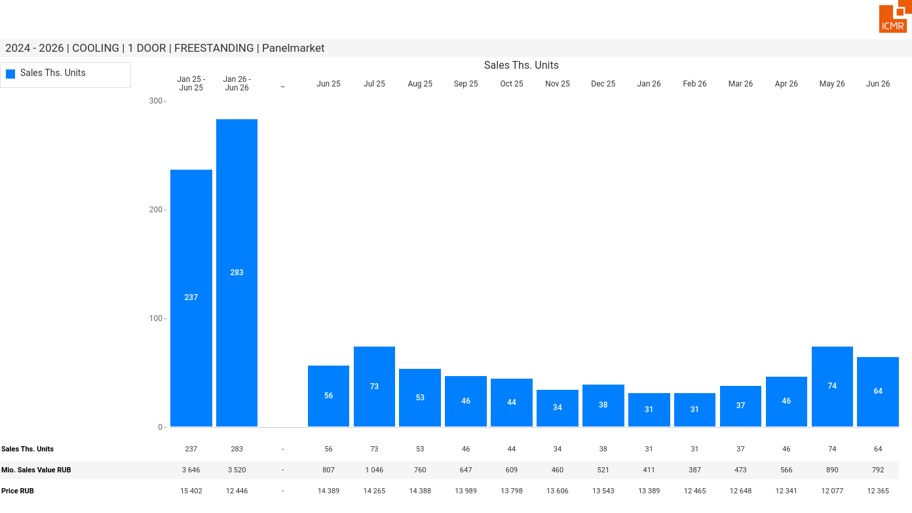
07/2026 PRJ 26fc7bc0 - TMPL d8cc54af - FRM 6760285e - ID 1

Slide 2
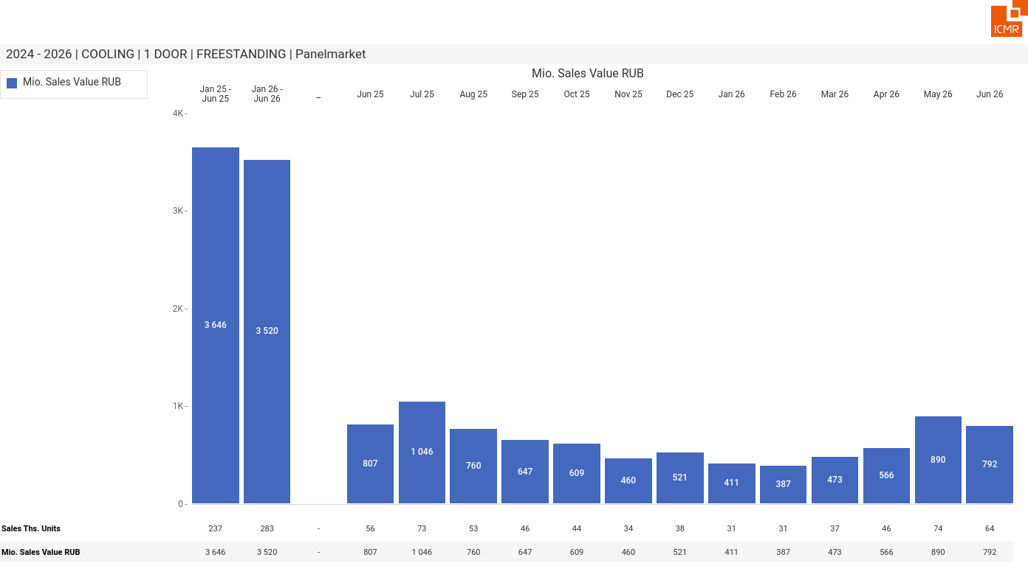
07/2026 PRJ 26fc7bc0 - TMPL d8cc54af - FRM dc205baf - ID 2

Slide 3
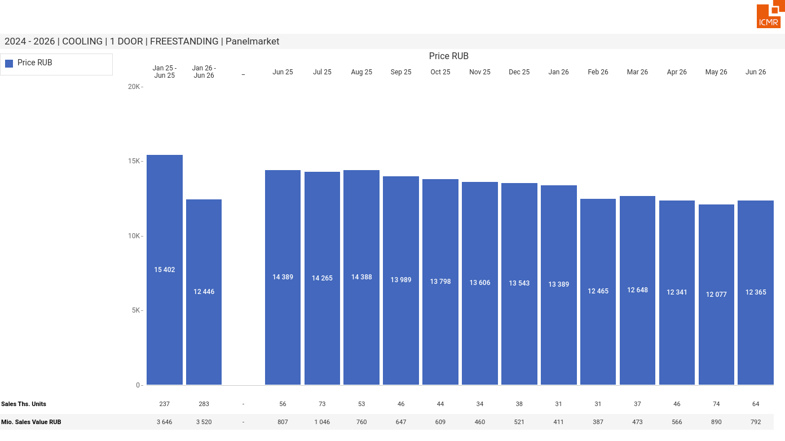
07/2026 PRJ 26fc7bc0 - TMPL d8cc54af - FRM 7ef5daae - ID 3

Slide 4
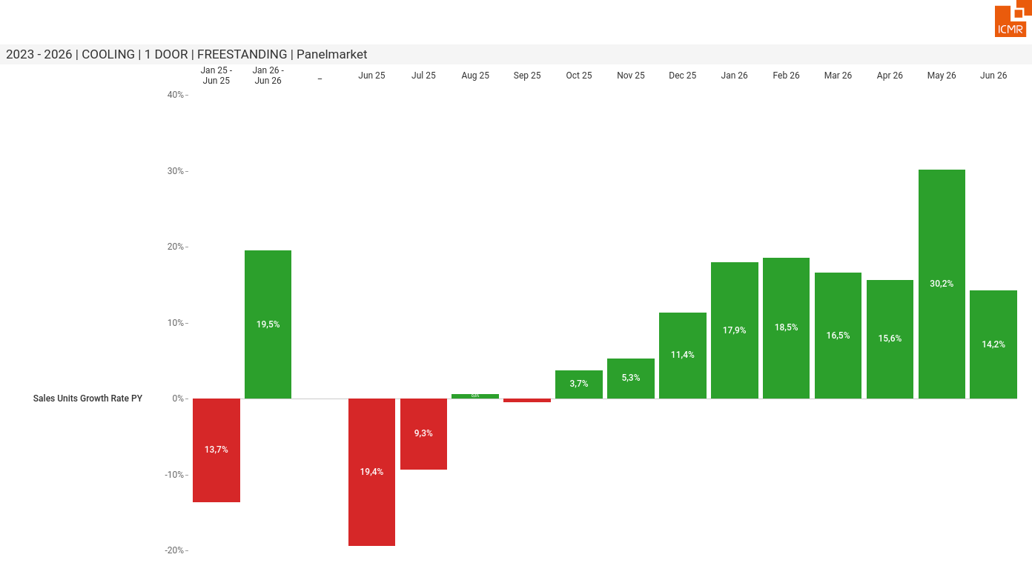
07/2026 PRJ 26fc7bc0 - TMPL d8cc54af - FRM 9e5182ff - ID 4

Slide 5
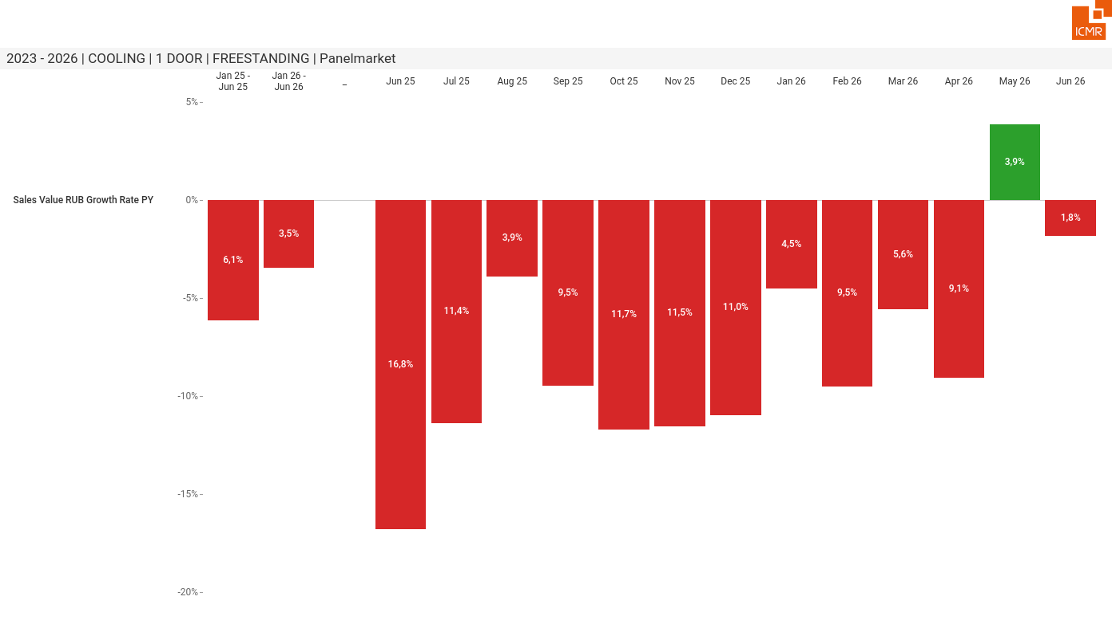
07/2026 PRJ 26fc7bc0 - TMPL d8cc54af - FRM bb4877dc - ID 5

Slide 6
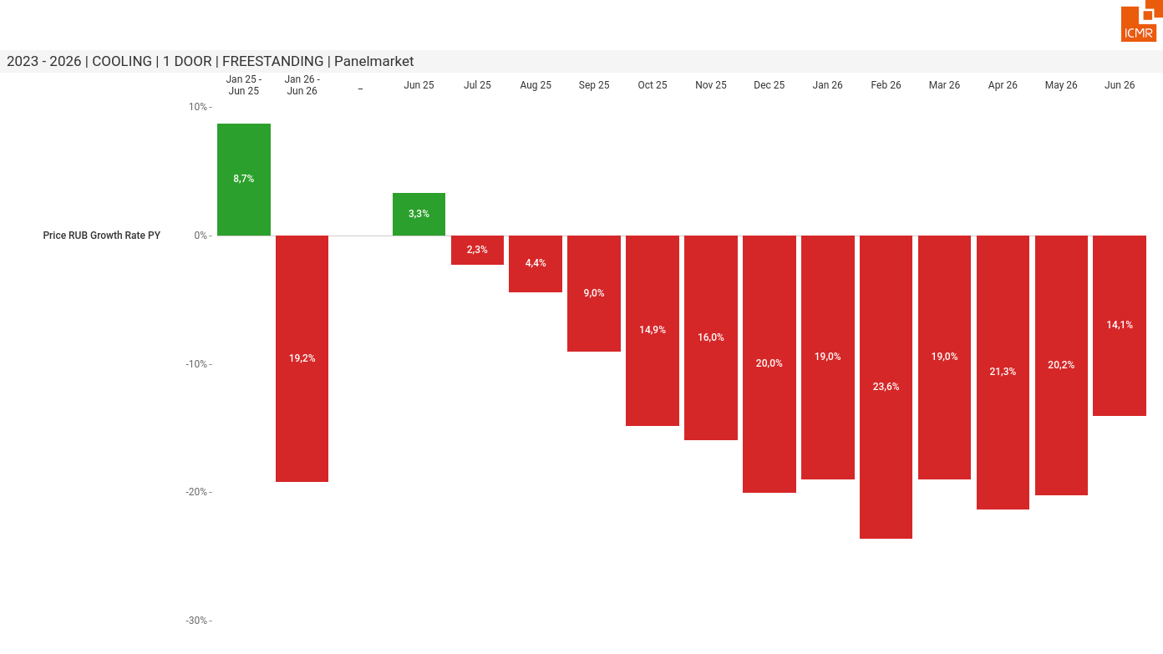
07/2026 PRJ 26fc7bc0 - TMPL d8cc54af - FRM 57f9077e - ID 6

Slide 7
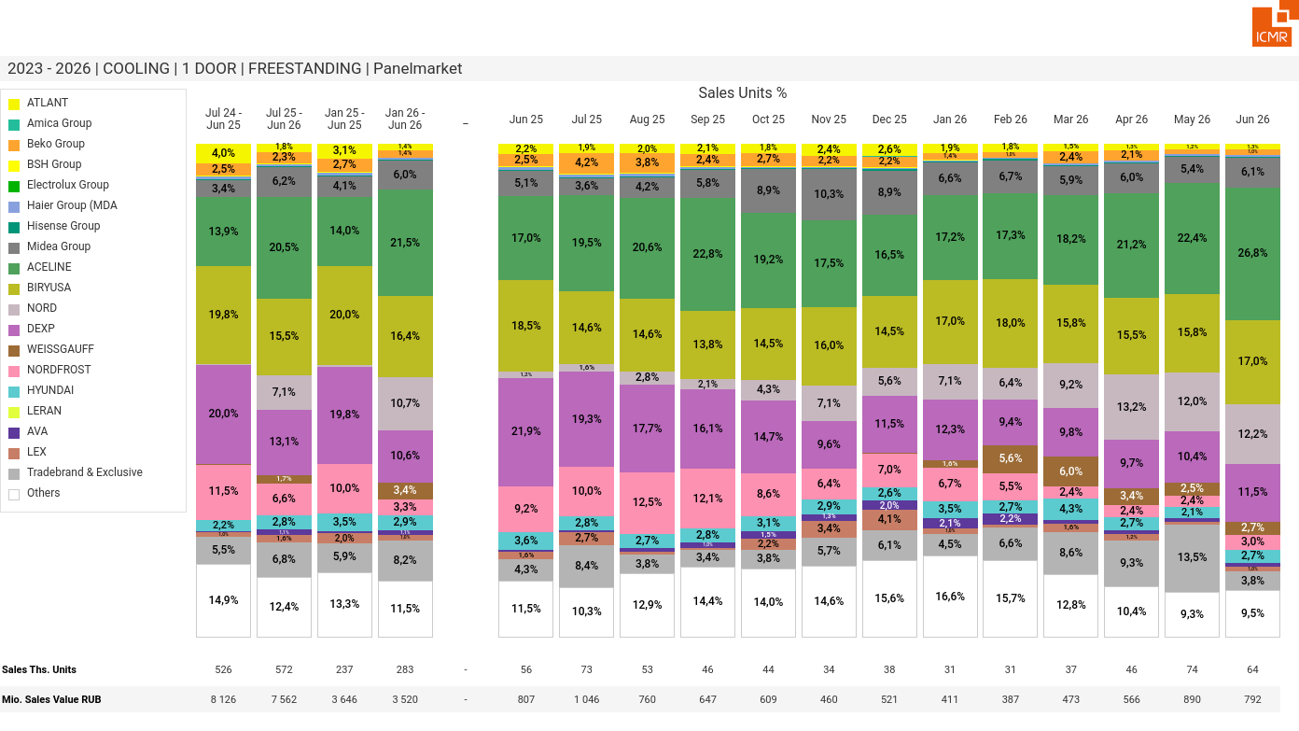
07/2026 PRJ 26fc7bc0 - TMPL d8cc54af - FRM cba1dcda - ID 7

Slide 8
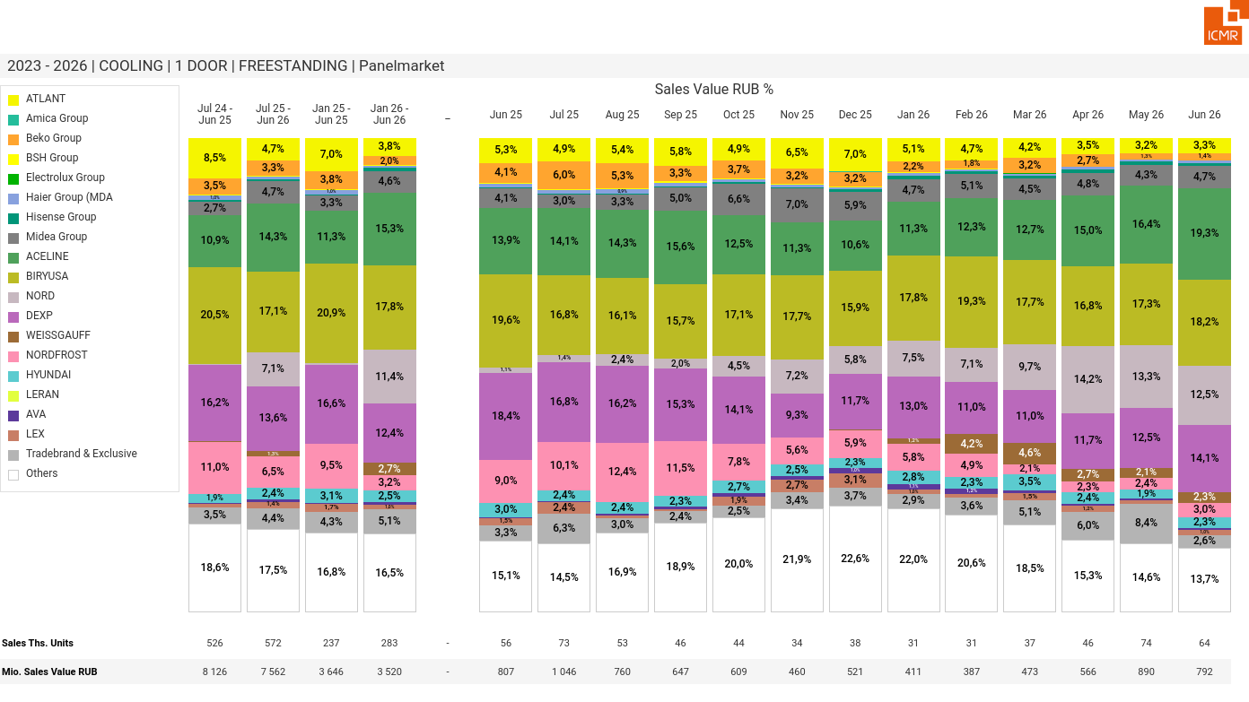
07/2026 PRJ 26fc7bc0 - TMPL d8cc54af - FRM 24482f2f - ID 8

Slide 9
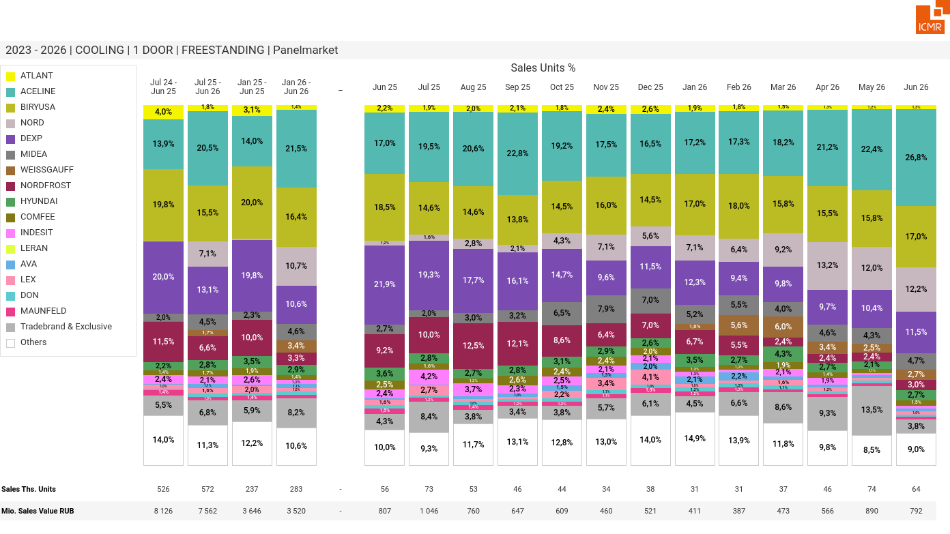
07/2026 PRJ 26fc7bc0 - TMPL d8cc54af - FRM be7f920e - ID 9

Slide 10
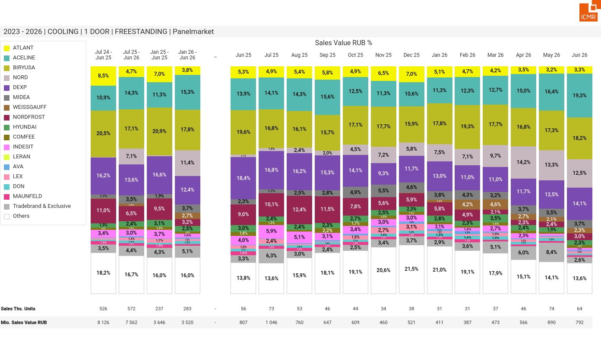
07/2026 PRJ 26fc7bc0 - TMPL d8cc54af - FRM 1061198c - ID 10

Slide 11
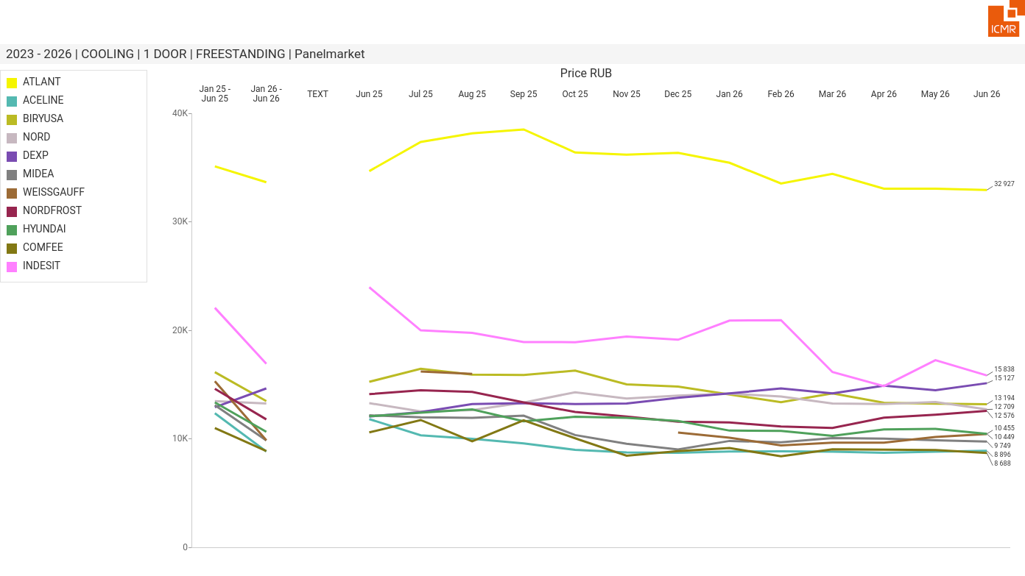
07/2026 PRJ 26fc7bc0 - TMPL d8cc54af - FRM 58fb3387 - ID 11

Slide 12
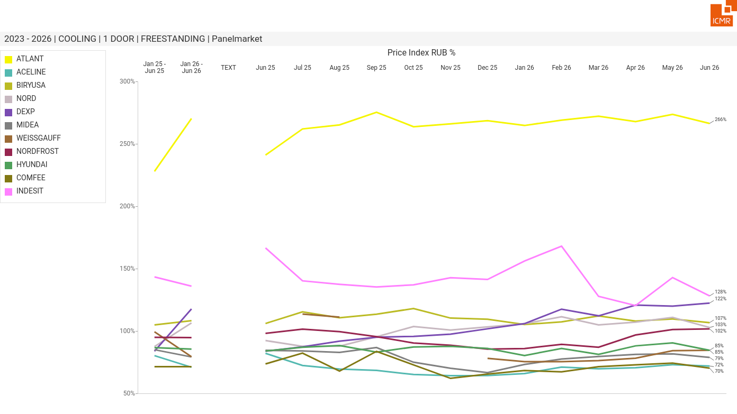
07/2026 PRJ 26fc7bc0 - TMPL d8cc54af - FRM 8b5ceaca - ID 12

Slide 13
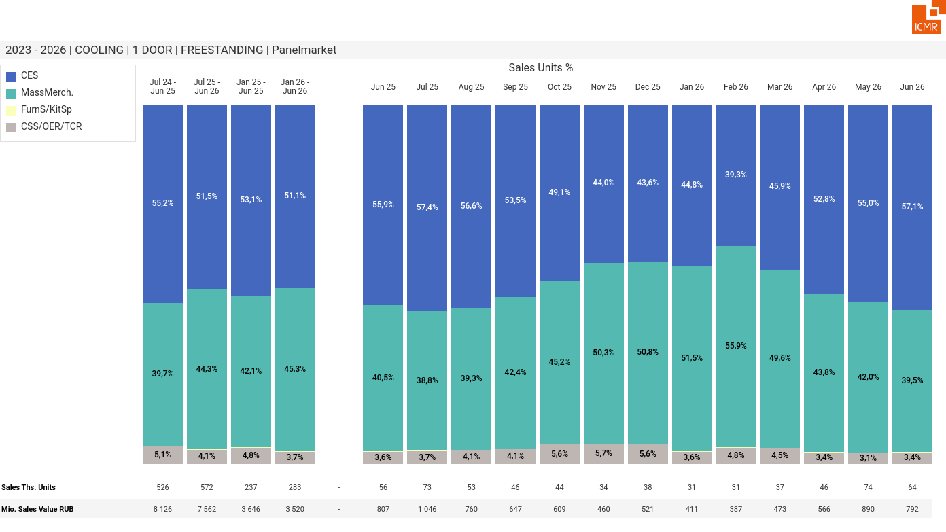
07/2026 PRJ 26fc7bc0 - TMPL d8cc54af - FRM 0042588b - ID 13

Slide 14
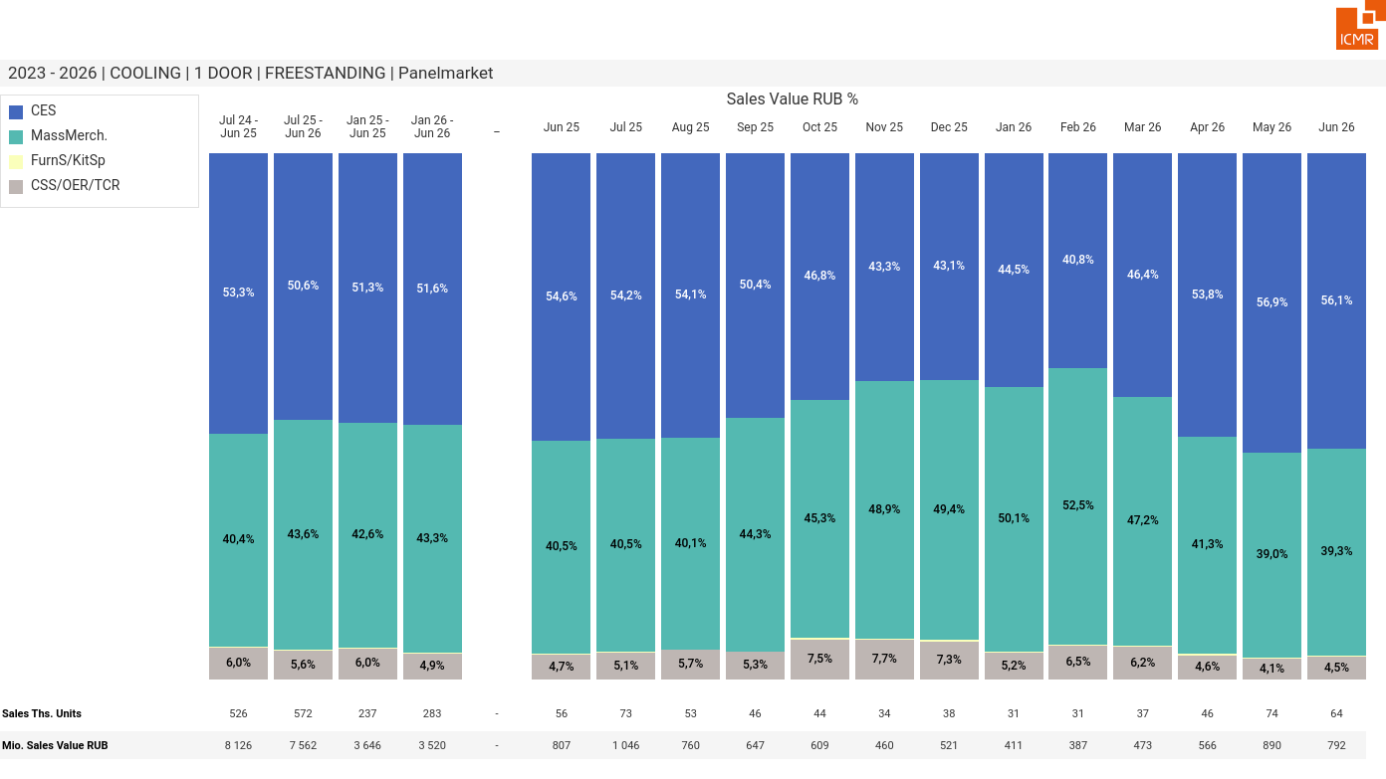
07/2026 PRJ 26fc7bc0 - TMPL d8cc54af - FRM d60eb198 - ID 14

Slide 15
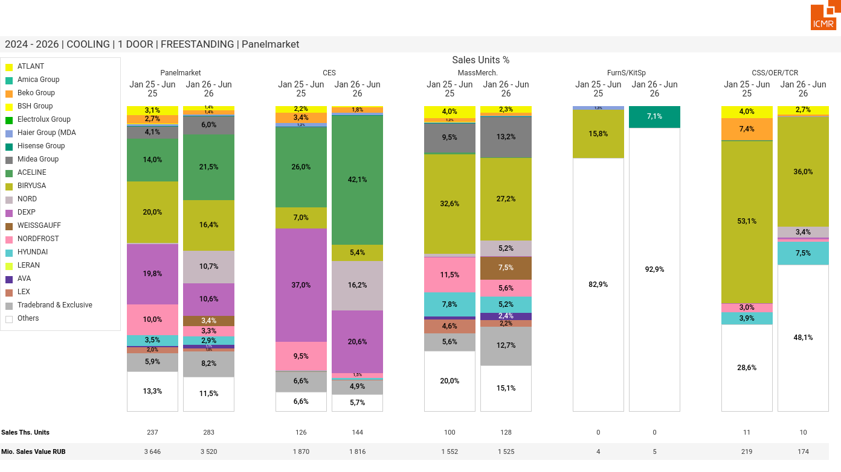
07/2026 PRJ 26fc7bc0 - TMPL d8cc54af - FRM afdf1ccf - ID 15

Slide 16
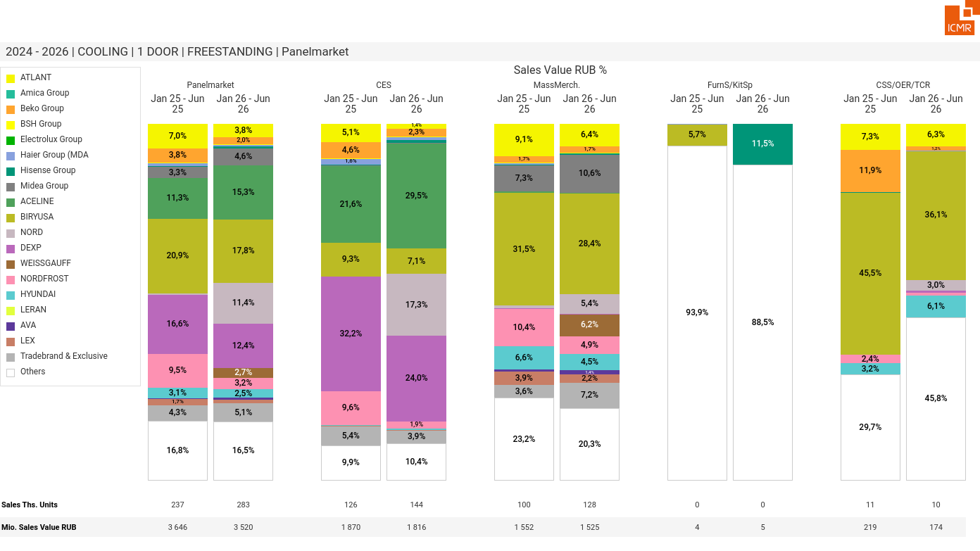
07/2026 PRJ 26fc7bc0 - TMPL d8cc54af - FRM fa045117 - ID 16

Slide 17
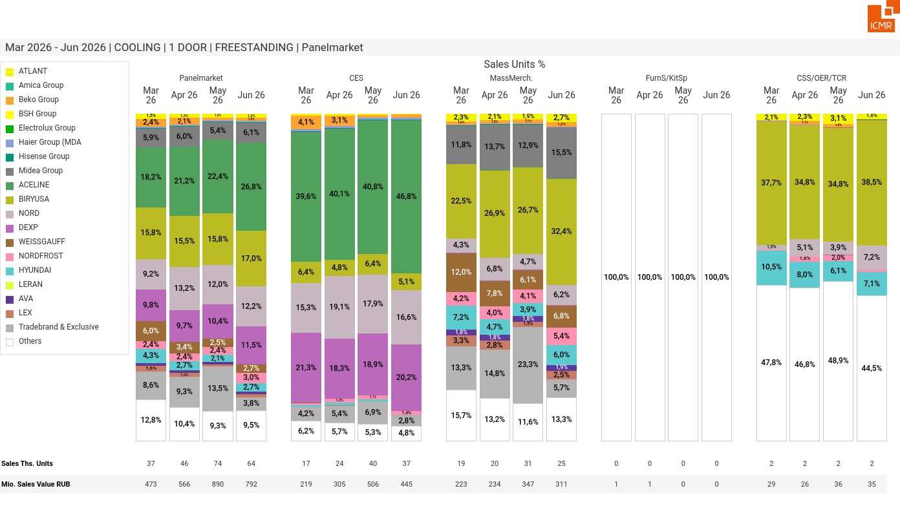
07/2026 PRJ 26fc7bc0 - TMPL d8cc54af - FRM 69fc4190 - ID 17

Slide 18
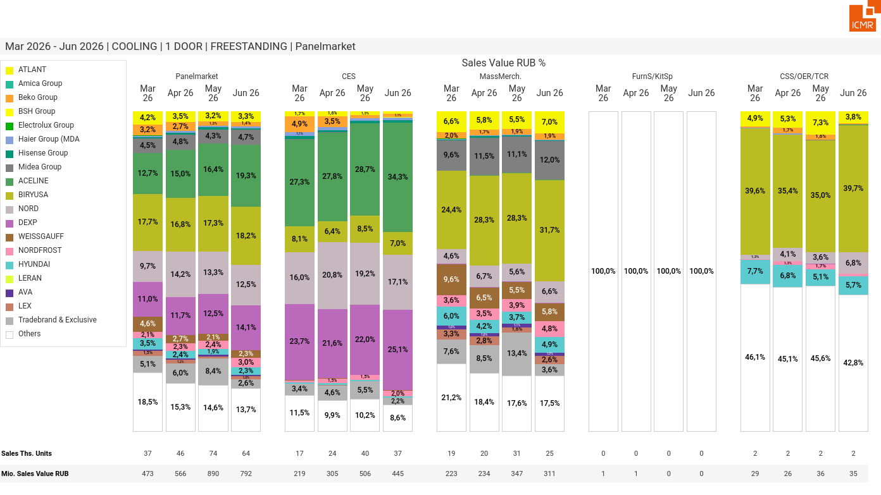
07/2026 PRJ 26fc7bc0 - TMPL d8cc54af - FRM b2dbc581 - ID 18

Slide 19
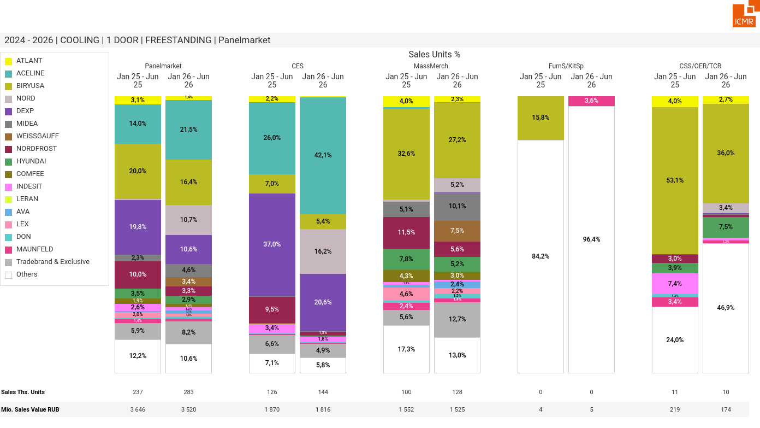
07/2026 PRJ 26fc7bc0 - TMPL d8cc54af - FRM 03a688a2 - ID 19

Slide 20
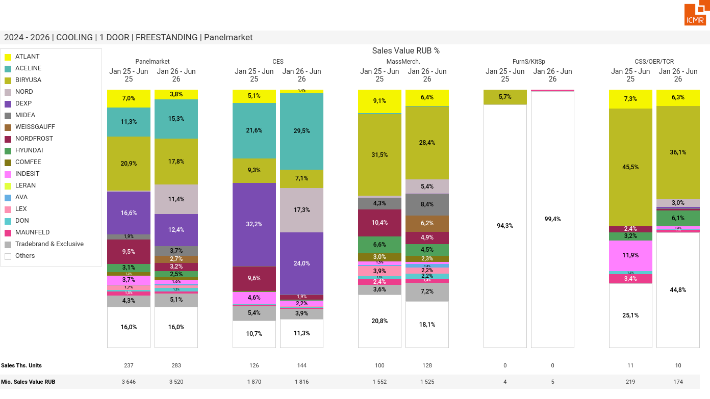
07/2026 PRJ 26fc7bc0 - TMPL d8cc54af - FRM 48453dea - ID 20

Slide 21
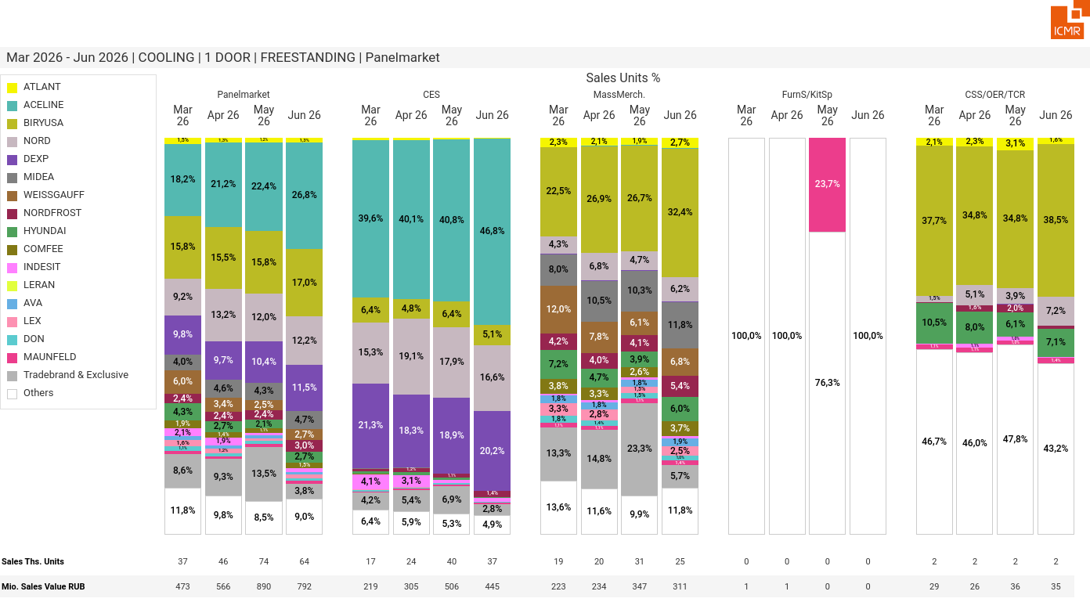
07/2026 PRJ 26fc7bc0 - TMPL d8cc54af - FRM a1ae8c44 - ID 21

Slide 22
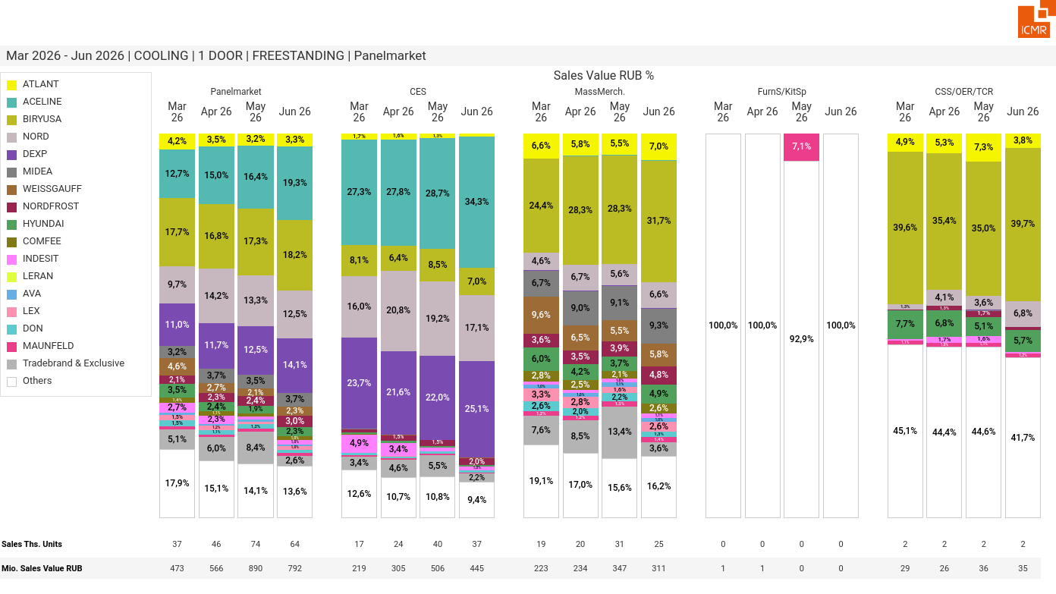
07/2026 PRJ 26fc7bc0 - TMPL d8cc54af - FRM 806fd1bf - ID 22

Slide 23
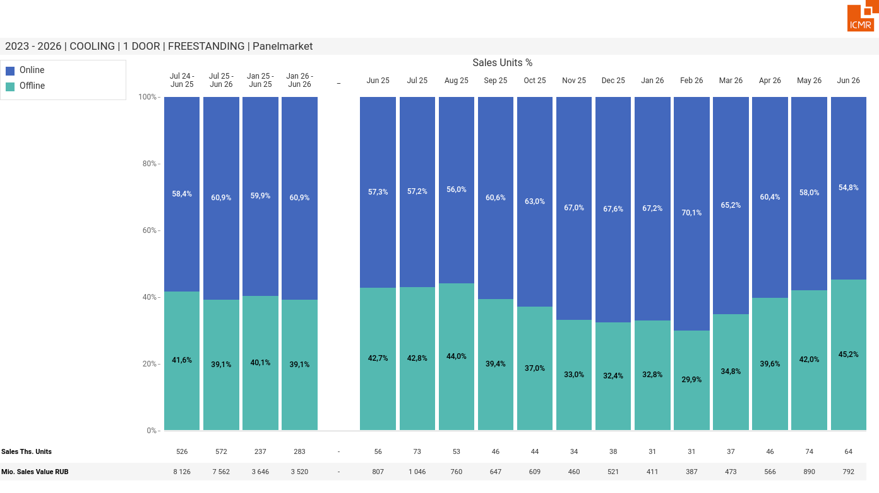
07/2026 PRJ 26fc7bc0 - TMPL d8cc54af - FRM e6b60794 - ID 23

Slide 24
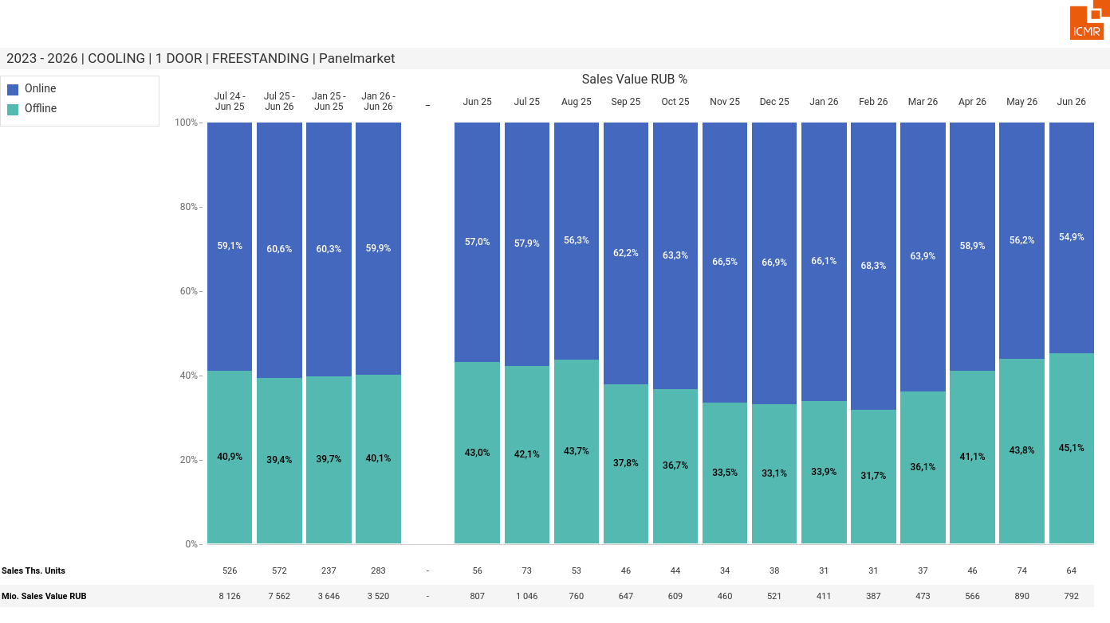
07/2026 PRJ 26fc7bc0 - TMPL d8cc54af - FRM 3d38b5fa - ID 24

Slide 25
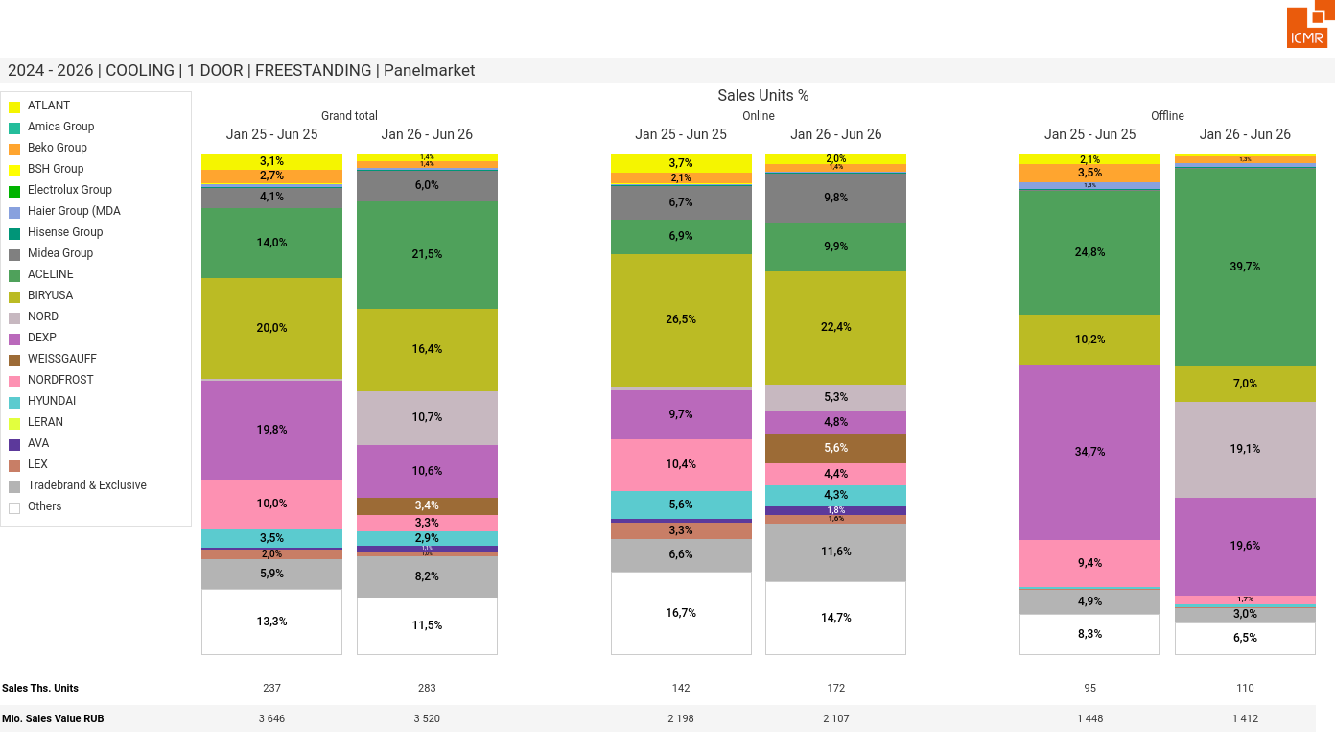
07/2026 PRJ 26fc7bc0 - TMPL d8cc54af - FRM 69dc8b63 - ID 25

Slide 26
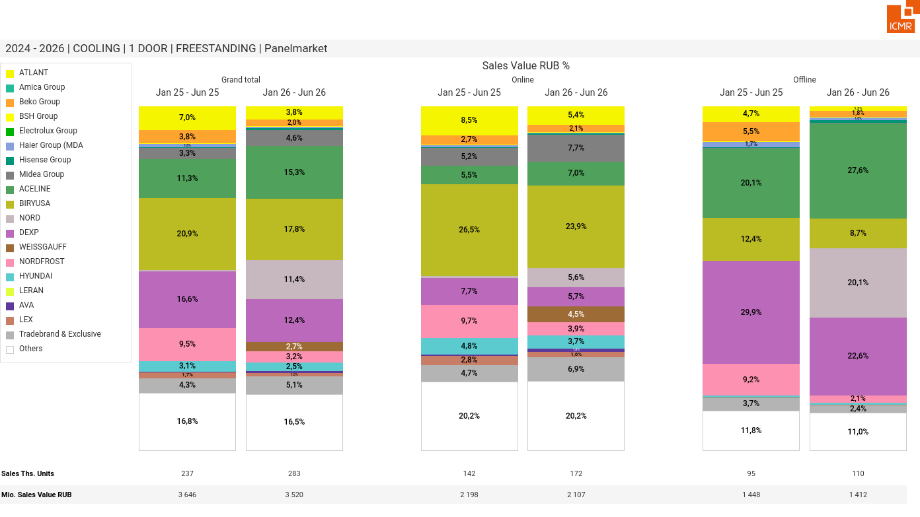
07/2026 PRJ 26fc7bc0 - TMPL d8cc54af - FRM bb7ca497 - ID 26

Slide 27
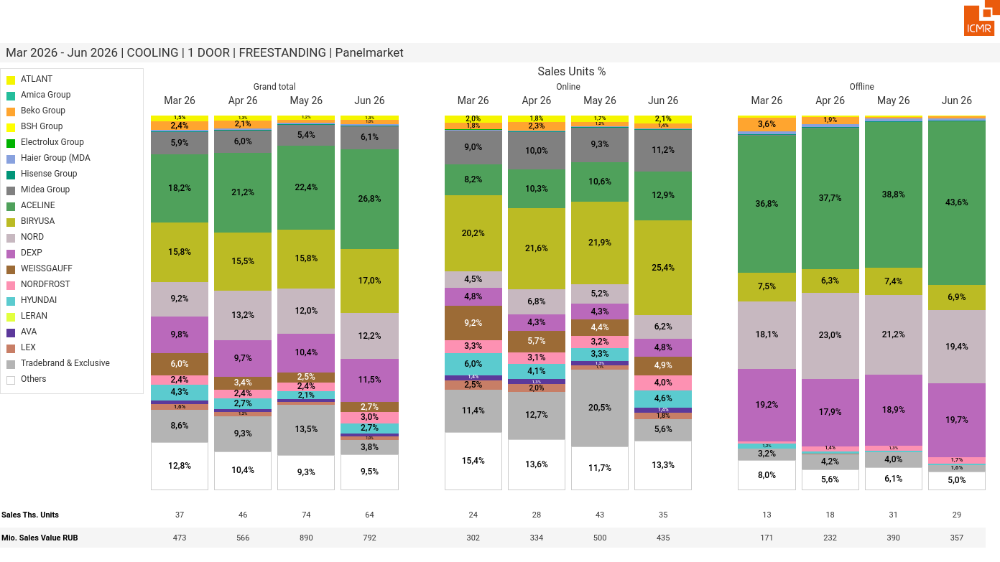
07/2026 PRJ 26fc7bc0 - TMPL d8cc54af - FRM 78508ae6 - ID 27

Slide 28
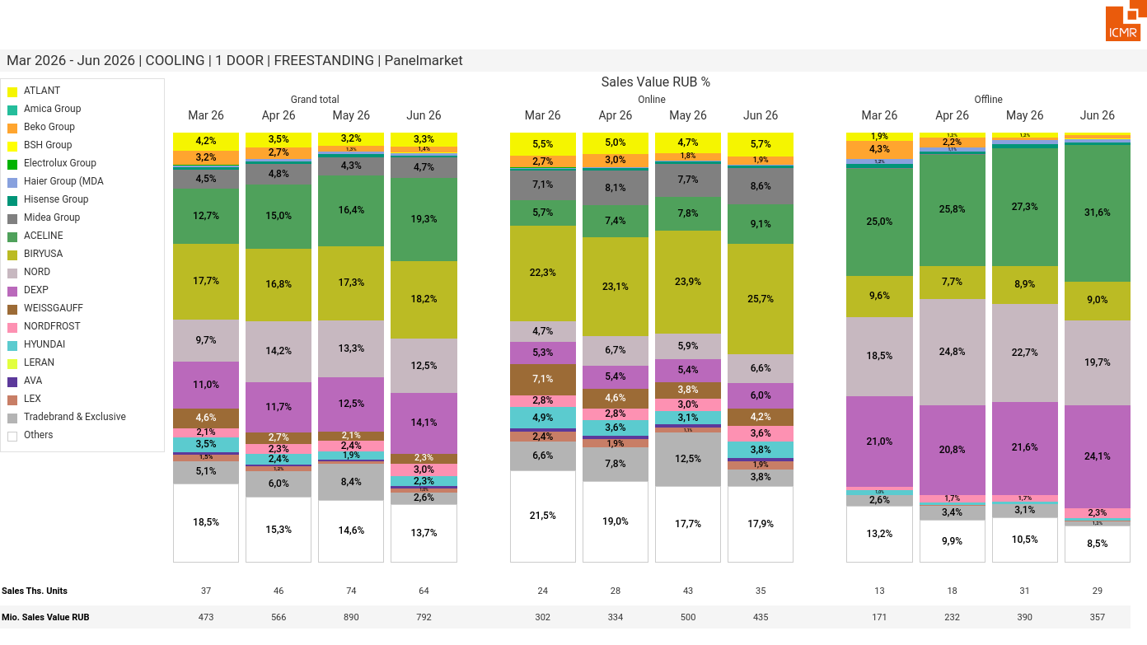
07/2026 PRJ 26fc7bc0 - TMPL d8cc54af - FRM 8289a37d - ID 28

Slide 29
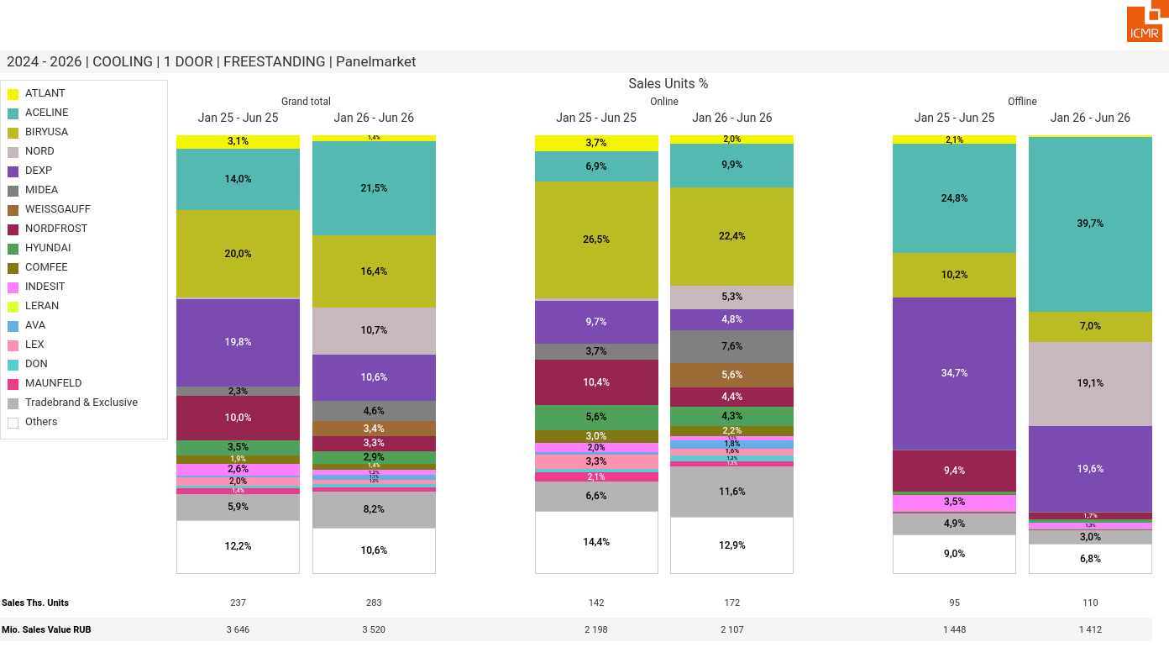
07/2026 PRJ 26fc7bc0 - TMPL d8cc54af - FRM 4ec8765b - ID 29

Slide 30
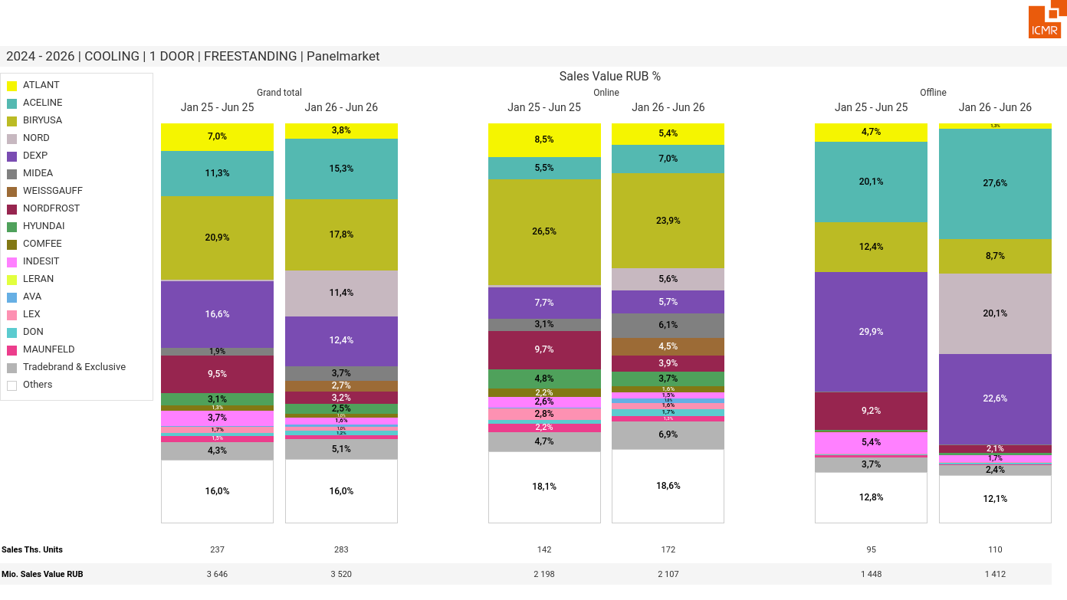
07/2026 PRJ 26fc7bc0 - TMPL d8cc54af - FRM a840f48b - ID 30

Slide 31
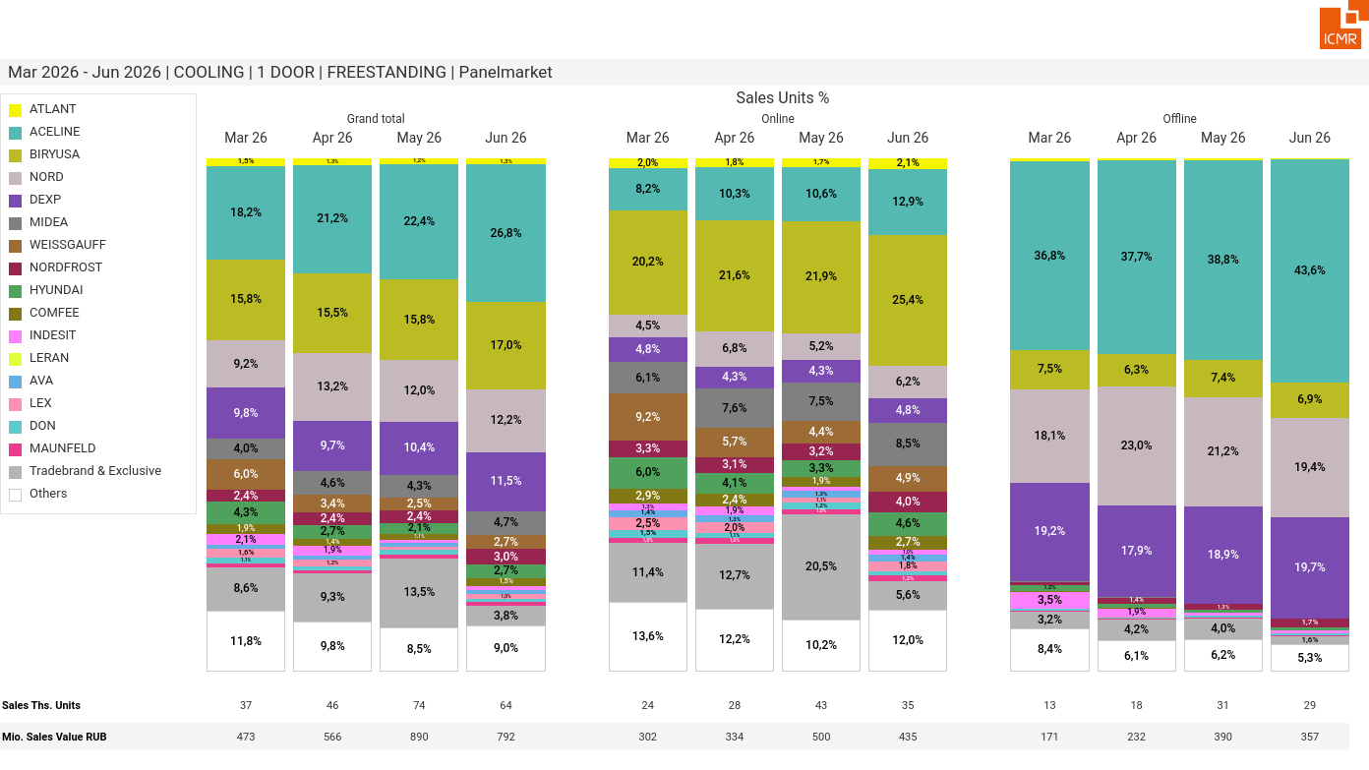
07/2026 PRJ 26fc7bc0 - TMPL d8cc54af - FRM d80c3782 - ID 31

Slide 32
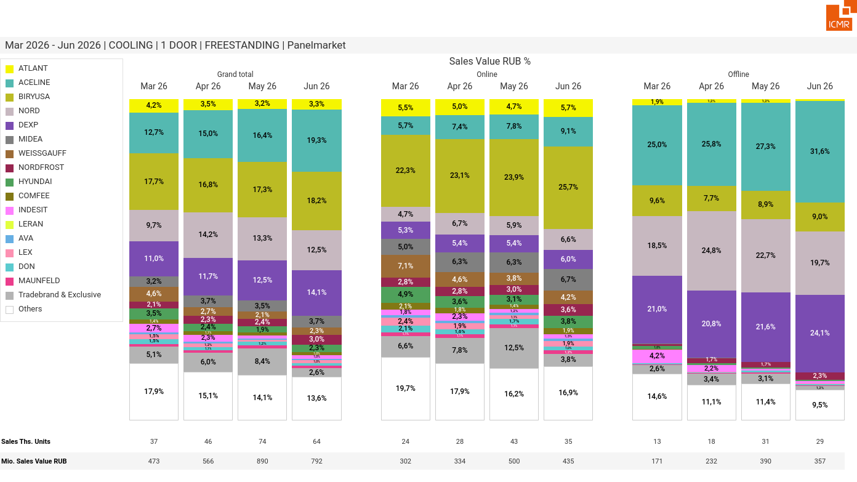
07/2026 PRJ 26fc7bc0 - TMPL d8cc54af - FRM 28399f29 - ID 32

Slide 33
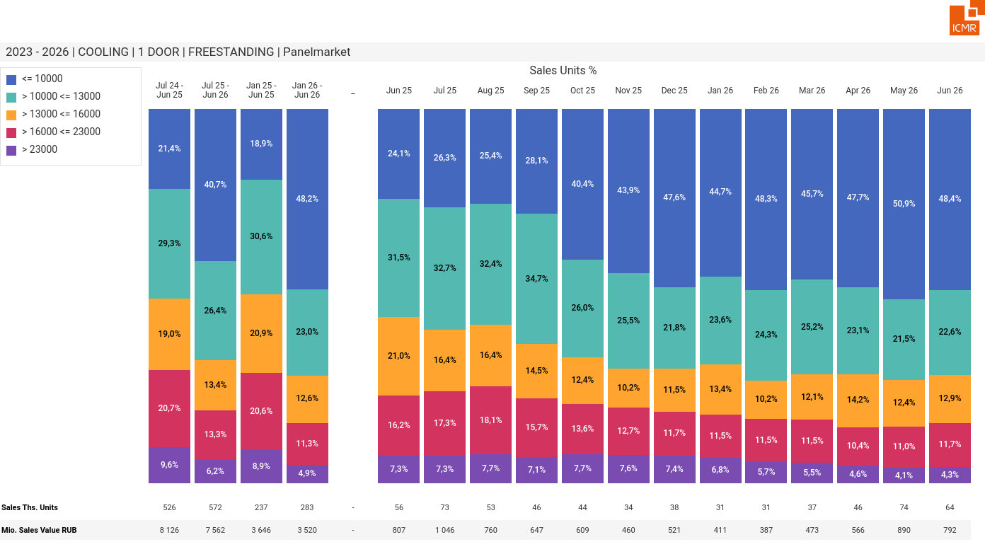
07/2026 PRJ 26fc7bc0 - TMPL d8cc54af - FRM d73ecab0 - ID 33

Slide 34
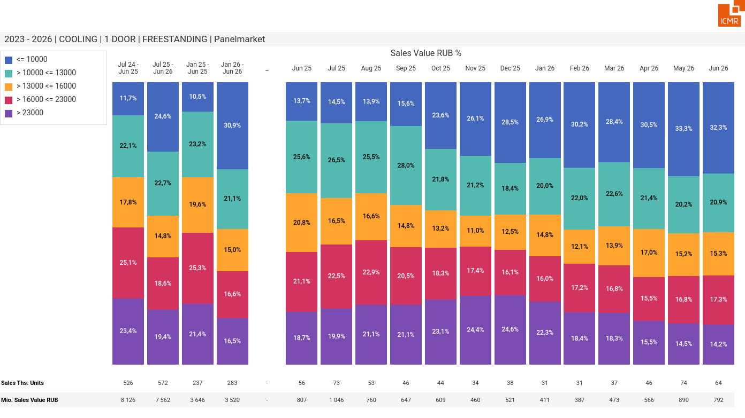
07/2026 PRJ 26fc7bc0 - TMPL d8cc54af - FRM fc2a41a3 - ID 34

Slide 35
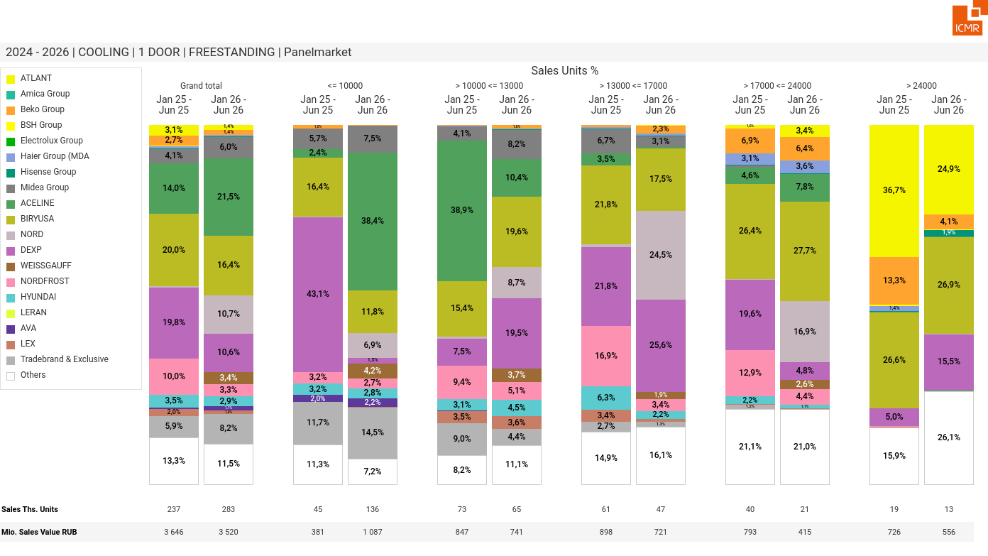
07/2026 PRJ 26fc7bc0 - TMPL d8cc54af - FRM 5c57fc68 - ID 35

Slide 36
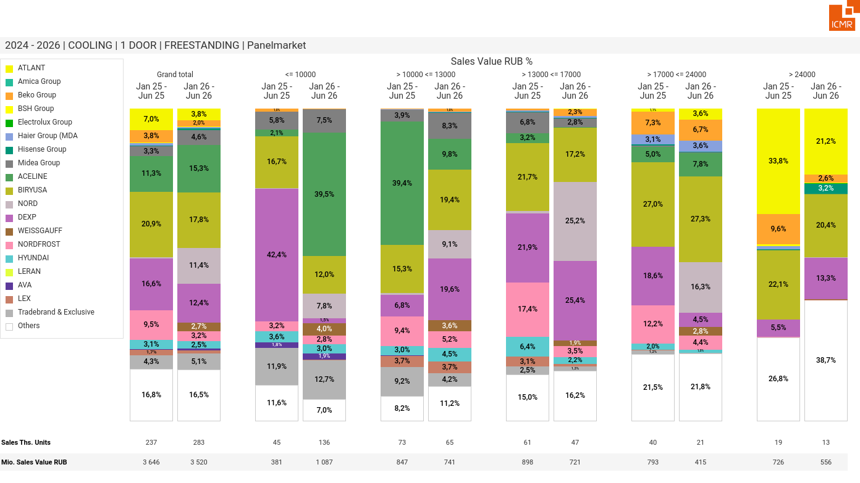
07/2026 PRJ 26fc7bc0 - TMPL d8cc54af - FRM 43728ded - ID 36

Slide 37
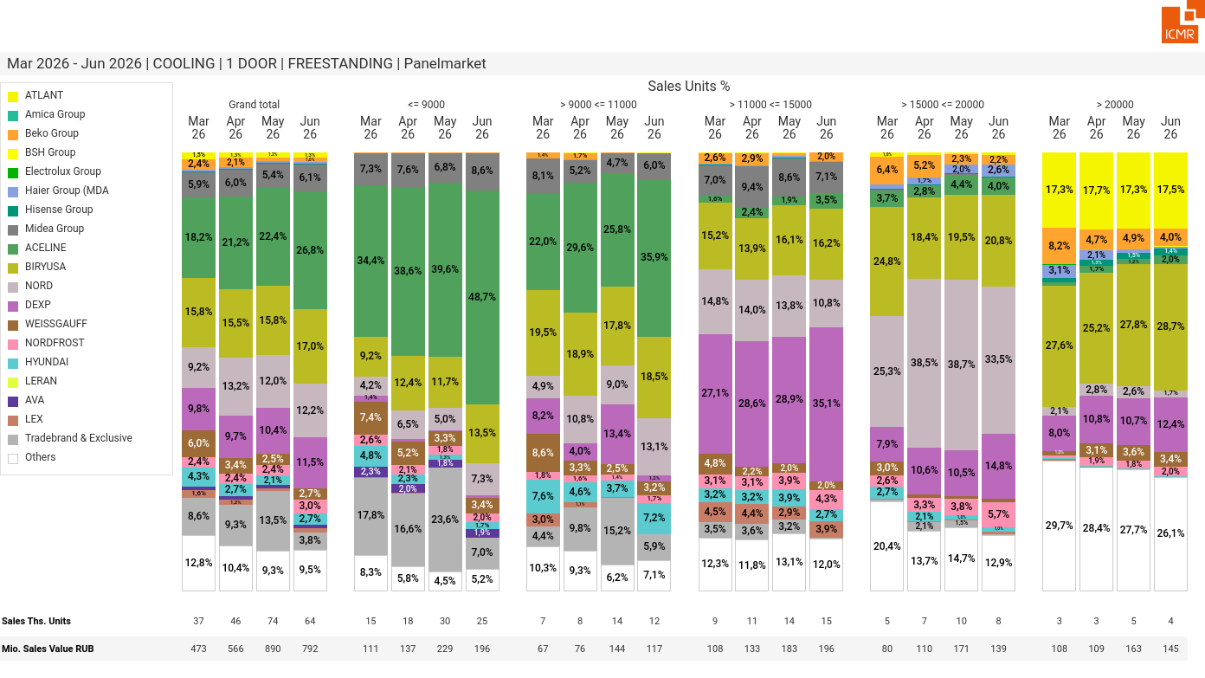
07/2026 PRJ 26fc7bc0 - TMPL d8cc54af - FRM 172efd18 - ID 37

Slide 38
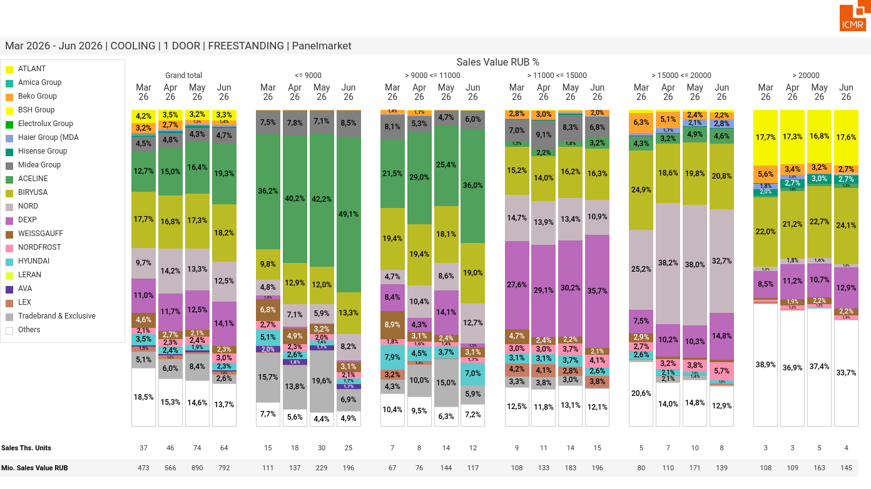
07/2026 PRJ 26fc7bc0 - TMPL d8cc54af - FRM 774de83f - ID 38

Slide 39
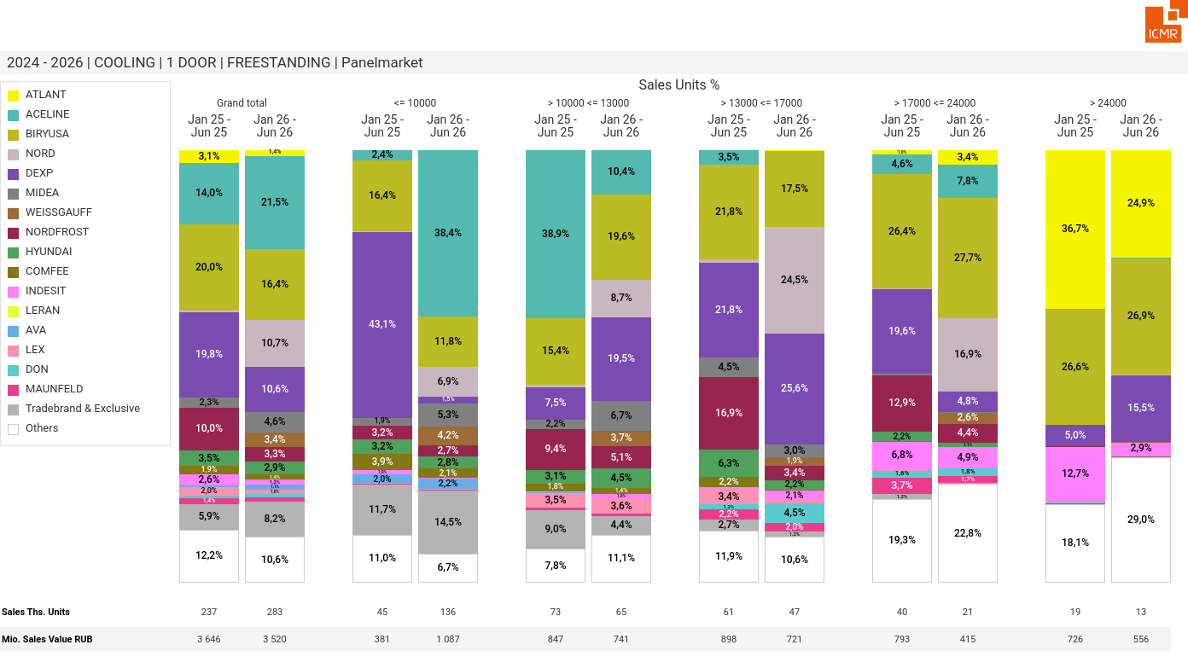
07/2026 PRJ 26fc7bc0 - TMPL d8cc54af - FRM cf06e96b - ID 39

Slide 40
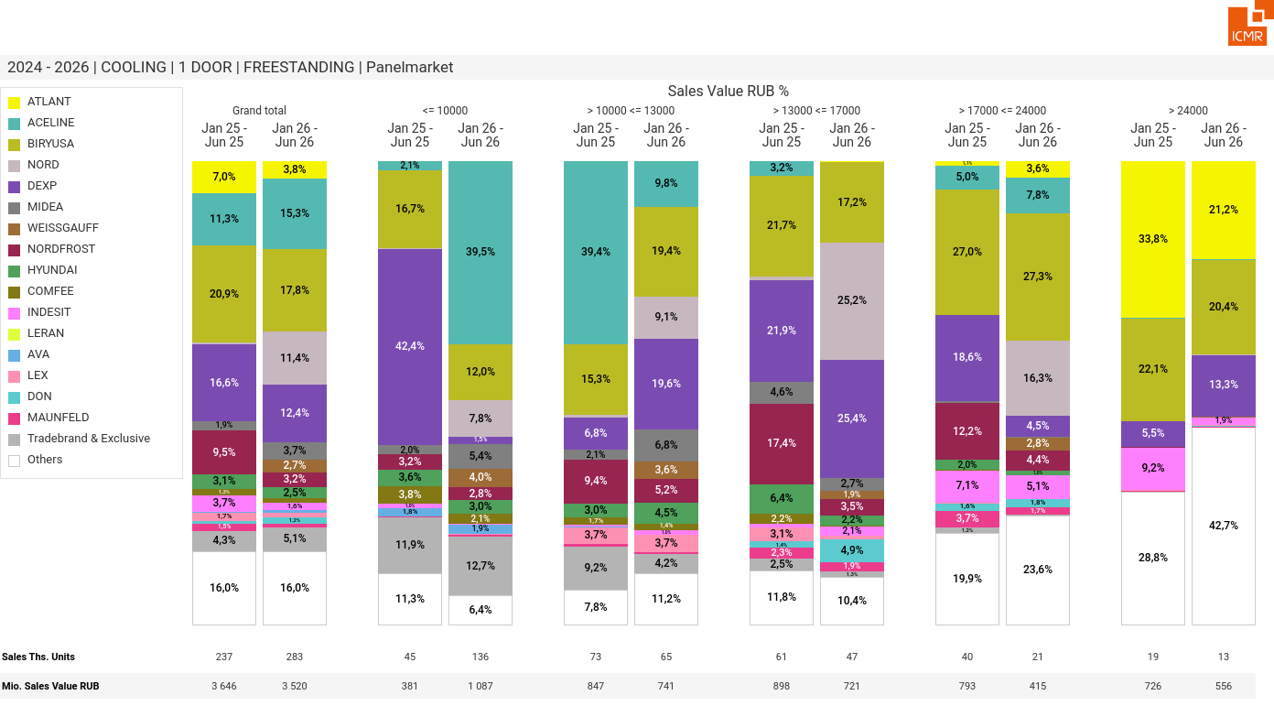
07/2026 PRJ 26fc7bc0 - TMPL d8cc54af - FRM a96fb4d1 - ID 40

Slide 41
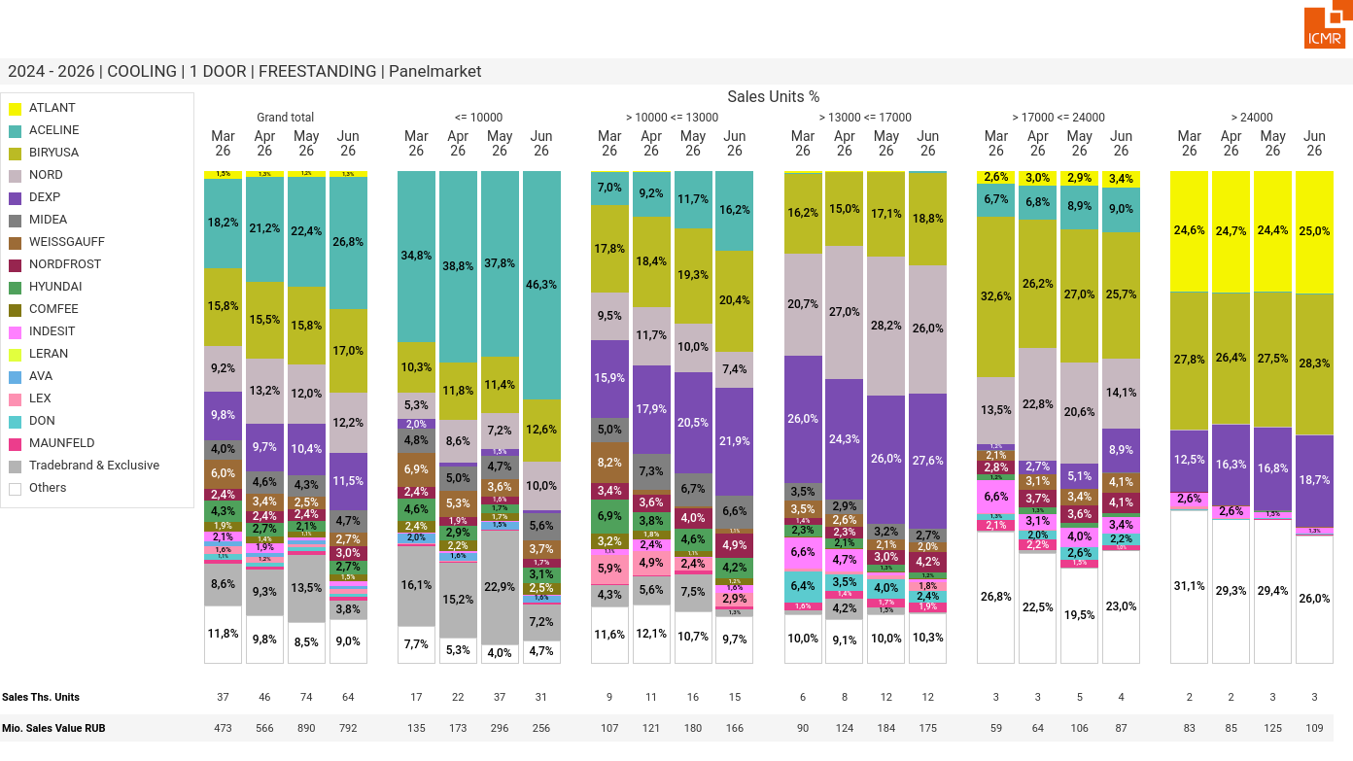
07/2026 PRJ 26fc7bc0 - TMPL d8cc54af - FRM 30c30242 - ID 41

Slide 42
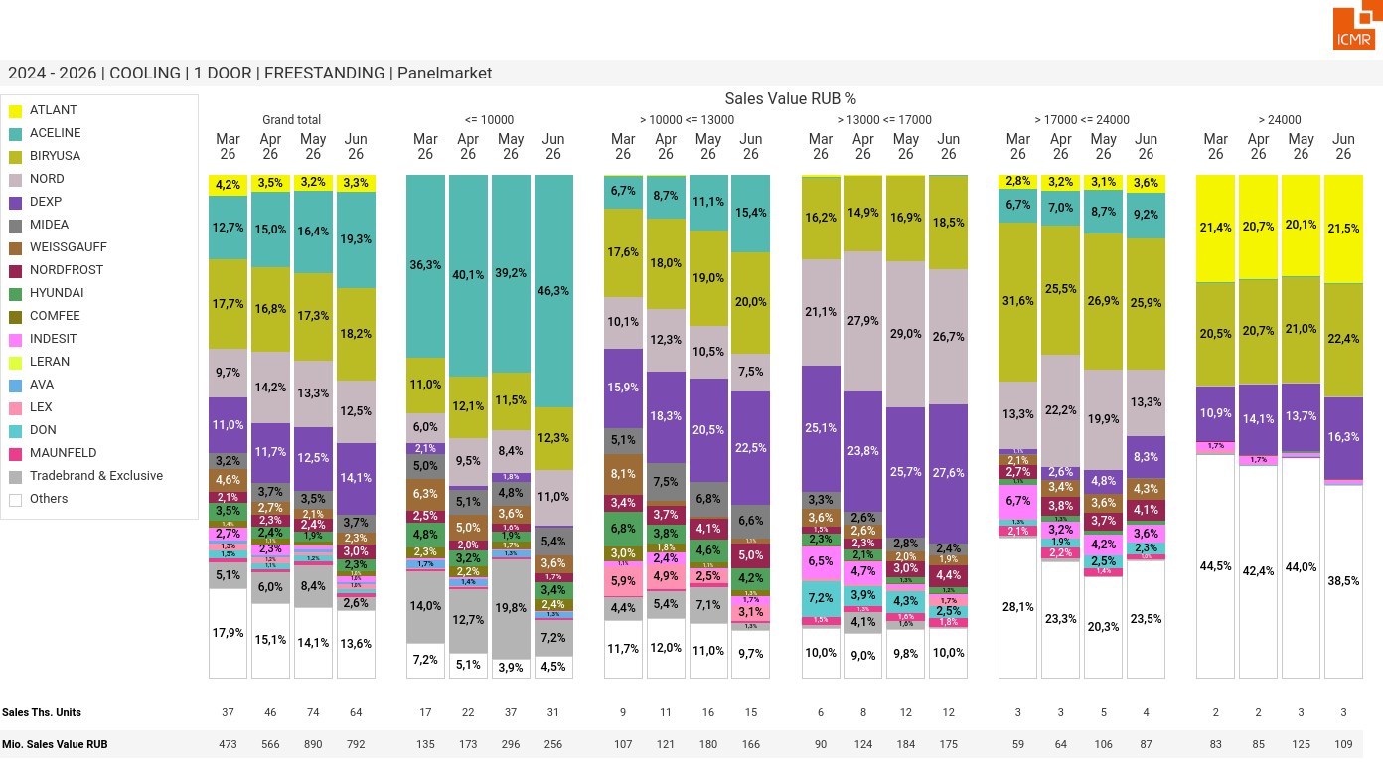
07/2026 PRJ 26fc7bc0 - TMPL d8cc54af - FRM 7ce108a1 - ID 42

Slide 43
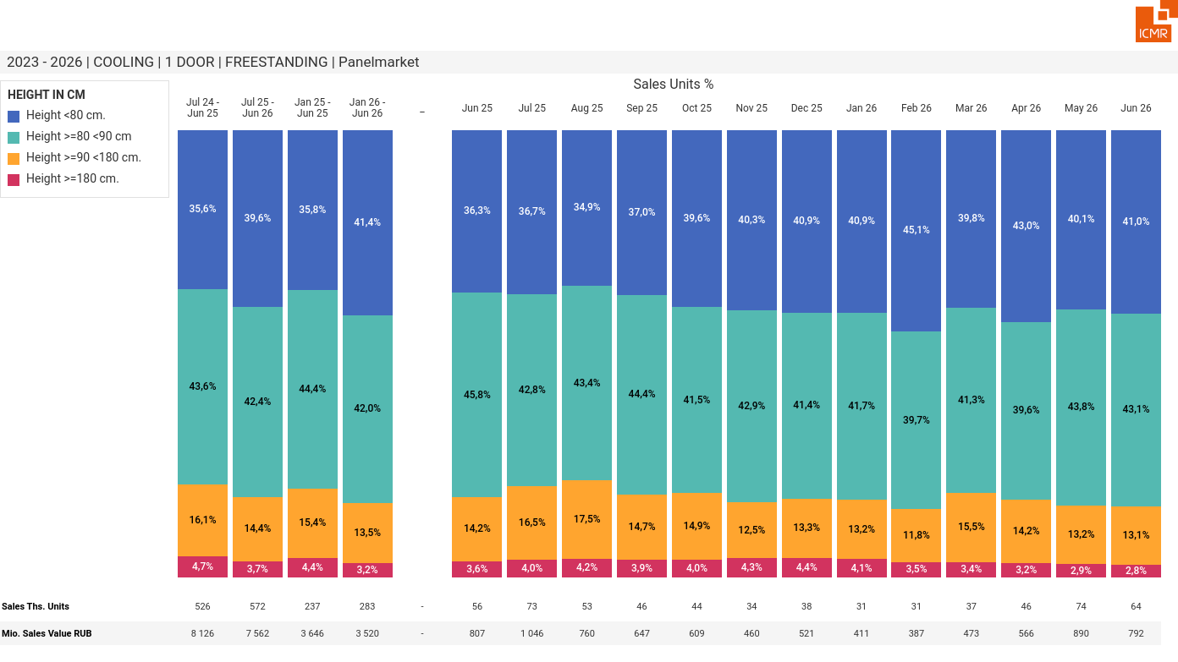
07/2026 PRJ 26fc7bc0 - TMPL d8cc54af - FRM d77ef055 - ID 43

Slide 44
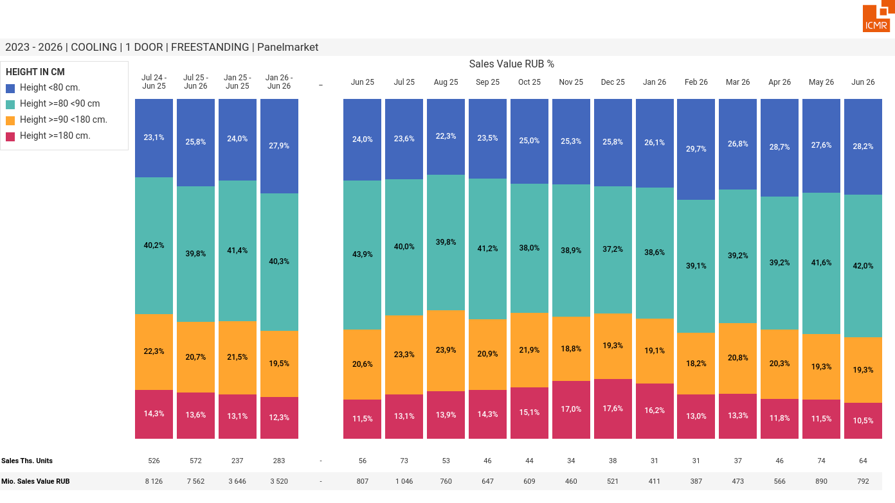
07/2026 PRJ 26fc7bc0 - TMPL d8cc54af - FRM 5ada3612 - ID 44

Slide 45
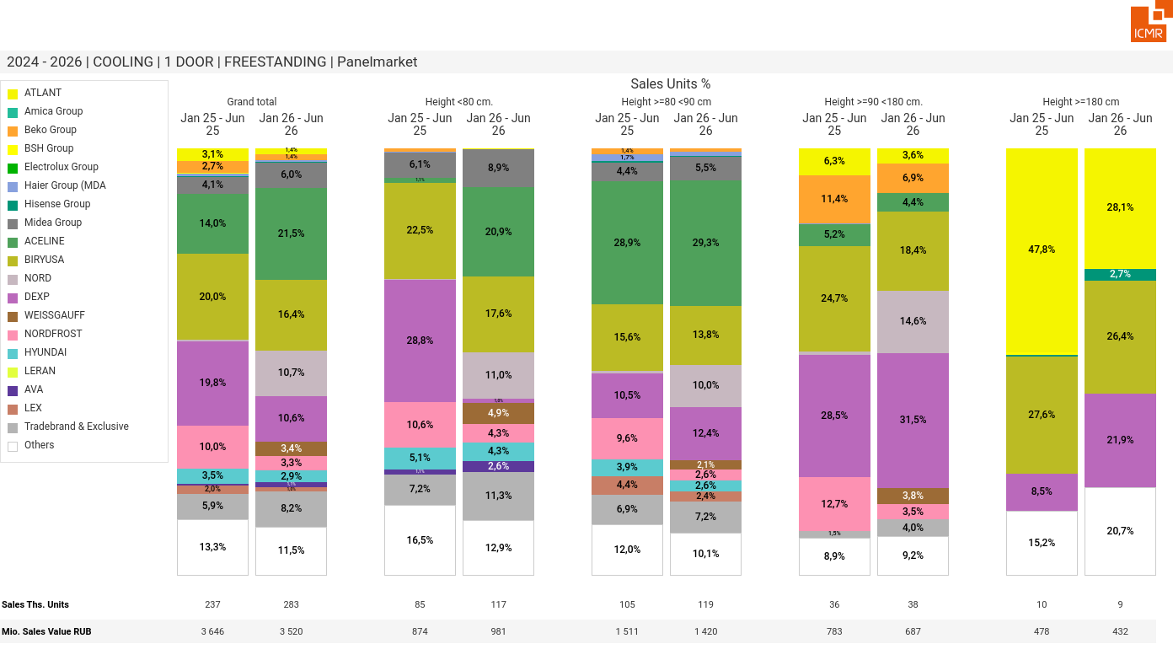
07/2026 PRJ 26fc7bc0 - TMPL d8cc54af - FRM 529efb4f - ID 45

Slide 46
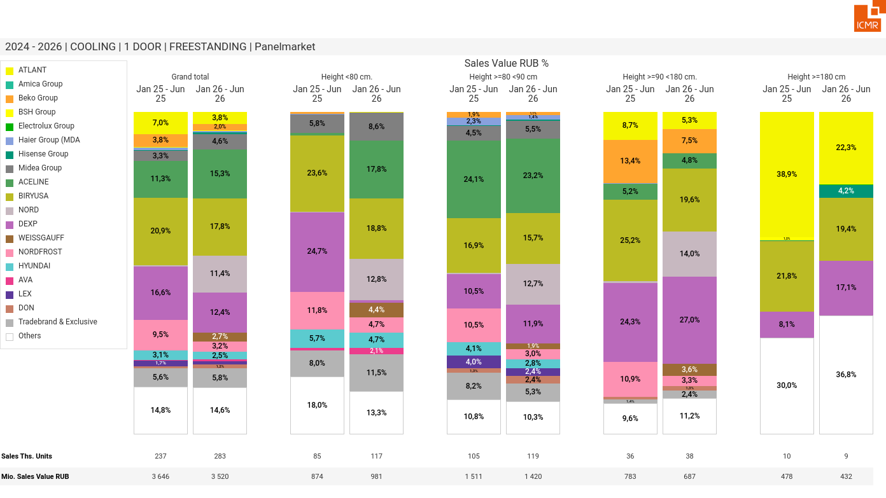
07/2026 PRJ 26fc7bc0 - TMPL d8cc54af - FRM 170241f8 - ID 1

Slide 47
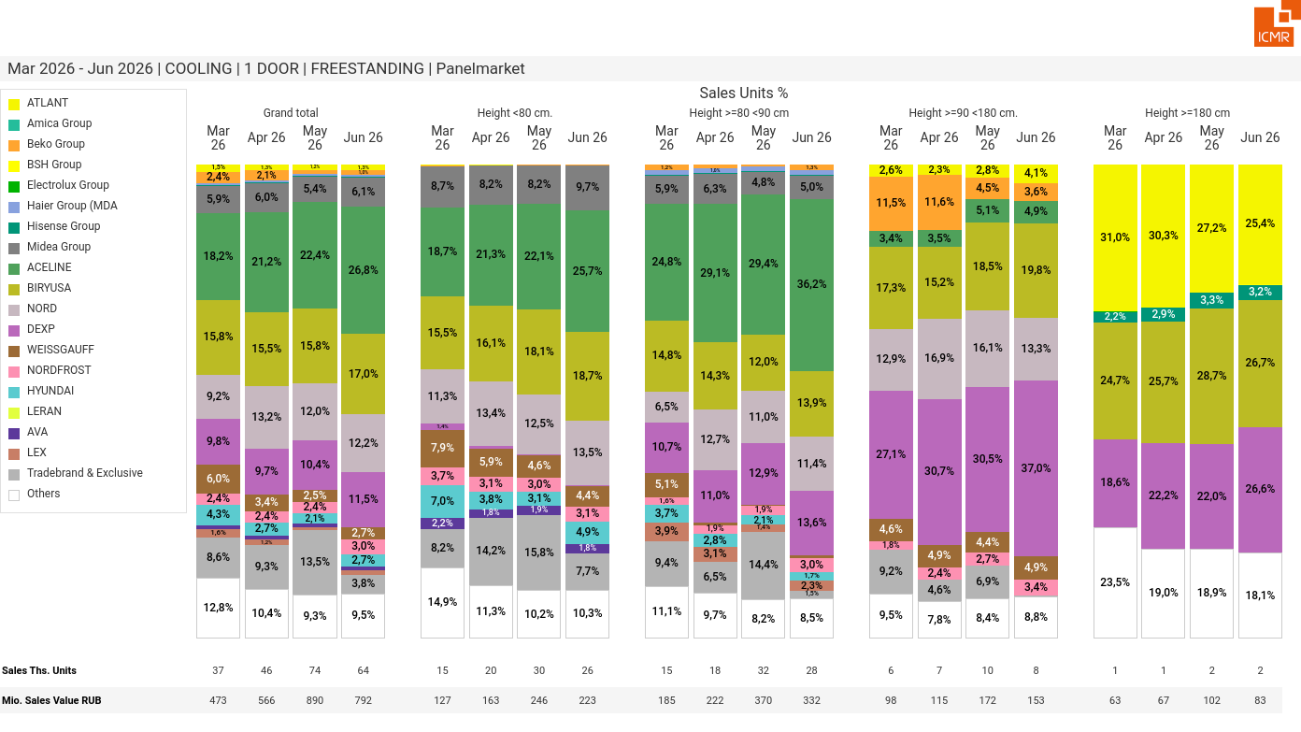
07/2026 PRJ 26fc7bc0 - TMPL d8cc54af - FRM fa01ba82 - ID 47

Slide 48
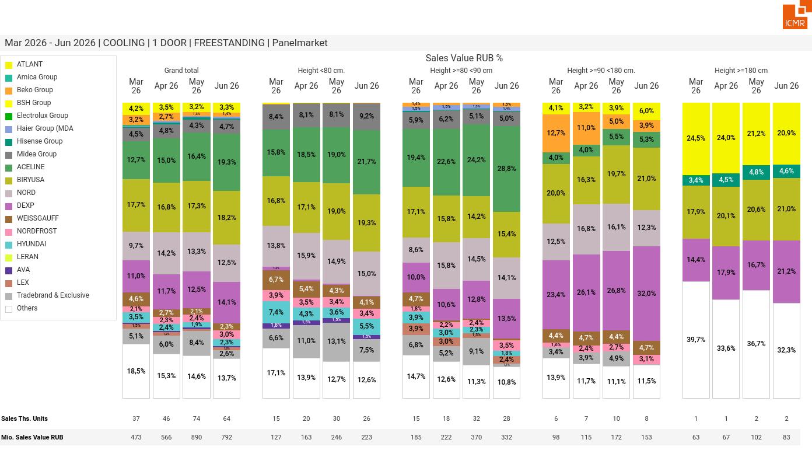
07/2026 PRJ 26fc7bc0 - TMPL d8cc54af - FRM df1bbcd6 - ID 48

Slide 49
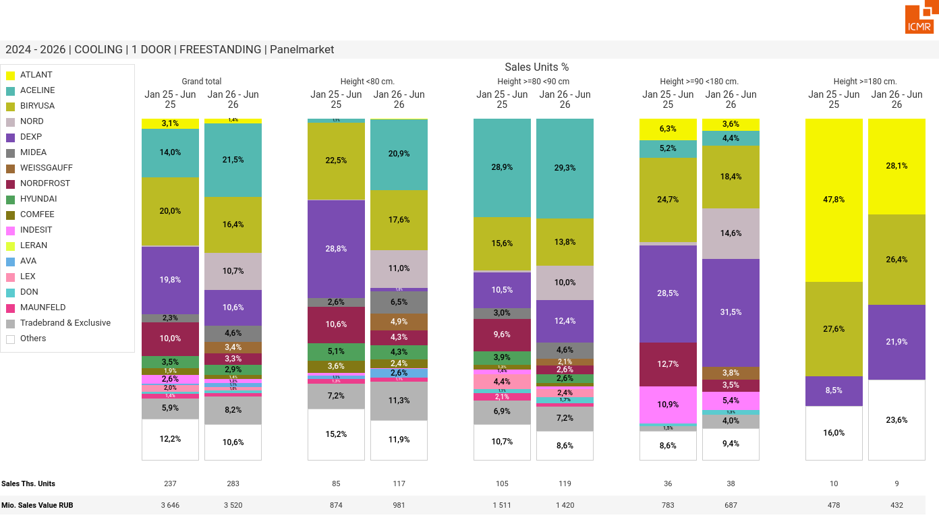
07/2026 PRJ 26fc7bc0 - TMPL d8cc54af - FRM 7258654c - ID 49

Slide 50
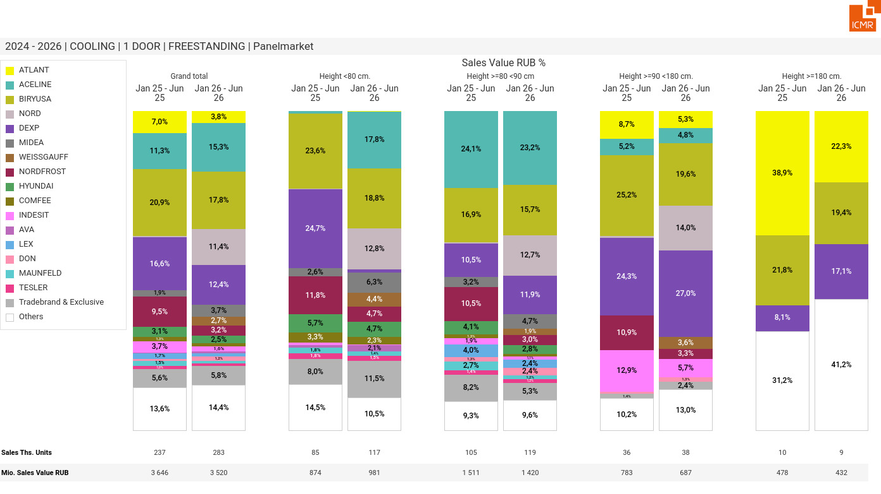
07/2026 PRJ 26fc7bc0 - TMPL d8cc54af - FRM 1ea7a558 - ID 1

Slide 51
07/2026 PRJ 26fc7bc0 - TMPL d8cc54af - FRM 876ec4d3 - ID 51

Slide 52

07/2026 PRJ 26fc7bc0 - TMPL d8cc54af - FRM aa7b1f7b - ID 52

Slide 53

07/2026 PRJ 26fc7bc0 - TMPL d8cc54af - FRM 0a65ed88 - ID 53

Slide 54

07/2026 PRJ 26fc7bc0 - TMPL d8cc54af - FRM 3a7e9b69 - ID 54

Slide 55

07/2026 PRJ 26fc7bc0 - TMPL d8cc54af - FRM dde7697a - ID 55

Slide 56

07/2026 PRJ 26fc7bc0 - TMPL d8cc54af - FRM 8522a041 - ID 56

Slide 57

07/2026 PRJ 26fc7bc0 - TMPL d8cc54af - FRM a2834e24 - ID 57

Slide 58

07/2026 PRJ 26fc7bc0 - TMPL d8cc54af - FRM 65ba9013 - ID 58

Slide 59

07/2026 PRJ 26fc7bc0 - TMPL d8cc54af - FRM 0aa6ca0a - ID 59

Slide 60

07/2026 PRJ 26fc7bc0 - TMPL d8cc54af - FRM 57d5b40b - ID 60

Slide 61

07/2026 PRJ 26fc7bc0 - TMPL d8cc54af - FRM 9cec0dcd - ID 61

Slide 62

07/2026 PRJ 26fc7bc0 - TMPL d8cc54af - FRM 49dd7f2d - ID 62

Slide 63

07/2026 PRJ 26fc7bc0 - TMPL d8cc54af - FRM 5faf8e32 - ID 63

Slide 64

07/2026 PRJ 26fc7bc0 - TMPL d8cc54af - FRM eb85738c - ID 64

Slide 65

07/2026 PRJ 26fc7bc0 - TMPL d8cc54af - FRM 018bd31c - ID 65

Slide 66

07/2026 PRJ 26fc7bc0 - TMPL d8cc54af - FRM 99377b80 - ID 66

Slide 67

07/2026 PRJ 26fc7bc0 - TMPL d8cc54af - FRM c688f6ea - ID 67

Slide 68

07/2026 PRJ 26fc7bc0 - TMPL d8cc54af - FRM 6d9a007a - ID 68

Slide 69

07/2026 PRJ 26fc7bc0 - TMPL d8cc54af - FRM 40a75ac8 - ID 69

Slide 70

07/2026 PRJ 26fc7bc0 - TMPL d8cc54af - FRM ba5efa2f - ID 70

Slide 71

07/2026 PRJ 26fc7bc0 - TMPL d8cc54af - FRM 8c5c7d46 - ID 71

Slide 72

07/2026 PRJ 26fc7bc0 - TMPL d8cc54af - FRM 66692893 - ID 72

Slide 73

07/2026 PRJ 26fc7bc0 - TMPL d8cc54af - FRM 57e85099 - ID 73

Slide 74

07/2026 PRJ 26fc7bc0 - TMPL d8cc54af - FRM 63ec3698 - ID 74

Slide 75

07/2026 PRJ 26fc7bc0 - TMPL d8cc54af - FRM 8c986b83 - ID 75

Slide 76

07/2026 PRJ 26fc7bc0 - TMPL d8cc54af - FRM 8f9af1f9 - ID 76

Slide 77

07/2026 PRJ 26fc7bc0 - TMPL d8cc54af - FRM 50e12af6 - ID 77

Slide 78

07/2026 PRJ 26fc7bc0 - TMPL d8cc54af - FRM 96df554d - ID 78

Slide 79

07/2026 PRJ 26fc7bc0 - TMPL d8cc54af - FRM 42703a72 - ID 79

Slide 80

07/2026 PRJ 26fc7bc0 - TMPL d8cc54af - FRM 1cca985f - ID 80

Slide 81

07/2026 PRJ 26fc7bc0 - TMPL d8cc54af - FRM a74a47dc - ID 81

Slide 82

07/2026 PRJ 26fc7bc0 - TMPL d8cc54af - FRM 7ba39250 - ID 82

Slide 83

07/2026 PRJ 26fc7bc0 - TMPL d8cc54af - FRM f7612cb6 - ID 83

Slide 84

07/2026 PRJ 26fc7bc0 - TMPL d8cc54af - FRM c102f2c0 - ID 84

Slide 85

07/2026 PRJ 26fc7bc0 - TMPL d8cc54af - FRM 5af3b365 - ID 85

Slide 86

07/2026 PRJ 26fc7bc0 - TMPL d8cc54af - FRM 807290a1 - ID 86

Slide 87

07/2026 PRJ 26fc7bc0 - TMPL d8cc54af - FRM d707f916 - ID 87

Slide 88

07/2026 PRJ 26fc7bc0 - TMPL d8cc54af - FRM 57194730 - ID 88

Slide 89

07/2026 PRJ 26fc7bc0 - TMPL d8cc54af - FRM 6567fdb7 - ID 89

Slide 90

07/2026 PRJ 26fc7bc0 - TMPL d8cc54af - FRM c109cf7f - ID 90

Slide 91

07/2026 PRJ 26fc7bc0 - TMPL d8cc54af - FRM 74d223e4 - ID 91

Slide 92

07/2026 PRJ 26fc7bc0 - TMPL d8cc54af - FRM 35fc2973 - ID 92

Slide 93

07/2026 PRJ 26fc7bc0 - TMPL d8cc54af - FRM aeabb1d0 - ID 93

Slide 94

07/2026 PRJ 26fc7bc0 - TMPL d8cc54af - FRM 090776df - ID 94

Slide 95

07/2026 PRJ 26fc7bc0 - TMPL d8cc54af - FRM be733353 - ID 95

Slide 96

07/2026 PRJ 26fc7bc0 - TMPL d8cc54af - FRM 1e8e2c19 - ID 96

Slide 97

07/2026 PRJ 26fc7bc0 - TMPL d8cc54af - FRM e0c8012f - ID 97

Slide 98

07/2026 PRJ 26fc7bc0 - TMPL d8cc54af - FRM e9c3a0c2 - ID 98

Slide 99

07/2026 PRJ 26fc7bc0 - TMPL d8cc54af - FRM 1cc5f7ee - ID 99

Slide 100

07/2026 PRJ 26fc7bc0 - TMPL d8cc54af - FRM 908ae622 - ID 100

Slide 101

07/2026 PRJ 26fc7bc0 - TMPL d8cc54af - FRM b88bde16 - ID 101

Slide 102

07/2026 PRJ 26fc7bc0 - TMPL d8cc54af - FRM 8e48bc6f - ID 102

Slide 103

07/2026 PRJ 26fc7bc0 - TMPL d8cc54af - FRM 2d6e5e1e - ID 103

Slide 104

07/2026 PRJ 26fc7bc0 - TMPL d8cc54af - FRM 5df51199 - ID 104

Slide 105

07/2026 PRJ 26fc7bc0 - TMPL d8cc54af - FRM 3c9ade14 - ID 105

Slide 106

07/2026 PRJ 26fc7bc0 - TMPL d8cc54af - FRM b234aac6 - ID 106

Slide 107

07/2026 PRJ 26fc7bc0 - TMPL d8cc54af - FRM 038df89f - ID 107

Slide 108

07/2026 PRJ 26fc7bc0 - TMPL d8cc54af - FRM eed5505e - ID 108

Slide 109

07/2026 PRJ 26fc7bc0 - TMPL d8cc54af - FRM bb276f3f - ID 109

Slide 110

07/2026 PRJ 26fc7bc0 - TMPL d8cc54af - FRM 3612d728 - ID 110

Slide 111

07/2026 PRJ 26fc7bc0 - TMPL d8cc54af - FRM 487fb2ce - ID 111

Slide 112

07/2026 PRJ 26fc7bc0 - TMPL d8cc54af - FRM 036ad46a - ID 112

Slide 113

07/2026 PRJ 26fc7bc0 - TMPL d8cc54af - FRM 152ecd93 - ID 113

Slide 114

07/2026 PRJ 26fc7bc0 - TMPL d8cc54af - FRM 0b34372f - ID 114

Slide 115

07/2026 PRJ 26fc7bc0 - TMPL d8cc54af - FRM e8c83bad - ID 115

Slide 116

07/2026 PRJ 26fc7bc0 - TMPL d8cc54af - FRM cd6c80fa - ID 116

Slide 117

07/2026 PRJ 26fc7bc0 - TMPL d8cc54af - FRM d43b1ad3 - ID 117

Slide 118

07/2026 PRJ 26fc7bc0 - TMPL d8cc54af - FRM a9472ebd - ID 118

Slide 119

07/2026 PRJ 26fc7bc0 - TMPL d8cc54af - FRM 872d412c - ID 119

Slide 120

07/2026 PRJ 26fc7bc0 - TMPL d8cc54af - FRM d01b3607 - ID 120

Slide 121

07/2026 PRJ 26fc7bc0 - TMPL d8cc54af - FRM b2d2224c - ID 121

Slide 122

07/2026 PRJ 26fc7bc0 - TMPL d8cc54af - FRM 839c4d8e - ID 122

Slide 123

07/2026 PRJ 26fc7bc0 - TMPL d8cc54af - FRM 21a7c852 - ID 123

Slide 124

07/2026 PRJ 26fc7bc0 - TMPL d8cc54af - FRM 9e42a7e8 - ID 124

Slide 125

07/2026 PRJ 26fc7bc0 - TMPL d8cc54af - FRM bd34b5aa - ID 125

Slide 126

07/2026 PRJ 26fc7bc0 - TMPL d8cc54af - FRM ad7b75ff - ID 126

Slide 127

07/2026 PRJ 26fc7bc0 - TMPL d8cc54af - FRM 5723fd1c - ID 127

Slide 128

07/2026 PRJ 26fc7bc0 - TMPL d8cc54af - FRM aa0ced4e - ID 128

Slide 129

07/2026 PRJ 26fc7bc0 - TMPL d8cc54af - FRM dbfc54d5 - ID 129

Slide 130

07/2026 PRJ 26fc7bc0 - TMPL d8cc54af - FRM f9fb1db5 - ID 130

Slide 131

07/2026 PRJ 26fc7bc0 - TMPL d8cc54af - FRM 49958292 - ID 131

Slide 132

07/2026 PRJ 26fc7bc0 - TMPL d8cc54af - FRM 40787a82 - ID 132

Slide 133

07/2026 PRJ 26fc7bc0 - TMPL d8cc54af - FRM 66708e49 - ID 133

Slide 134

07/2026 PRJ 26fc7bc0 - TMPL d8cc54af - FRM 74e6f1f5 - ID 134

Slide 135

07/2026 PRJ 26fc7bc0 - TMPL d8cc54af - FRM 9fe04729 - ID 135

Slide 136

07/2026 PRJ 26fc7bc0 - TMPL d8cc54af - FRM 67313fbd - ID 136

Slide 137

07/2026 PRJ 26fc7bc0 - TMPL d8cc54af - FRM e825bd97 - ID 137

Slide 138

07/2026 PRJ 26fc7bc0 - TMPL d8cc54af - FRM a9cc3775 - ID 138

Slide 139

07/2026 PRJ 26fc7bc0 - TMPL d8cc54af - FRM e9f0f92b - ID 139

Slide 140

07/2026 PRJ 26fc7bc0 - TMPL d8cc54af - FRM d118190b - ID 140

Slide 141

07/2026 PRJ 26fc7bc0 - TMPL d8cc54af - FRM feee4ab8 - ID 141

Slide 142

07/2026 PRJ 26fc7bc0 - TMPL d8cc54af - FRM 74b6e8c7 - ID 142

Slide 143

07/2026 PRJ 26fc7bc0 - TMPL d8cc54af - FRM beade24a - ID 143

Slide 144

07/2026 PRJ 26fc7bc0 - TMPL d8cc54af - FRM 83598455 - ID 144

Slide 145

07/2026 PRJ 26fc7bc0 - TMPL d8cc54af - FRM 0eb47e00 - ID 145

Slide 146

07/2026 PRJ 26fc7bc0 - TMPL d8cc54af - FRM 3a02dff5 - ID 146

Slide 147

07/2026 PRJ 26fc7bc0 - TMPL d8cc54af - FRM 77613cf9 - ID 147

Slide 148

07/2026 PRJ 26fc7bc0 - TMPL d8cc54af - FRM f12aca82 - ID 148

Slide 149

07/2026 PRJ 26fc7bc0 - TMPL d8cc54af - FRM cfbc8e6c - ID 149

Slide 150

07/2026 PRJ 26fc7bc0 - TMPL d8cc54af - FRM 536ea4e3 - ID 150

Slide 151

07/2026 PRJ 26fc7bc0 - TMPL d8cc54af - FRM 02414e8f - ID 151

Slide 152

07/2026 PRJ 26fc7bc0 - TMPL d8cc54af - FRM 4d04ed44 - ID 152

Slide 153

07/2026 PRJ 26fc7bc0 - TMPL d8cc54af - FRM aca61560 - ID 153

Slide 154

07/2026 PRJ 26fc7bc0 - TMPL d8cc54af - FRM 4e9a26cf - ID 154

Slide 155

07/2026 PRJ 26fc7bc0 - TMPL d8cc54af - FRM 4866e470 - ID 155

Slide 156

07/2026 PRJ 26fc7bc0 - TMPL d8cc54af - FRM 335b57e4 - ID 156

Slide 157

07/2026 PRJ 26fc7bc0 - TMPL d8cc54af - FRM c8b4fe59 - ID 157

Slide 158

07/2026 PRJ 26fc7bc0 - TMPL d8cc54af - FRM 140124b5 - ID 158

Slide 159

07/2026 PRJ 26fc7bc0 - TMPL d8cc54af - FRM 3a06a990 - ID 159

Slide 160

07/2026 PRJ 26fc7bc0 - TMPL d8cc54af - FRM 1aa7f96e - ID 160

Slide 161

07/2026 PRJ 26fc7bc0 - TMPL d8cc54af - FRM 2e90c404 - ID 161

Slide 162

07/2026 PRJ 26fc7bc0 - TMPL d8cc54af - FRM de5d9998 - ID 162

Slide 163

07/2026 PRJ 26fc7bc0 - TMPL d8cc54af - FRM 0ba03f88 - ID 163

Slide 164

07/2026 PRJ 26fc7bc0 - TMPL d8cc54af - FRM c61a6316 - ID 164

Slide 165

07/2026 PRJ 26fc7bc0 - TMPL d8cc54af - FRM 0eadfae8 - ID 165

Slide 166

07/2026 PRJ 26fc7bc0 - TMPL d8cc54af - FRM 5948cc20 - ID 166

Slide 167

07/2026 PRJ 26fc7bc0 - TMPL d8cc54af - FRM 962ae053 - ID 167

Slide 168

07/2026 PRJ 26fc7bc0 - TMPL d8cc54af - FRM 6ffde731 - ID 168

Slide 169

07/2026 PRJ 26fc7bc0 - TMPL d8cc54af - FRM 71629b1e - ID 169

Slide 170

07/2026 PRJ 26fc7bc0 - TMPL d8cc54af - FRM 44b36f06 - ID 170

Slide 171

07/2026 PRJ 26fc7bc0 - TMPL d8cc54af - FRM f11cefef - ID 171

Slide 172

07/2026 PRJ 26fc7bc0 - TMPL d8cc54af - FRM 2ee70bd5 - ID 172

Slide 173

07/2026 PRJ 26fc7bc0 - TMPL d8cc54af - FRM b65f2293 - ID 173

Slide 174

07/2026 PRJ 26fc7bc0 - TMPL d8cc54af - FRM 00e49c7b - ID 174

Slide 175

07/2026 PRJ 26fc7bc0 - TMPL d8cc54af - FRM bbc9422a - ID 175

Slide 176

07/2026 PRJ 26fc7bc0 - TMPL d8cc54af - FRM d24bb990 - ID 176

Slide 177

07/2026 PRJ 26fc7bc0 - TMPL d8cc54af - FRM 423de010 - ID 177

Slide 178

07/2026 PRJ 26fc7bc0 - TMPL d8cc54af - FRM 78de69a1 - ID 178

Slide 179

07/2026 PRJ 26fc7bc0 - TMPL d8cc54af - FRM e048a322 - ID 179

Slide 180

07/2026 PRJ 26fc7bc0 - TMPL d8cc54af - FRM 5e171ef5 - ID 180

Slide 181

07/2026 PRJ 26fc7bc0 - TMPL d8cc54af - FRM a0c3fd02 - ID 181

Slide 182

07/2026 PRJ 26fc7bc0 - TMPL d8cc54af - FRM 79890bd5 - ID 182

Slide 183

07/2026 PRJ 26fc7bc0 - TMPL d8cc54af - FRM d2c2130e - ID 183

Slide 184

07/2026 PRJ 26fc7bc0 - TMPL d8cc54af - FRM 2a96b2a8 - ID 184

Slide 185

07/2026 PRJ 26fc7bc0 - TMPL d8cc54af - FRM 4d193e51 - ID 185

Slide 186

07/2026 PRJ 26fc7bc0 - TMPL d8cc54af - FRM 59678b33 - ID 186

Slide 187

07/2026 PRJ 26fc7bc0 - TMPL d8cc54af - FRM e31243d1 - ID 187

Slide 188

07/2026 PRJ 26fc7bc0 - TMPL d8cc54af - FRM 5336964e - ID 188

Slide 189

07/2026 PRJ 26fc7bc0 - TMPL d8cc54af - FRM 5aa058ed - ID 189

Slide 190

07/2026 PRJ 26fc7bc0 - TMPL d8cc54af - FRM 7b2b05c9 - ID 190

Slide 191

07/2026 PRJ 26fc7bc0 - TMPL d8cc54af - FRM 76fd64f4 - ID 191

Slide 192

07/2026 PRJ 26fc7bc0 - TMPL d8cc54af - FRM 9448f402 - ID 192

Slide 193

07/2026 PRJ 26fc7bc0 - TMPL d8cc54af - FRM 288a5306 - ID 193

Slide 194

07/2026 PRJ 26fc7bc0 - TMPL d8cc54af - FRM 14b876f3 - ID 194

Slide 195

07/2026 PRJ 26fc7bc0 - TMPL d8cc54af - FRM 6815bebe - ID 195

Slide 196

07/2026 PRJ 26fc7bc0 - TMPL d8cc54af - FRM 9b8482a7 - ID 196

Slide 197

07/2026 PRJ 26fc7bc0 - TMPL d8cc54af - FRM 5ec06866 - ID 197

Slide 198

07/2026 PRJ 26fc7bc0 - TMPL d8cc54af - FRM ee638337 - ID 198

Slide 199

07/2026 PRJ 26fc7bc0 - TMPL d8cc54af - FRM e6a2abd6 - ID 199

Slide 200

07/2026 PRJ 26fc7bc0 - TMPL d8cc54af - FRM 08baa39b - ID 200

Slide 201

07/2026 PRJ 26fc7bc0 - TMPL d8cc54af - FRM 03e25a06 - ID 201

Slide 202

07/2026 PRJ 26fc7bc0 - TMPL d8cc54af - FRM 744506ac - ID 202

Slide 203

07/2026 PRJ 26fc7bc0 - TMPL d8cc54af - FRM a268e26e - ID 203

Slide 204

07/2026 PRJ 26fc7bc0 - TMPL d8cc54af - FRM be198d43 - ID 204

Slide 205

07/2026 PRJ 26fc7bc0 - TMPL d8cc54af - FRM 1cecbdfd - ID 205

Slide 206

07/2026 PRJ 26fc7bc0 - TMPL d8cc54af - FRM c9bb1a52 - ID 206

Slide 207

07/2026 PRJ 26fc7bc0 - TMPL d8cc54af - FRM 3c651ce7 - ID 207

Slide 208

07/2026 PRJ 26fc7bc0 - TMPL d8cc54af - FRM 1cd99eee - ID 208

Slide 209

07/2026 PRJ 26fc7bc0 - TMPL d8cc54af - FRM 427446e0 - ID 209

Slide 210

07/2026 PRJ 26fc7bc0 - TMPL d8cc54af - FRM d8e92afc - ID 210

Slide 211

07/2026 PRJ 26fc7bc0 - TMPL d8cc54af - FRM cbe22ccb - ID 211

Slide 212

07/2026 PRJ 26fc7bc0 - TMPL d8cc54af - FRM 880666c2 - ID 212

Slide 213

07/2026 PRJ 26fc7bc0 - TMPL d8cc54af - FRM 40ec5c86 - ID 213

Slide 214
07/2026 PRJ 26fc7bc0 - TMPL d8cc54af - FRM 3629a953 - ID 214

Slide 215

07/2026 PRJ 26fc7bc0 - TMPL d8cc54af - FRM 4e7cab6a - ID 215

Slide 216

07/2026 PRJ 26fc7bc0 - TMPL d8cc54af - FRM 2955d7f0 - ID 216

Slide 217

07/2026 PRJ 26fc7bc0 - TMPL d8cc54af - FRM 5c82c41f - ID 217

Slide 218

07/2026 PRJ 26fc7bc0 - TMPL d8cc54af - FRM 38961a7c - ID 218

Slide 219

07/2026 PRJ 26fc7bc0 - TMPL d8cc54af - FRM 85890c34 - ID 219

Slide 220

07/2026 PRJ 26fc7bc0 - TMPL d8cc54af - FRM ffc3202b - ID 220

Slide 221

07/2026 PRJ 26fc7bc0 - TMPL d8cc54af - FRM e0b333ac - ID 221

Slide 222

07/2026 PRJ 26fc7bc0 - TMPL d8cc54af - FRM 20879831 - ID 222

Slide 223

07/2026 PRJ 26fc7bc0 - TMPL d8cc54af - FRM 4c9ec00c - ID 223

Slide 224

07/2026 PRJ 26fc7bc0 - TMPL d8cc54af - FRM 53ea2d66 - ID 224

Slide 225

07/2026 PRJ 26fc7bc0 - TMPL d8cc54af - FRM be5d6e05 - ID 225

Slide 226

07/2026 PRJ 26fc7bc0 - TMPL d8cc54af - FRM 82291afb - ID 226

Slide 227

07/2026 PRJ 26fc7bc0 - TMPL d8cc54af - FRM b830e324 - ID 227

Slide 228

07/2026 PRJ 26fc7bc0 - TMPL d8cc54af - FRM 6e2c6843 - ID 228

Slide 229

07/2026 PRJ 26fc7bc0 - TMPL d8cc54af - FRM b5750704 - ID 229

Slide 230

07/2026 PRJ 26fc7bc0 - TMPL d8cc54af - FRM dbf97d40 - ID 230

Slide 231

07/2026 PRJ 26fc7bc0 - TMPL d8cc54af - FRM c443110a - ID 231

Slide 232

07/2026 PRJ 26fc7bc0 - TMPL d8cc54af - FRM 26a990ea - ID 232

Slide 233

07/2026 PRJ 26fc7bc0 - TMPL d8cc54af - FRM 5aad8162 - ID 233

Slide 234

07/2026 PRJ 26fc7bc0 - TMPL d8cc54af - FRM 348765dc - ID 234

Slide 235

07/2026 PRJ 26fc7bc0 - TMPL d8cc54af - FRM 1b2f946e - ID 235

Slide 236

07/2026 PRJ 26fc7bc0 - TMPL d8cc54af - FRM 8cd0608d - ID 236

Slide 237

07/2026 PRJ 26fc7bc0 - TMPL d8cc54af - FRM 2c9a6147 - ID 237

Slide 238

07/2026 PRJ 26fc7bc0 - TMPL d8cc54af - FRM b11f57b0 - ID 238

Slide 239

07/2026 PRJ 26fc7bc0 - TMPL d8cc54af - FRM 4c47317a - ID 239

Slide 240

07/2026 PRJ 26fc7bc0 - TMPL d8cc54af - FRM 351925af - ID 240

Slide 241

07/2026 PRJ 26fc7bc0 - TMPL d8cc54af - FRM 4256512a - ID 241

Slide 242

07/2026 PRJ 26fc7bc0 - TMPL d8cc54af - FRM 0cc864e4 - ID 242

Slide 243

07/2026 PRJ 26fc7bc0 - TMPL d8cc54af - FRM 5430b941 - ID 243

Slide 244

07/2026 PRJ 26fc7bc0 - TMPL d8cc54af - FRM 40ad74a7 - ID 244

Slide 245

07/2026 PRJ 26fc7bc0 - TMPL d8cc54af - FRM faa1688c - ID 245

Slide 246

07/2026 PRJ 26fc7bc0 - TMPL d8cc54af - FRM c607beda - ID 246

Slide 247

07/2026 PRJ 26fc7bc0 - TMPL d8cc54af - FRM cbc34a55 - ID 247

Slide 248

07/2026 PRJ 26fc7bc0 - TMPL d8cc54af - FRM 6db2d007 - ID 248

Slide 249

07/2026 PRJ 26fc7bc0 - TMPL d8cc54af - FRM 6217532d - ID 249

Slide 250

07/2026 PRJ 26fc7bc0 - TMPL d8cc54af - FRM 6d8219c6 - ID 250

Slide 251

07/2026 PRJ 26fc7bc0 - TMPL d8cc54af - FRM 02b172cf - ID 251

Slide 252

07/2026 PRJ 26fc7bc0 - TMPL d8cc54af - FRM 39cff2f1 - ID 252

Slide 253

07/2026 PRJ 26fc7bc0 - TMPL d8cc54af - FRM 6cdbcf5e - ID 253

Slide 254

07/2026 PRJ 26fc7bc0 - TMPL d8cc54af - FRM 103084e0 - ID 254

Slide 255

07/2026 PRJ 26fc7bc0 - TMPL d8cc54af - FRM f25b58e3 - ID 255

Slide 256

07/2026 PRJ 26fc7bc0 - TMPL d8cc54af - FRM 4fbe5068 - ID 256

