Slide 1
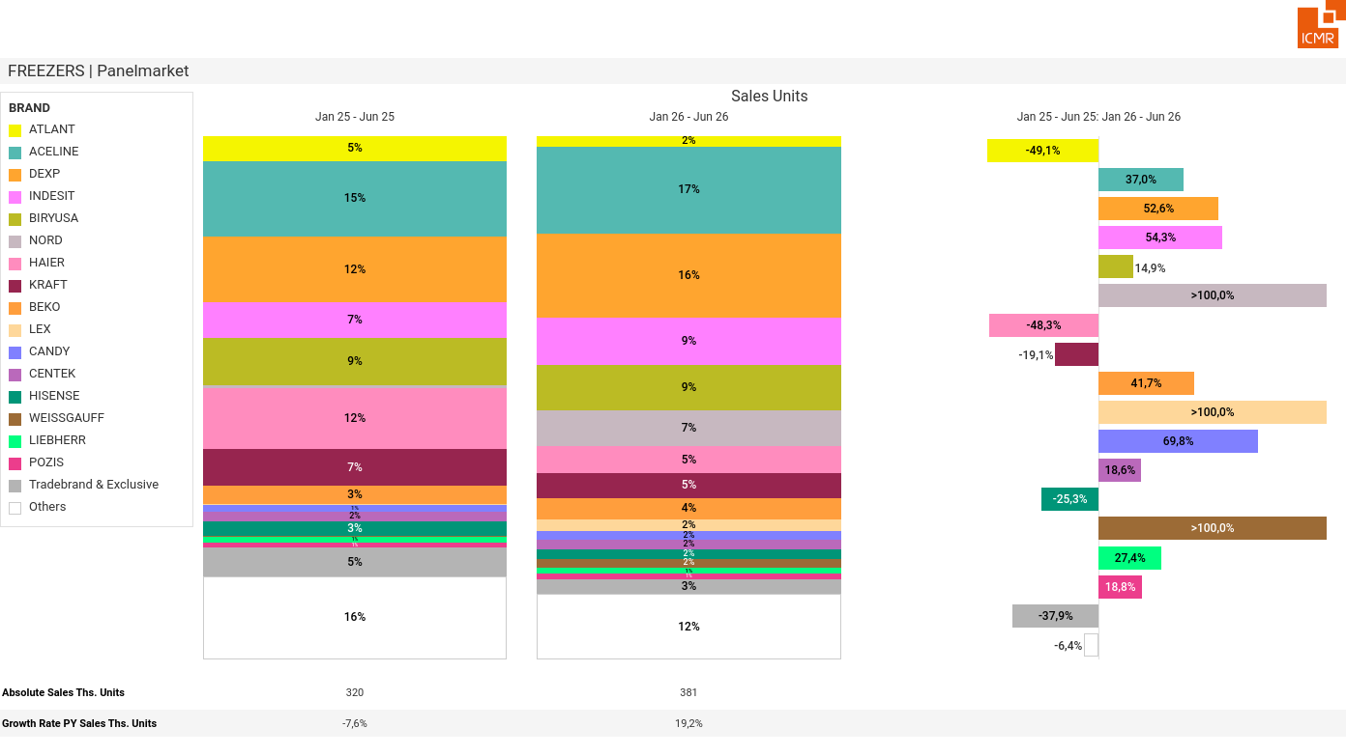
07/2026 PRJ 26fc7bc0 - TMPL 945c9f12 - FRM e17c4010 - ID 1

Slide 2
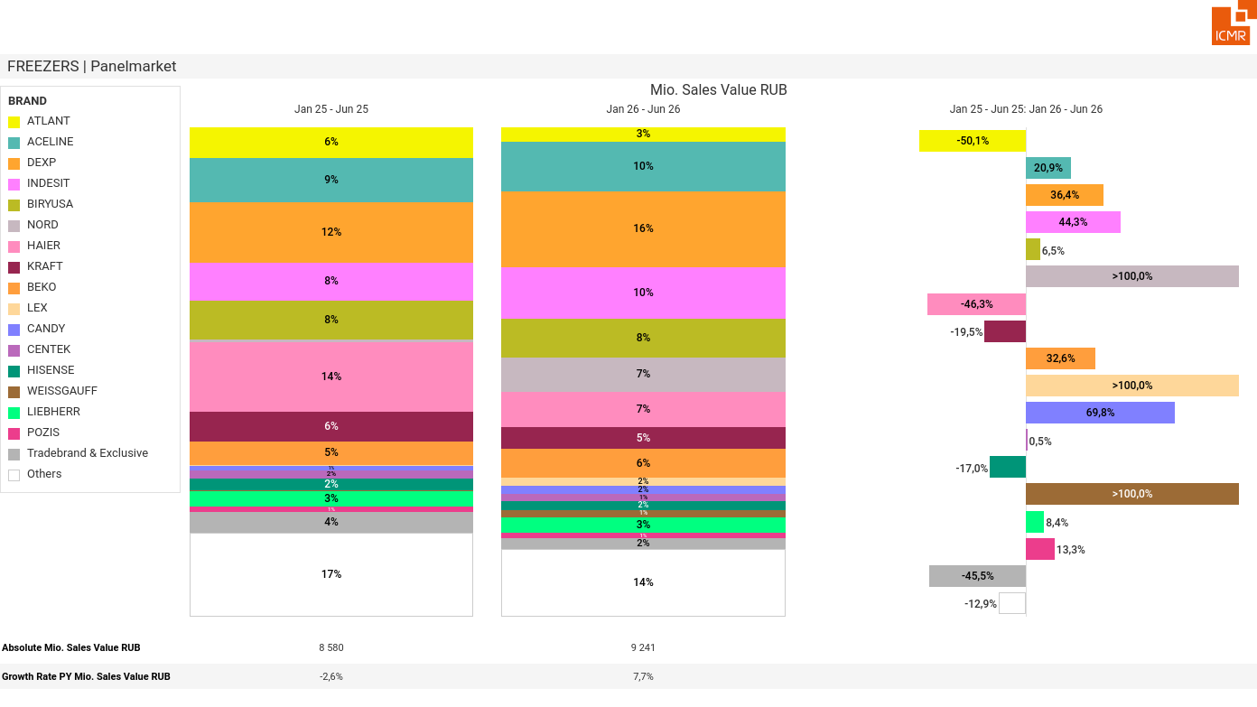
07/2026 PRJ 26fc7bc0 - TMPL 945c9f12 - FRM 913dda64 - ID 2

Slide 3
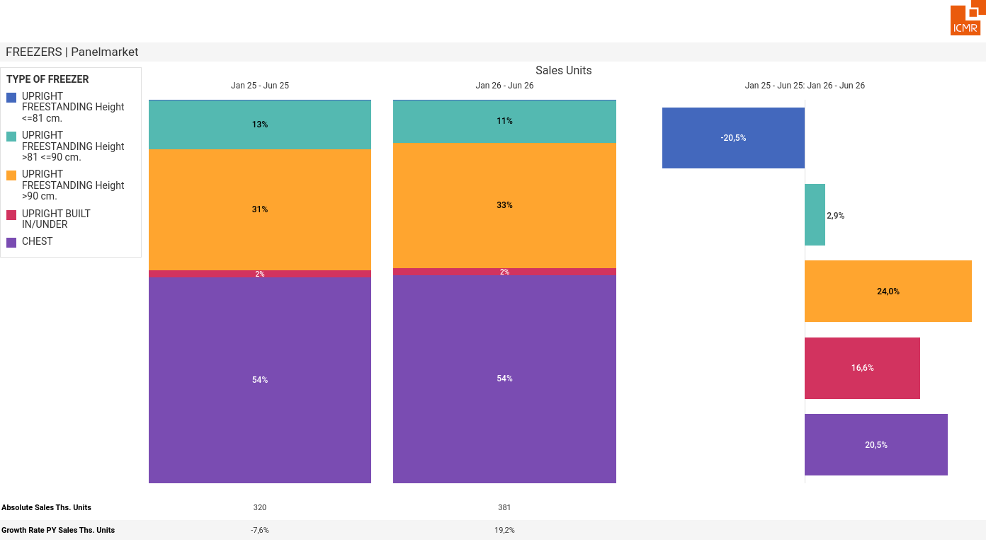
07/2026 PRJ 26fc7bc0 - TMPL 945c9f12 - FRM 401a482d - ID 3

Slide 4
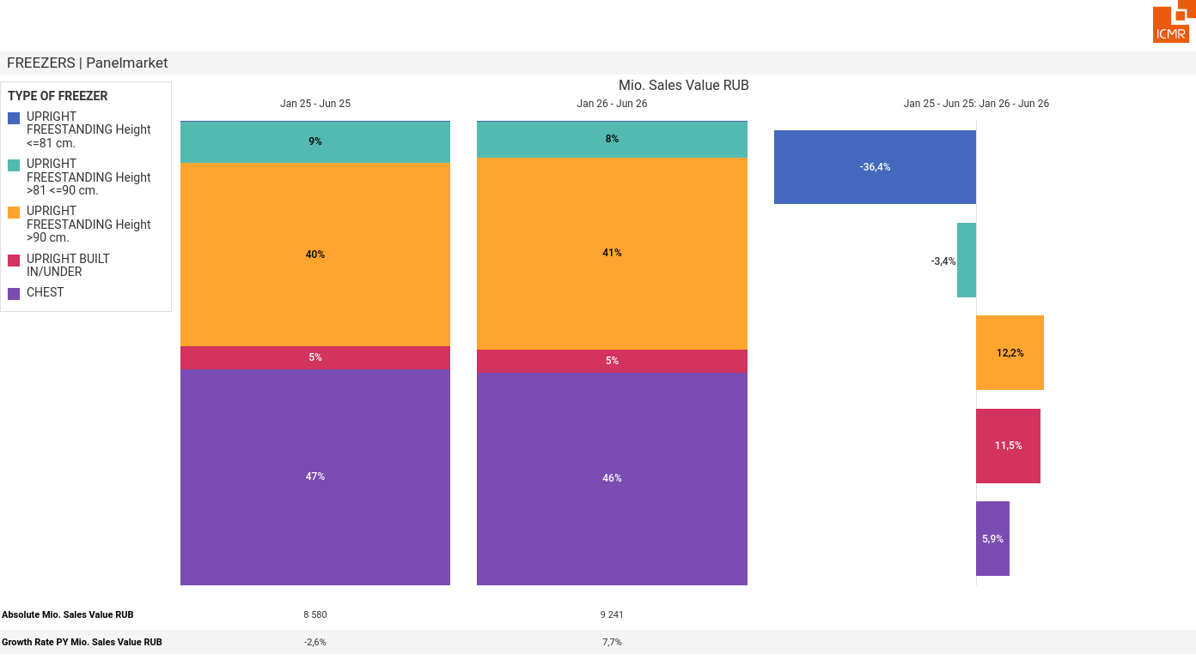
07/2026 PRJ 26fc7bc0 - TMPL 945c9f12 - FRM 61c1e71b - ID 4

Slide 5
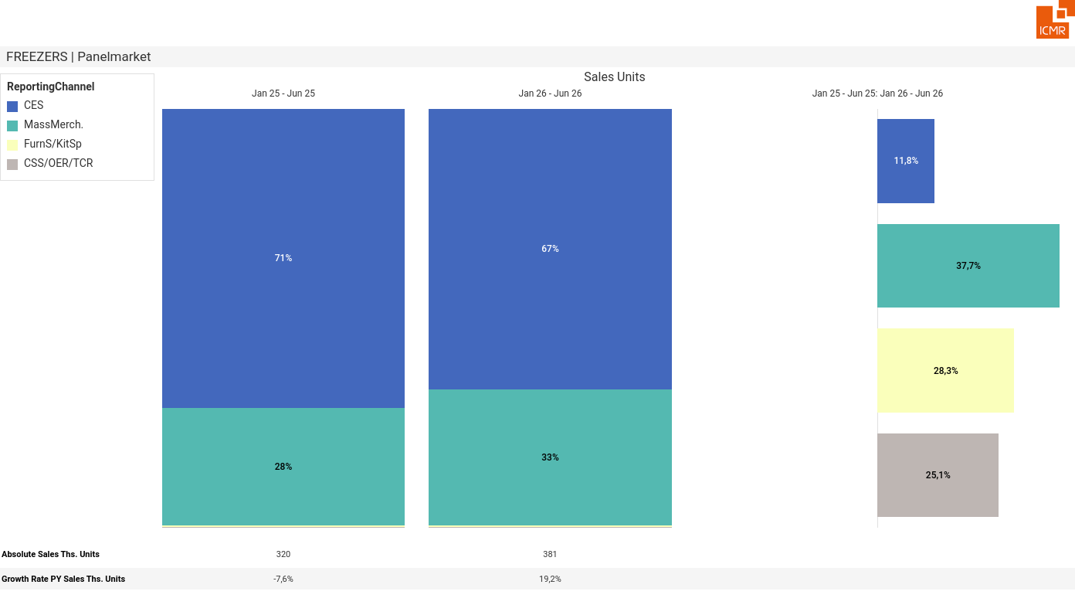
07/2026 PRJ 26fc7bc0 - TMPL 945c9f12 - FRM 99dbfed9 - ID 5

Slide 6
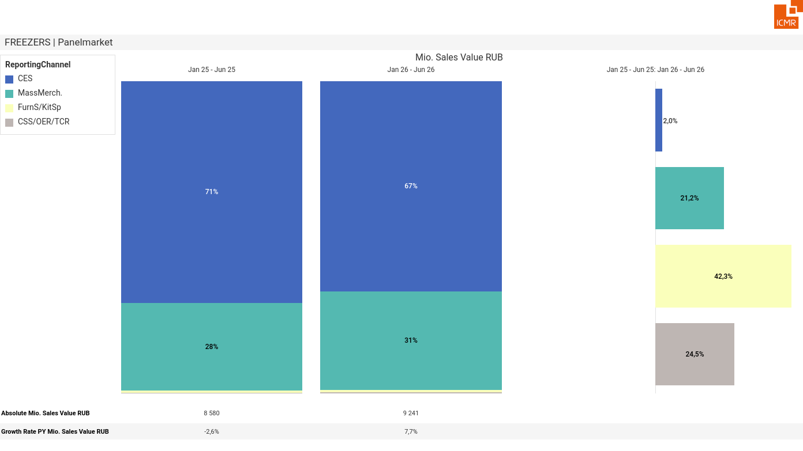
07/2026 PRJ 26fc7bc0 - TMPL 945c9f12 - FRM a0dc915e - ID 6

Slide 7
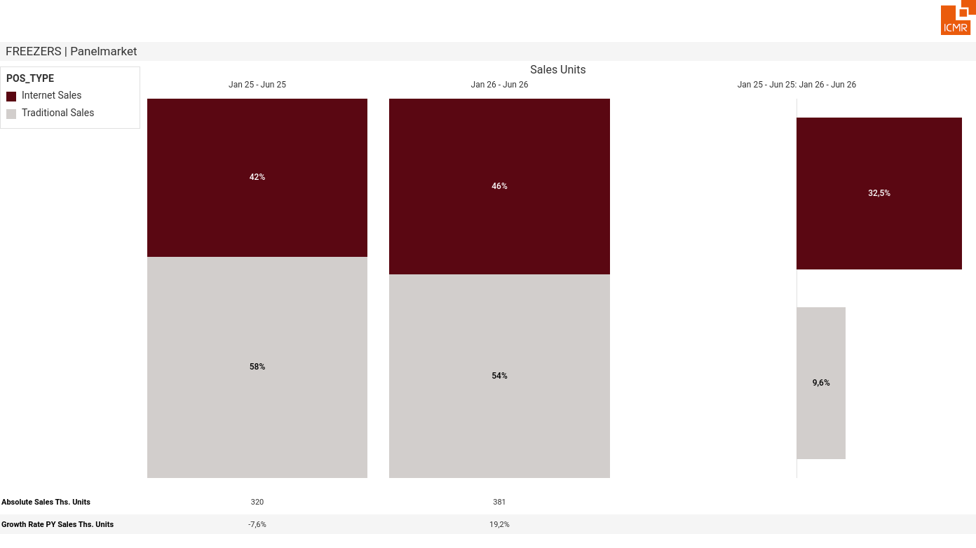
07/2026 PRJ 26fc7bc0 - TMPL 945c9f12 - FRM 68073052 - ID 7

Slide 8
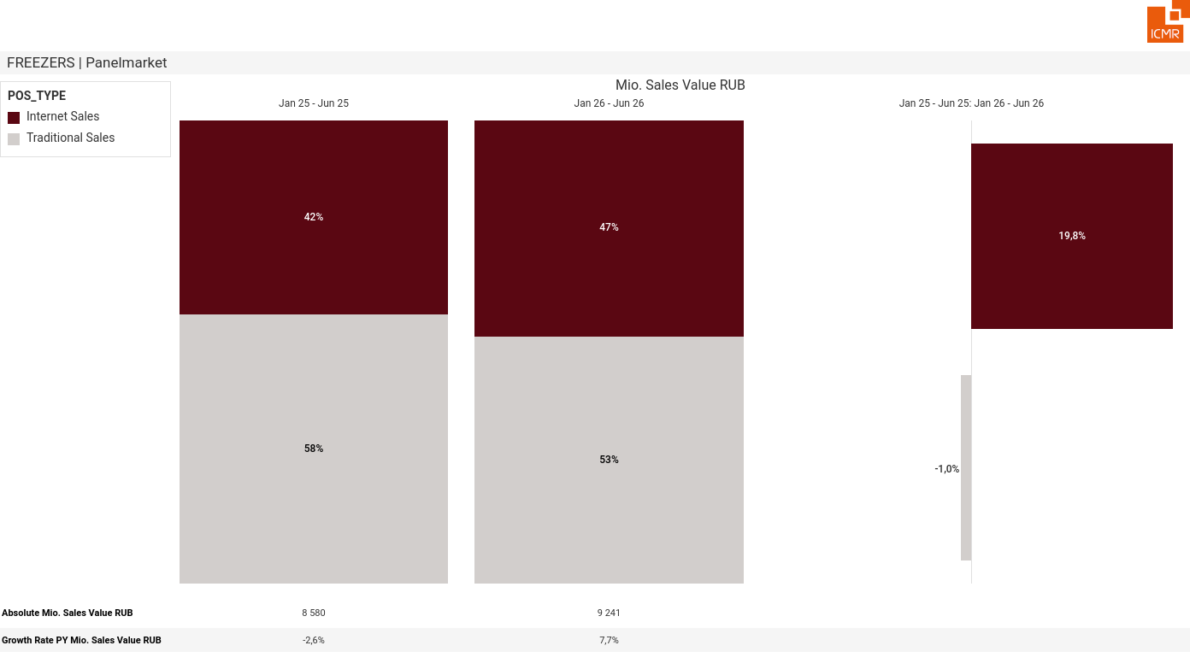
07/2026 PRJ 26fc7bc0 - TMPL 945c9f12 - FRM 5916c4d4 - ID 8

Slide 9
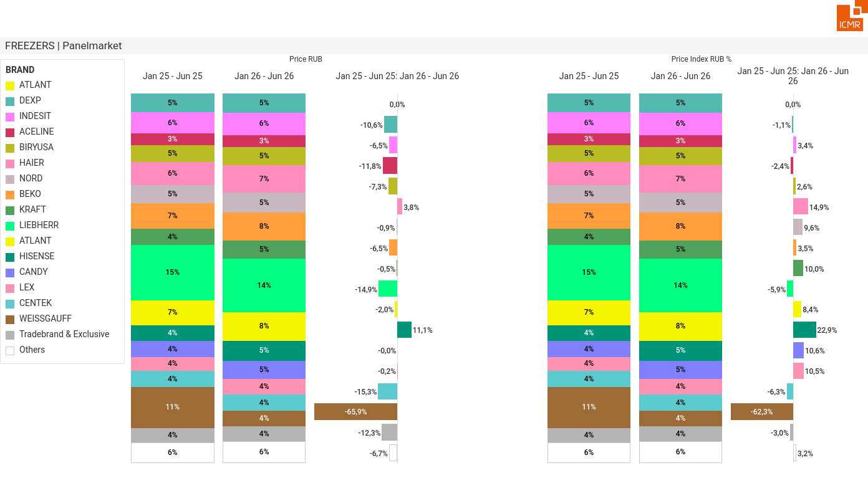
07/2026 PRJ 26fc7bc0 - TMPL 945c9f12 - FRM c55ea2ee - ID 9

