Slide 1
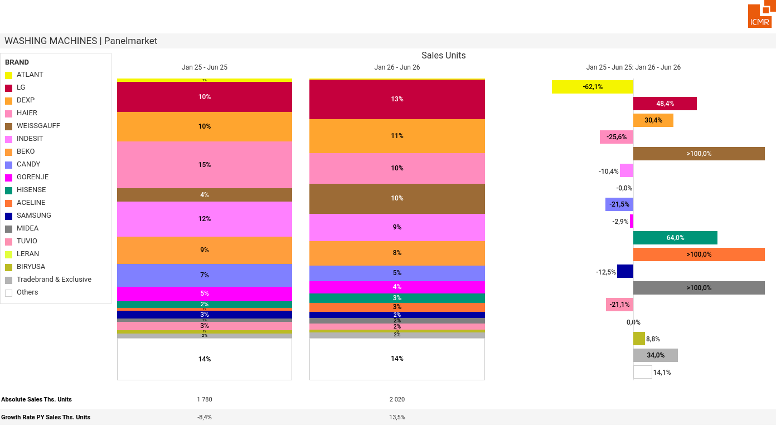
07/2026 PRJ 26fc7bc0 - TMPL 547ff4a5 - FRM e8faafd3 - ID 1

Slide 2
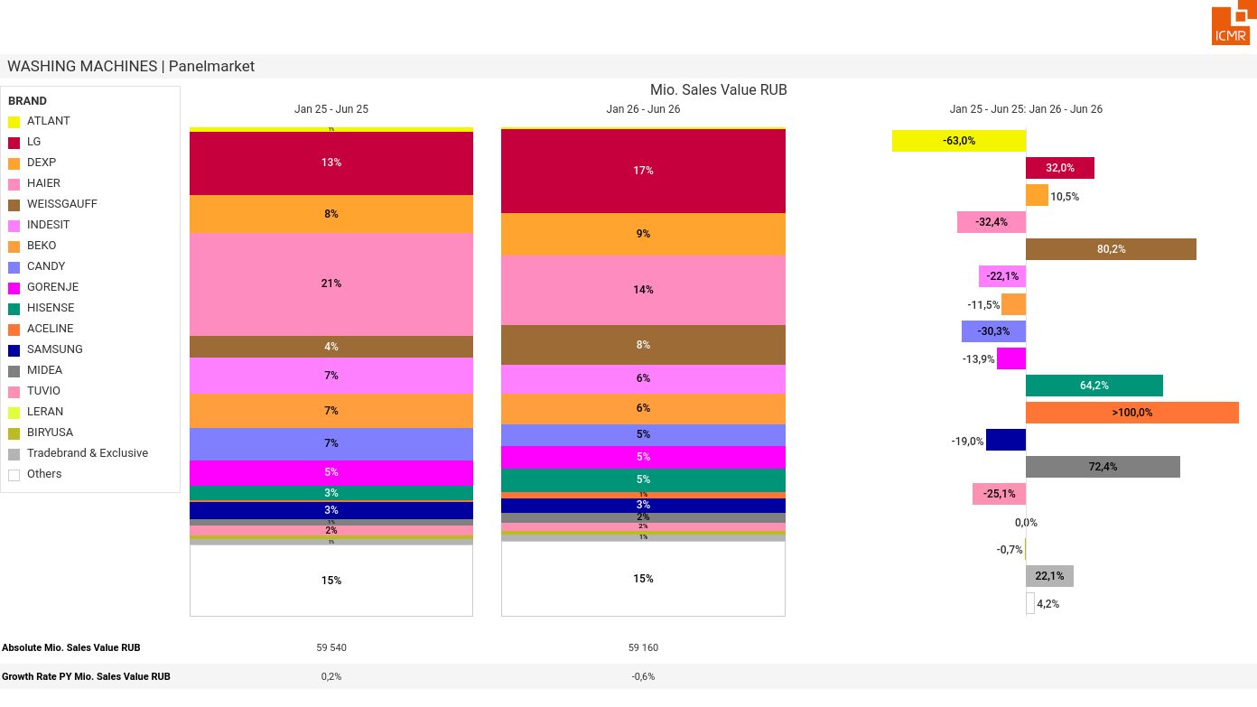
07/2026 PRJ 26fc7bc0 - TMPL 547ff4a5 - FRM e7efe9dc - ID 2

Slide 3
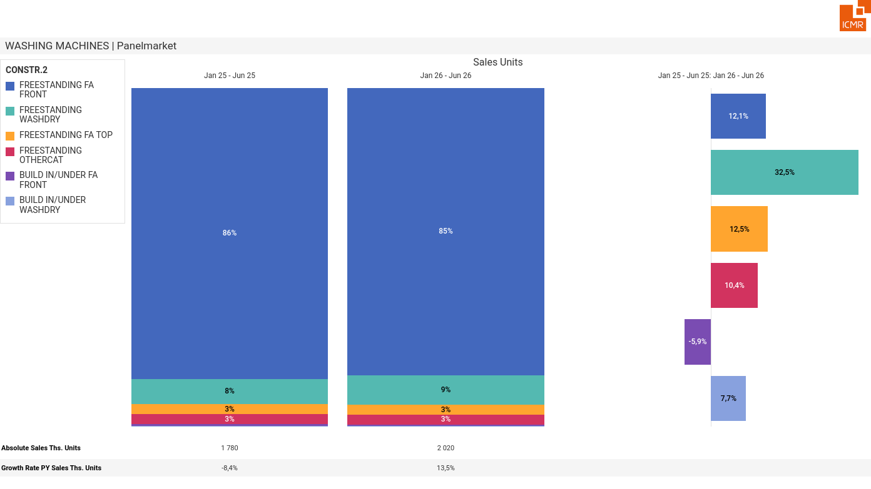
07/2026 PRJ 26fc7bc0 - TMPL 547ff4a5 - FRM 03636211 - ID 3

Slide 4
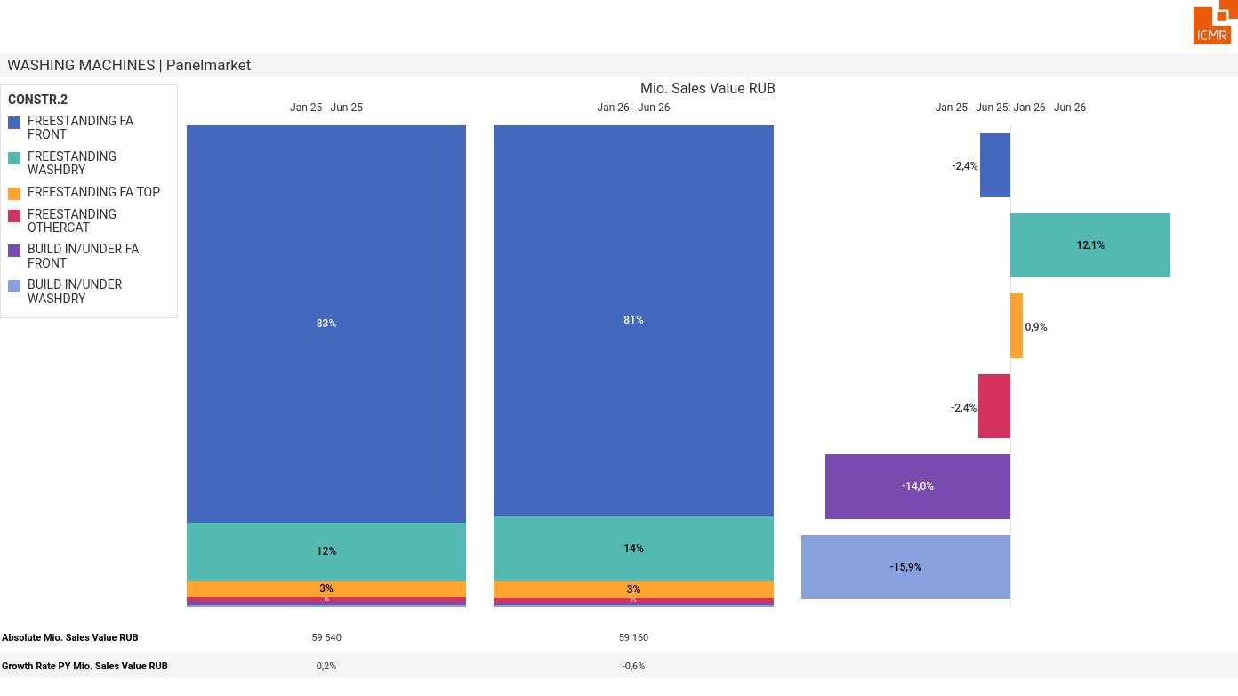
07/2026 PRJ 26fc7bc0 - TMPL 547ff4a5 - FRM 5606569d - ID 4

Slide 5
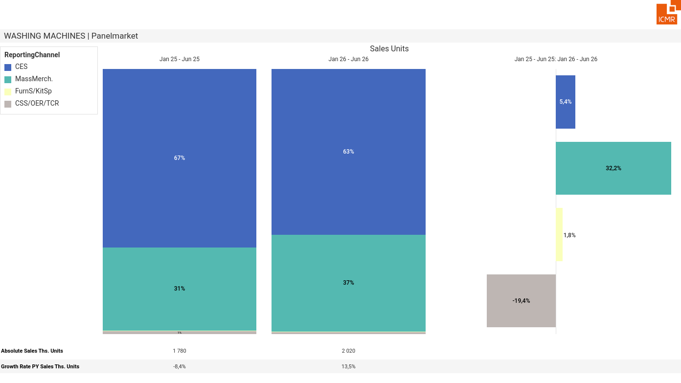
07/2026 PRJ 26fc7bc0 - TMPL 547ff4a5 - FRM 3b35a06c - ID 5

Slide 6
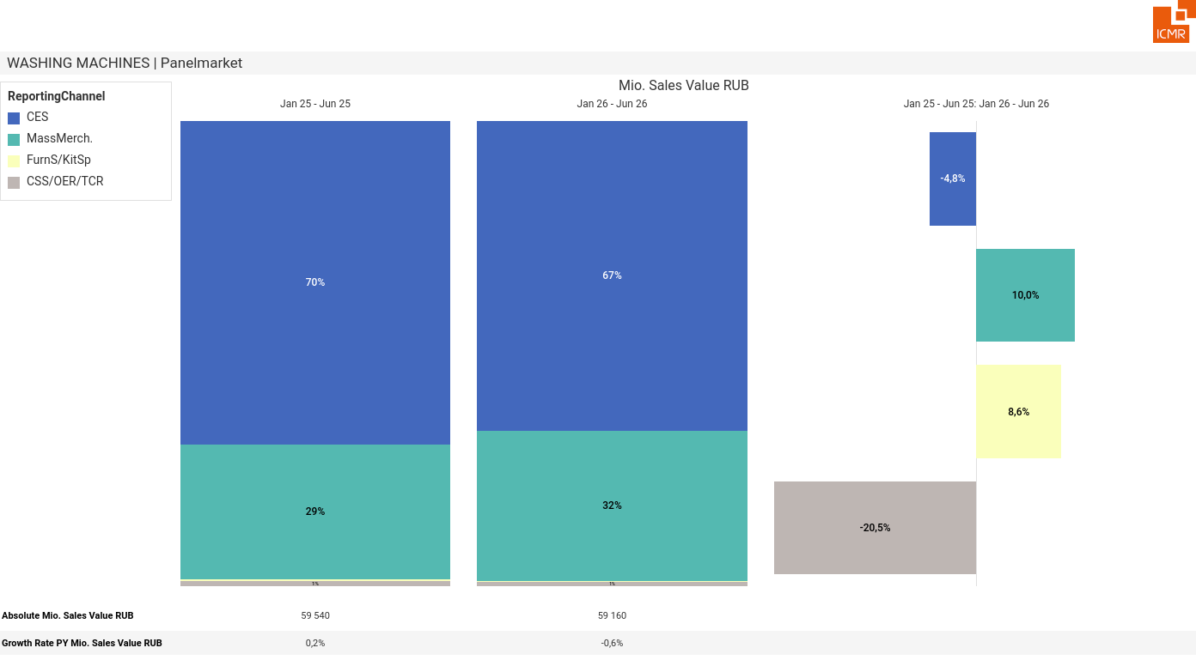
07/2026 PRJ 26fc7bc0 - TMPL 547ff4a5 - FRM abc1065c - ID 6

Slide 7
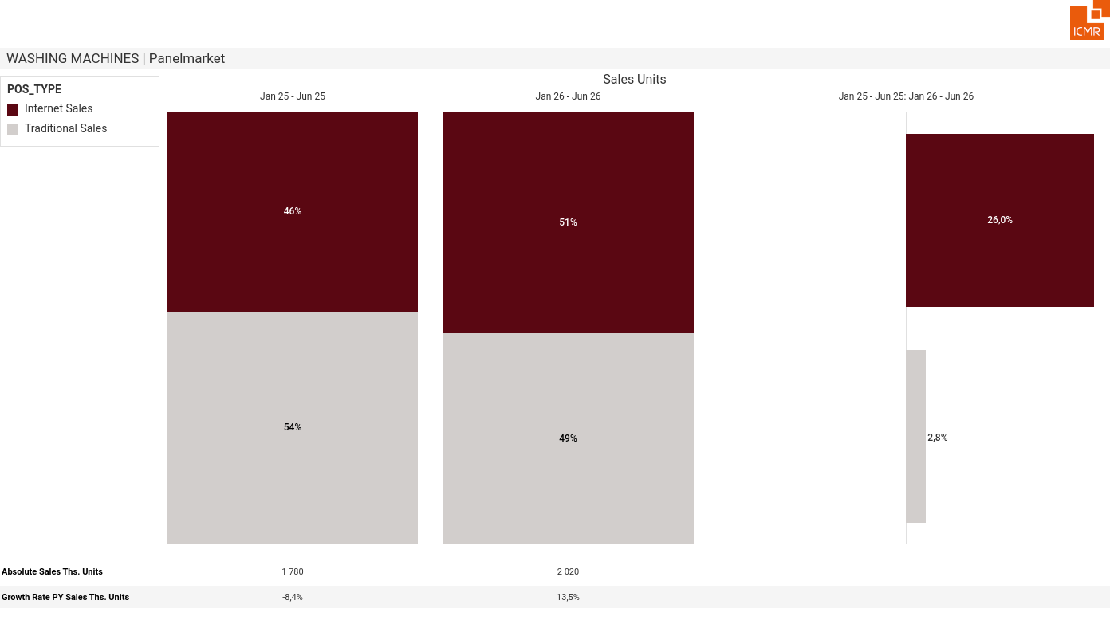
07/2026 PRJ 26fc7bc0 - TMPL 547ff4a5 - FRM 09200461 - ID 7

Slide 8
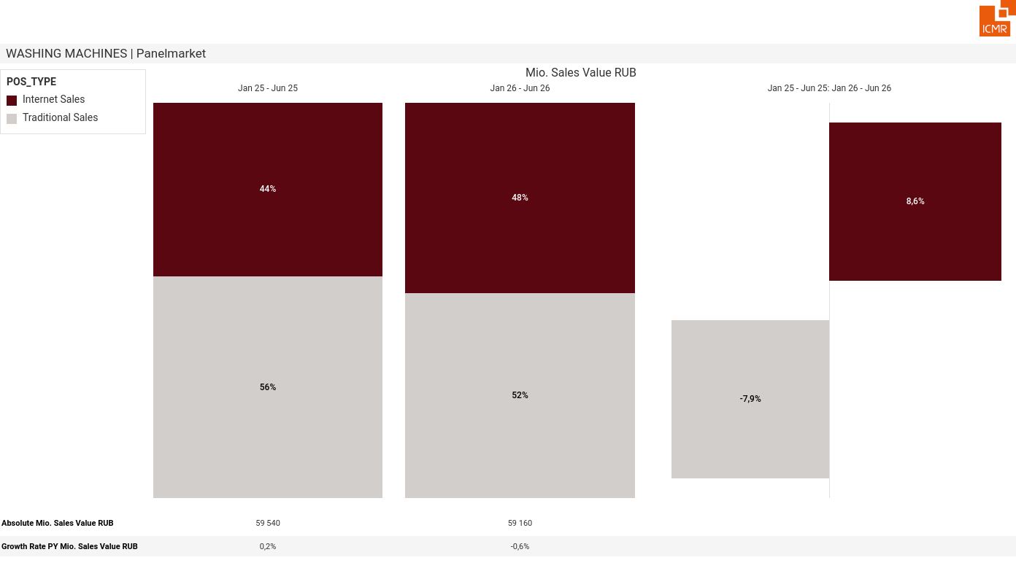
07/2026 PRJ 26fc7bc0 - TMPL 547ff4a5 - FRM ee574030 - ID 8

Slide 9
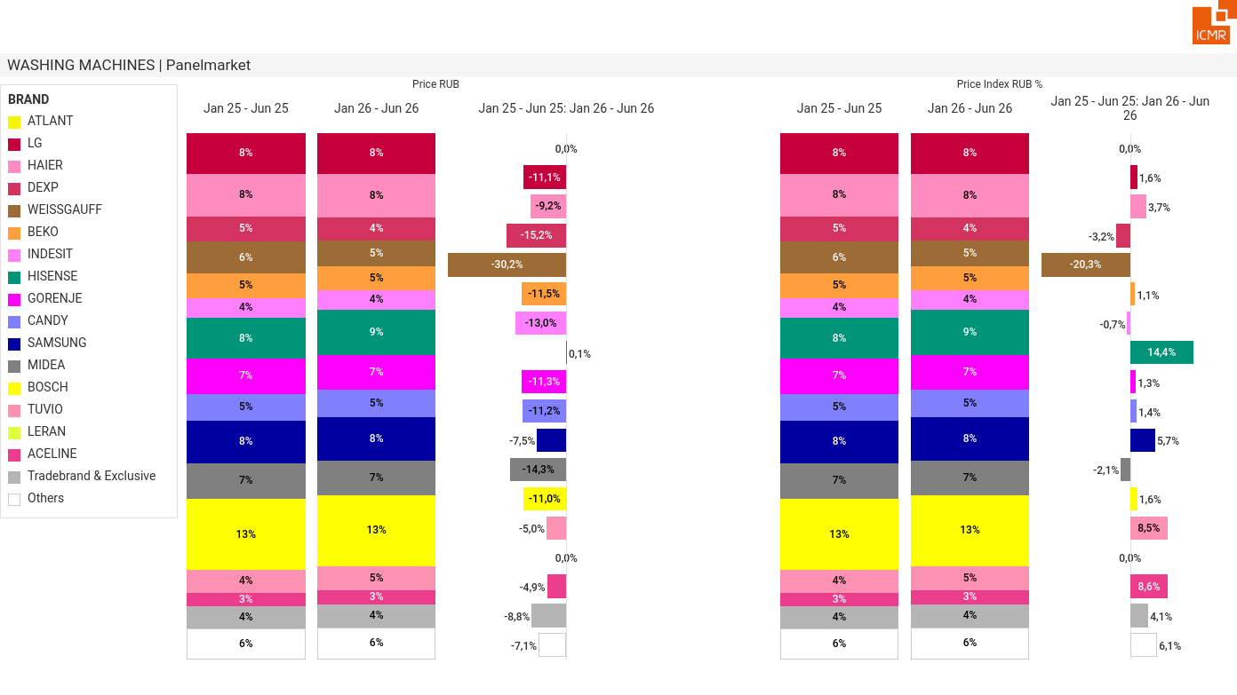
07/2026 PRJ 26fc7bc0 - TMPL 547ff4a5 - FRM aa3089cb - ID 9

